Slide 1
A Multi-Scale Investigation of the Historic Long Island Flash Flood on 13 August 2014
Philippe P. Papin, Benjamin J. Moore, Nick P. Bassill, Josh J. Alland, Michael S. Fischer, Casey M. Peirano, Stephanie N. Stevenson, and Lance F. Bosart
27th Conference on Weather Analysis and Forecasting
23rd Conference on Numerical Weather Prediction
30th June 2015
Department of Atmospheric and Environmental Sciences, University at Albany, State University of New York

Slide 2
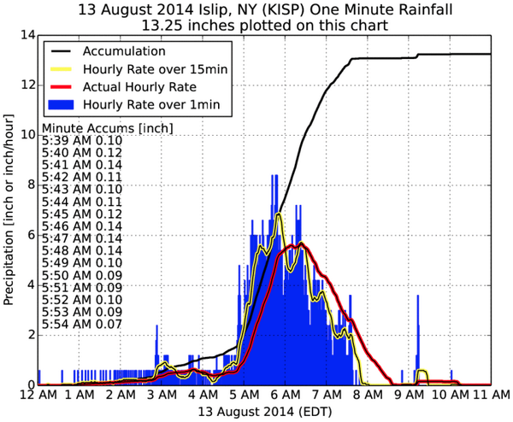
Motivation: Event Recap
24 hour NY precipitation record set at Islip, NY: 345 mm (13.57”)
250 mm (~10”) in 2 h
Convective band of high reflectivity
Training over Islip
Part of larger synoptic scale trough
Accumulation Total (in)
1 min running mean rain rate (in/h)
15 min running mean rain rate (in/h)
1 h running mean rain rate (in/h)
Courtesy of Daryl Herzmann from Iowa State University

Slide 3
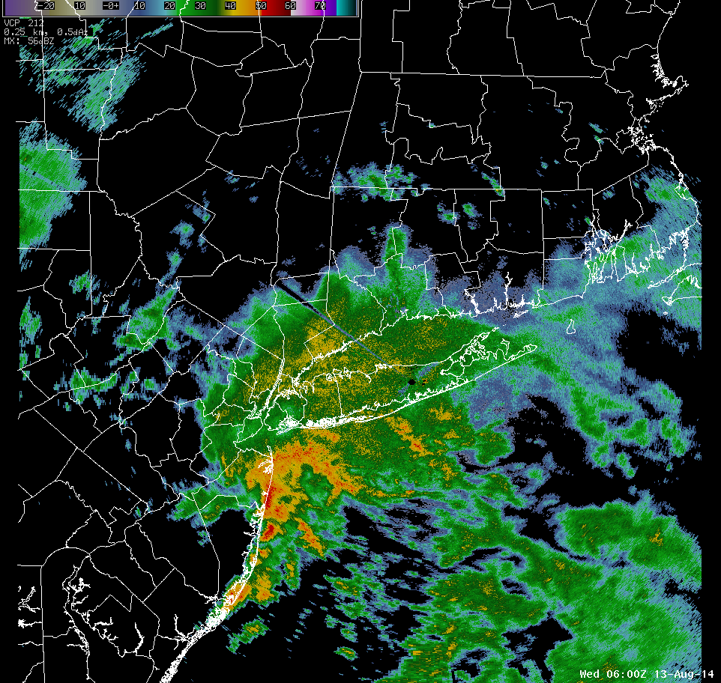
Motivation: Event Recap
24 hour NY precipitation record set at Islip, NY: 345 mm (13.57”)
250 mm (~10”) in 2 h
Convective band of high reflectivity
Training over Islip
Part of larger synoptic scale trough
KISP
Courtesy of Mt. Holly NWS

Slide 4
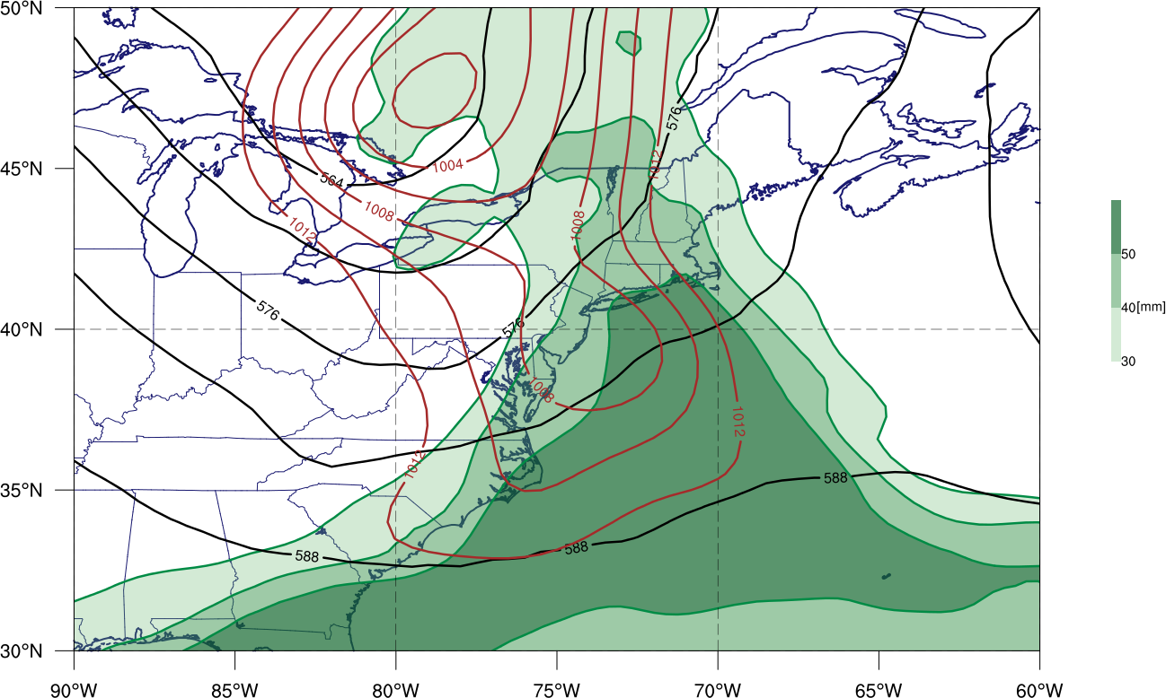
Motivation: Event Recap
24 hour NY precipitation record set at Islip, NY: 345 mm (13.57”)
250 mm (~10”) in 2 h
Convective band of high reflectivity
Training over Islip
Part of larger synoptic scale trough
1200 UTC 13 Aug 2014 Precipitable water (shading, mm), 500-hPa geopotential height (black contours, dam), mean sea level pressure (brown contours, hPa)
L
500-hPa Trough Axis
KISP
L
GFS Analysis

Slide 5
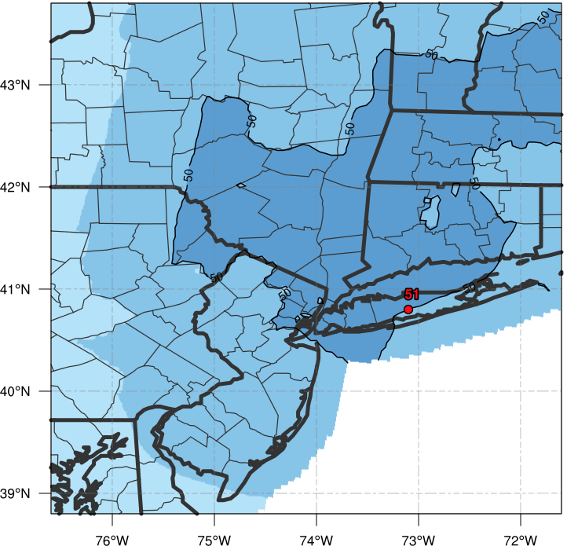
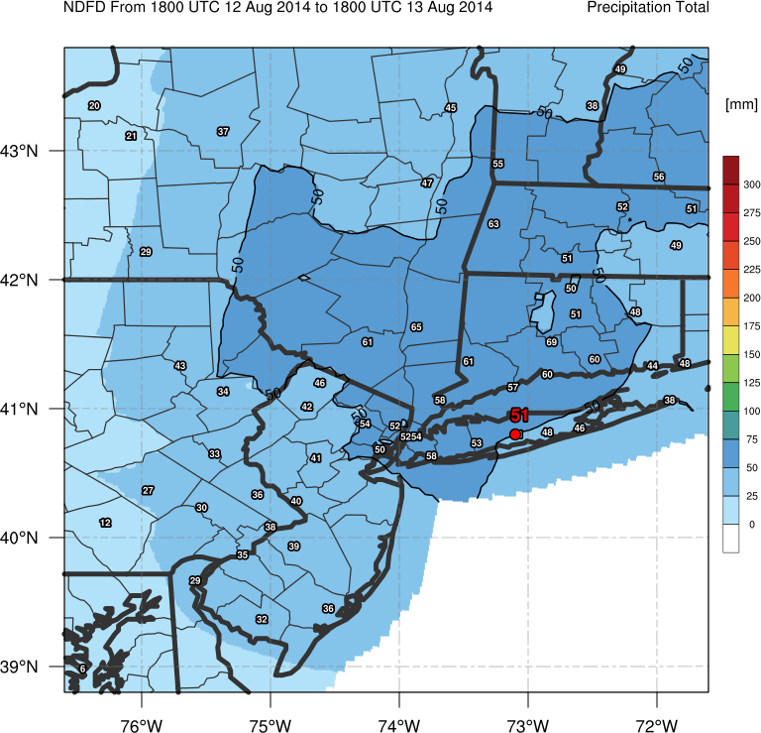
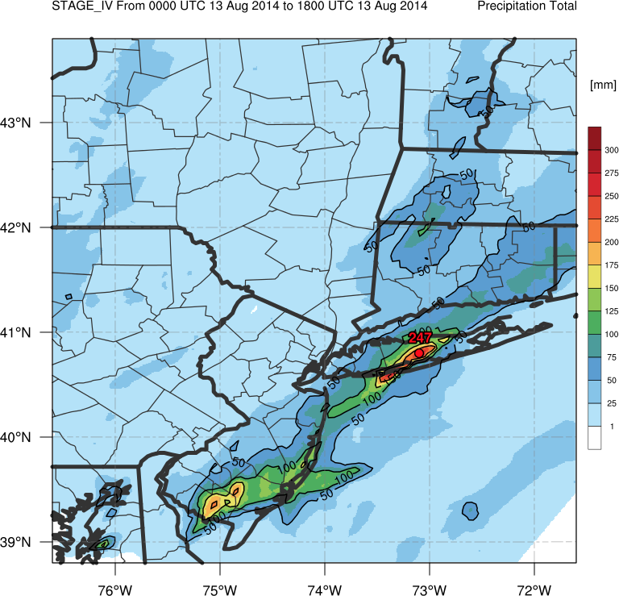
Motivation: Predictability
NDFD Forecast Precipitation Total (0000 UTC – 1800 UTC 13 Aug 2014)
Large region of > 50 mm (2”) of precipitation forecasted across New England
Over forecast of rainfall in Hudson River valley
Under forecast of rainfall in NJ and Long Island
2 – 3”
1 – 2”

Slide 6
Motivation: Predictability
Stage IV Precipitation Total (0000 UTC – 1800 UTC 13 Aug 2014)
Large region of > 50 mm (2”) of precipitation forecasted across New England
Over forecast of rainfall in Hudson River valley
Under forecast of rainfall in NJ and Long Island
< 1”
> 10”

Slide 7
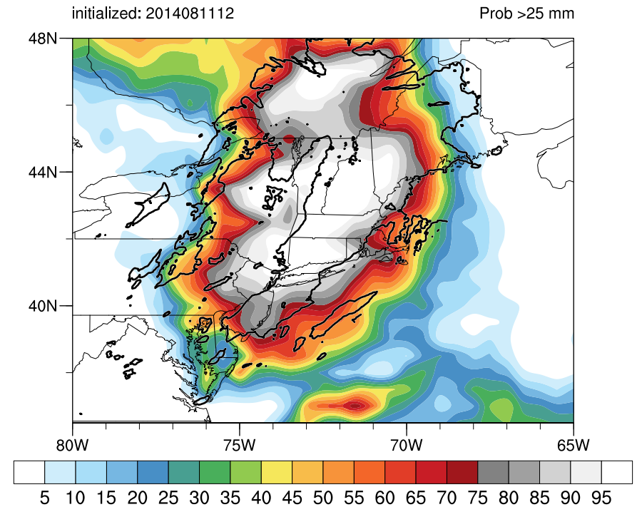
Motivation: Predictability
Precipitation Probabilities
ECMWF Ensemble probability of > 25 mm of precipitation (shaded, %)
Verifying > 25 mm precipitation (black contour, 25 mm)
ECMWF Forecast accurately depicted region of moderate precipitation (> 25 mm)
ECMWF Forecast did not accurately forecast of extreme precipitation amounts (> 100 mm)

Slide 8
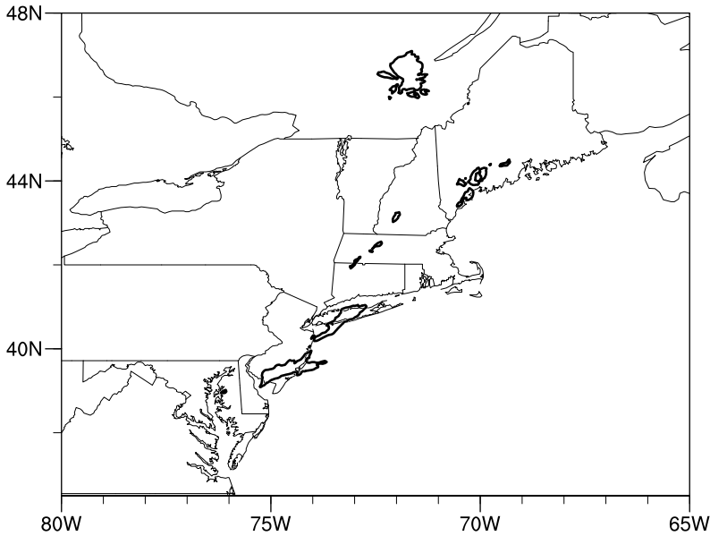
Motivation: Predictability
Precipitation Probabilities
ECMWF Ensemble probability of > 100 mm of precipitation (shaded, %)
Verifying > 100 mm precipitation (black contour, 100 mm)
ECMWF Forecast accurately depicted region of moderate precipitation (> 25 mm)
ECMWF Forecast did not accurately forecast of extreme precipitation amounts (> 100 mm)
ECMWF ensemble does not have sufficient horizontal resolution to resolve this mesoscale event
Focus of talk on mesoscale predictability and meteorology behind Long Island rainfall.
Failure to forecast extreme precipitation over Long Island

Slide 9
Datasets
51 member ECMWF ensemble
Primarily used to assess synoptic variability
15 member convection permitting WRF ensemble
Investigated in detail to assess mesoscale variability

Slide 10
WRF Ensemble
WRF 15-Member Ensemble
Initialized on 0000 UTC 13 August 2014
Display results of 5 km gridded resolution (inner nest)
All initialized with same 0.5º GFS Analysis
Convection permitting
Physics based ensemble
5 different microphysics parameterizations
3 different boundary layer physics
Results in 15 possible combinations
Planetary Boundary Layer Physics | Microphysics
 | Lin | Ferrier | Goddard | WSM-6 | Thompson
Yonsei University (YSU) | Run_01 | Run_04 | Run_07 | Run_10 | Run_13
Mellor-Yamada-Janic (MYJ) | Run_02 | Run_05 | Run_08 | Run_11 | Run_14
Mellor-Yamada Nakanishi and Niino Level 2.5 (MYNN) | Run_03 | Run_06 | Run_09 | Run_12 | Run_15

Slide 11
WRF Ensemble
Stage IV Precipitation Total (0000 UTC – 1800 UTC 13 Aug 2014)
Simulations organized into 5 “best” and 5 “worst” runs
Grid points restricted to counties near Long Island
Determined by how accurately simulation captures PDF of high end total rainfall
> 100 mm
Best runs more accurately capture tail end of verifying PDF
Better predict high end total rainfall
Notes:
TURN OFF NUMBERS EXCEPT for KISP

Slide 12
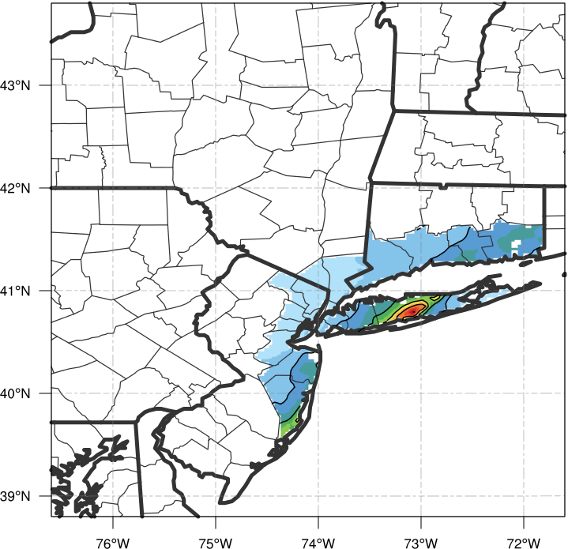
WRF Ensemble
Stage IV Precipitation Total (0000 UTC – 1800 UTC 13 Aug 2014)
Simulations organized into 5 “best” and 5 “worst” runs
Grid points restricted to counties near Long Island
Determined by how accurately simulation captures PDF of high end total rainfall
> 100 mm
Best runs more accurately capture tail end of verifying PDF
Better predict high end total rainfall
N = 2508 grid points
Notes:
TURN OFF NUMBERS EXCEPT for KISP

Slide 13
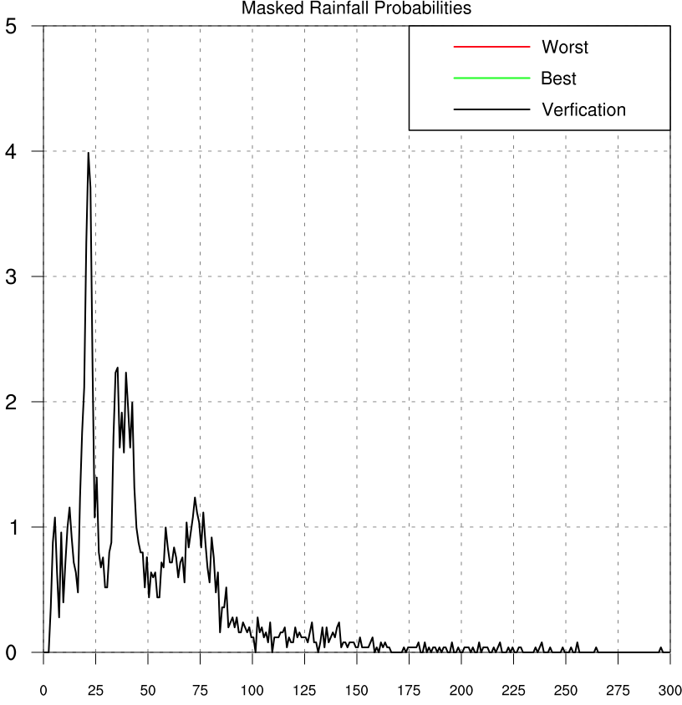
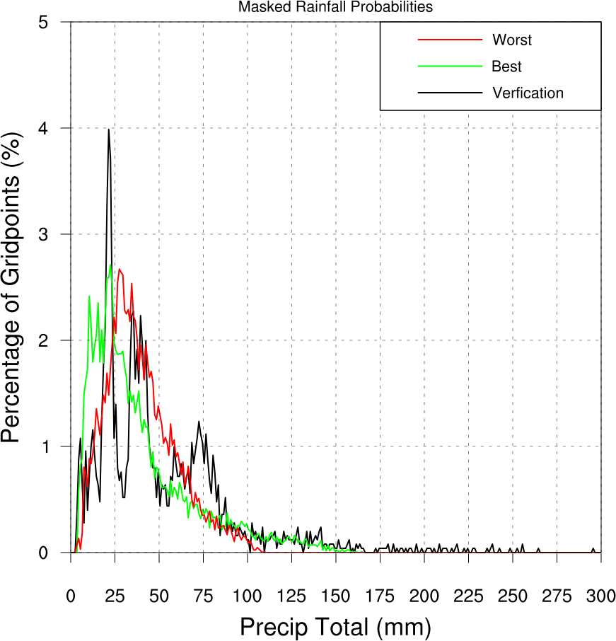
WRF Ensemble
Simulations organized into 5 “best” and 5 “worst” runs
Grid points restricted to counties near Long Island
Determined by how accurately simulation captures PDF of high end total rainfall
> 100 mm
Best runs more accurately capture tail end of verifying PDF
Better predict high end total rainfall
N = 2508 grid points
Binned every 1 mm

Slide 14
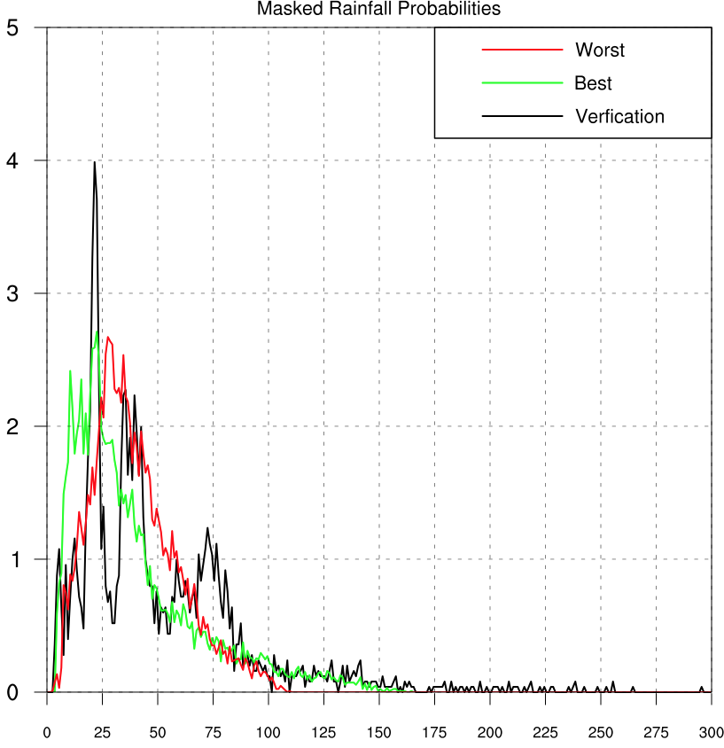
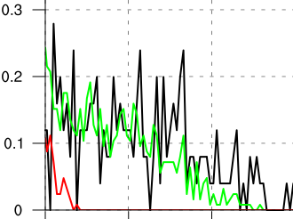
WRF Ensemble
Simulations organized into 5 “best” and 5 “worst” runs
Grid points restricted to counties near Long Island
Determined by how accurately simulation captures PDF of high end total rainfall
> 100 mm
Best runs more accurately capture tail end of verifying PDF
Better predict high end total rainfall
N = 2508 grid points
Binned every 1 mm

Slide 15
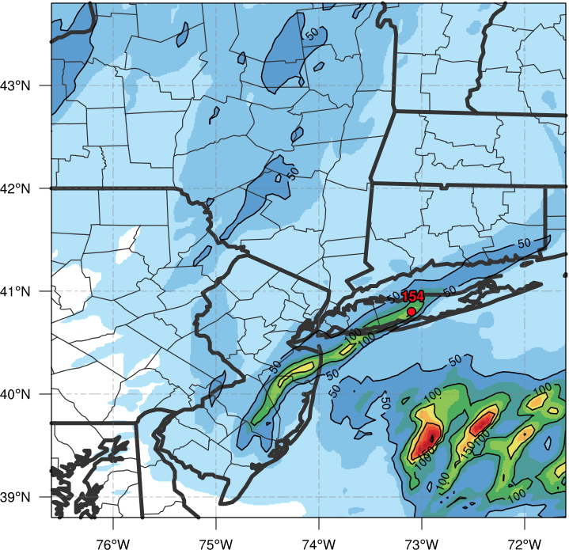
WRF Ensemble
Run 07 Precipitation Total (0000 UTC – 1800 UTC 13 Aug 2014)
Compare Runs
Best Simulation (run_07)
Goddard Microphysics
YSU Boundary Layer Physics
Bad Simulation (run_02)
Lin Microphysics
MYJ Boundary Layer Physics
Linear band of > 100 mm totals close to verification

Slide 16
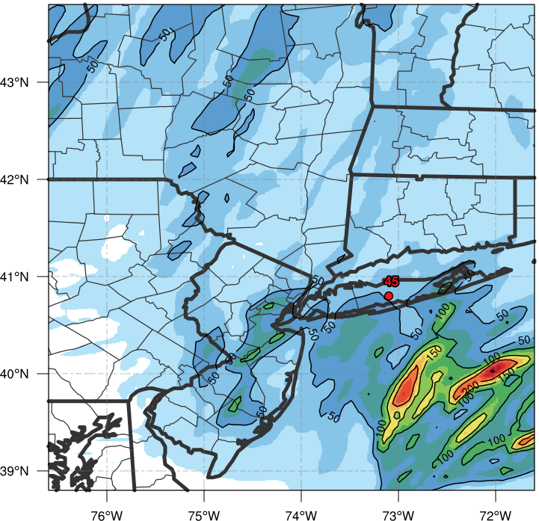
WRF Ensemble
Run 02 Precipitation Total (0000 UTC – 1800 UTC 13 Aug 2014)
Compare Runs
Best Simulation (run_07)
Goddard Microphysics
YSU Boundary Layer Physics
Bad Simulation (run_02)
Lin Microphysics
MYJ Boundary Layer Physics
Lack of focused precipitation totals
Remainder of talk will compare these two simulations

Slide 17
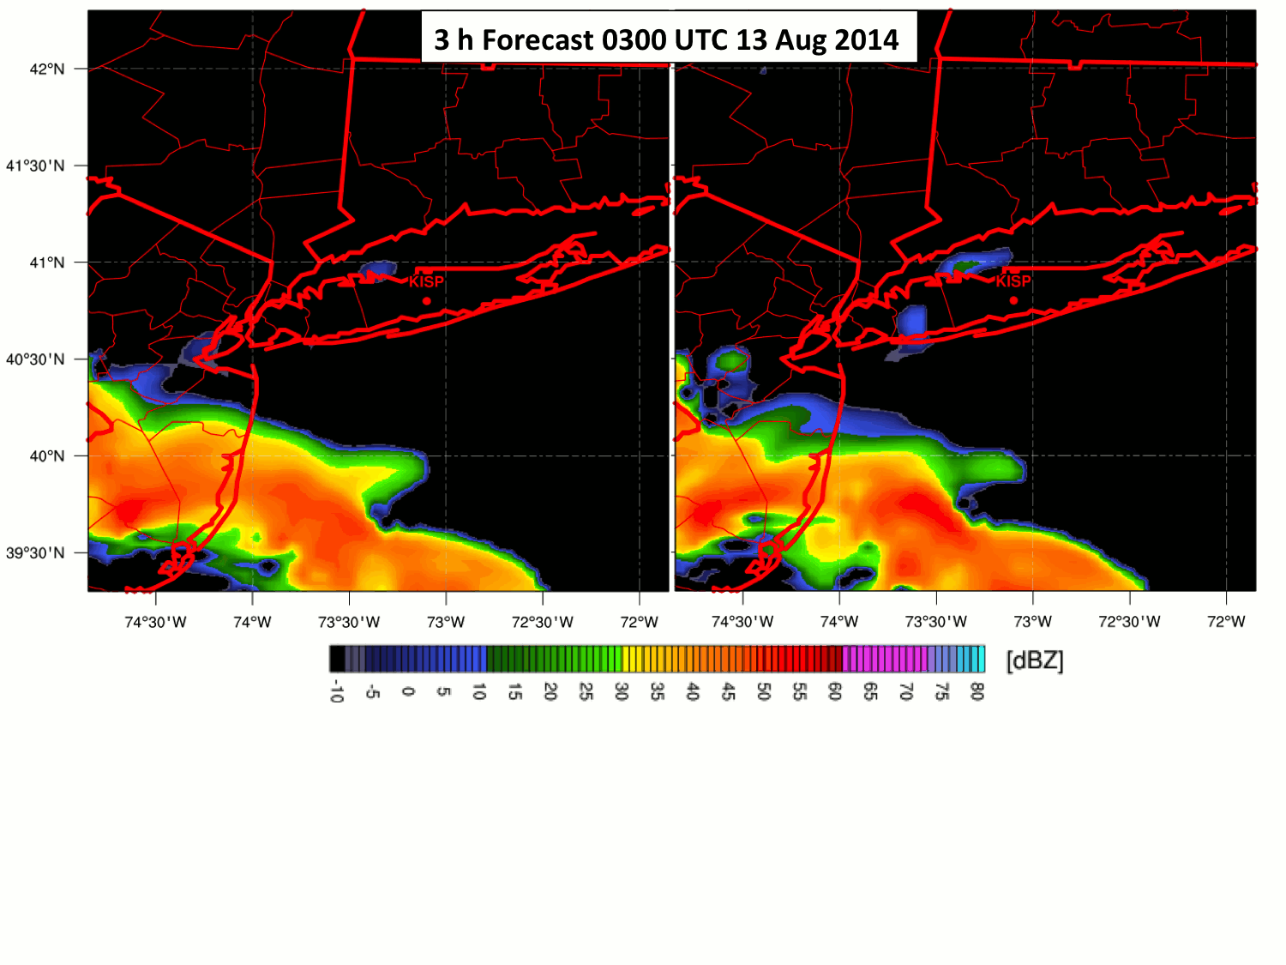
WRF Ensemble
Reflectivity Animation
Lowest layer reflectivity (shading, dBZ)
Best Member
Bad Member

Slide 18
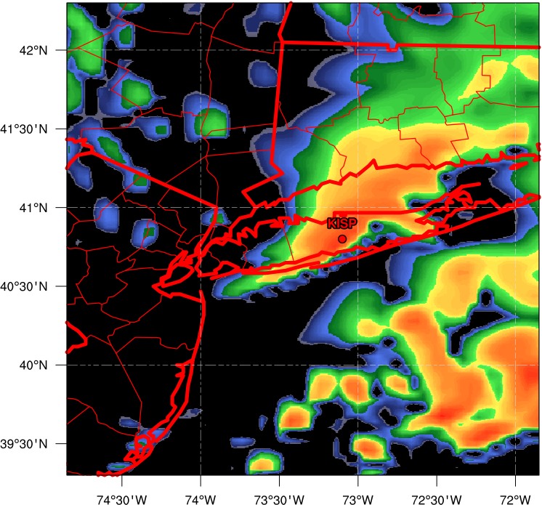
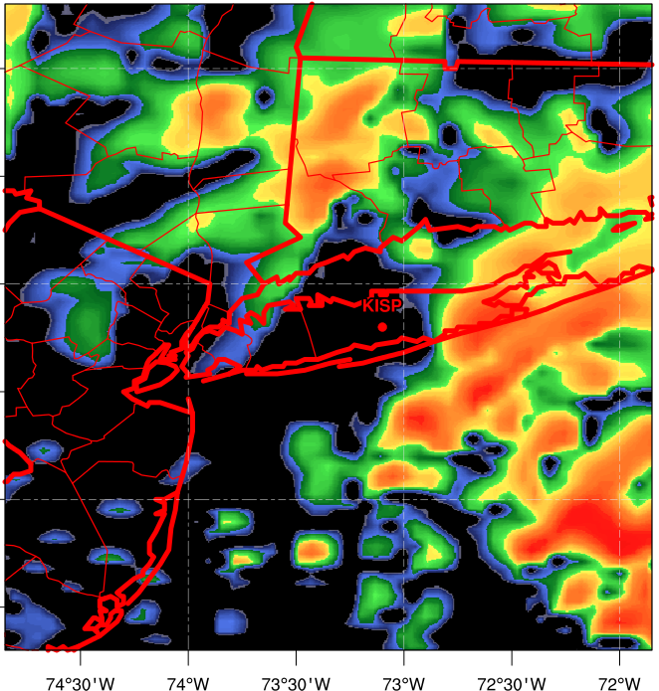
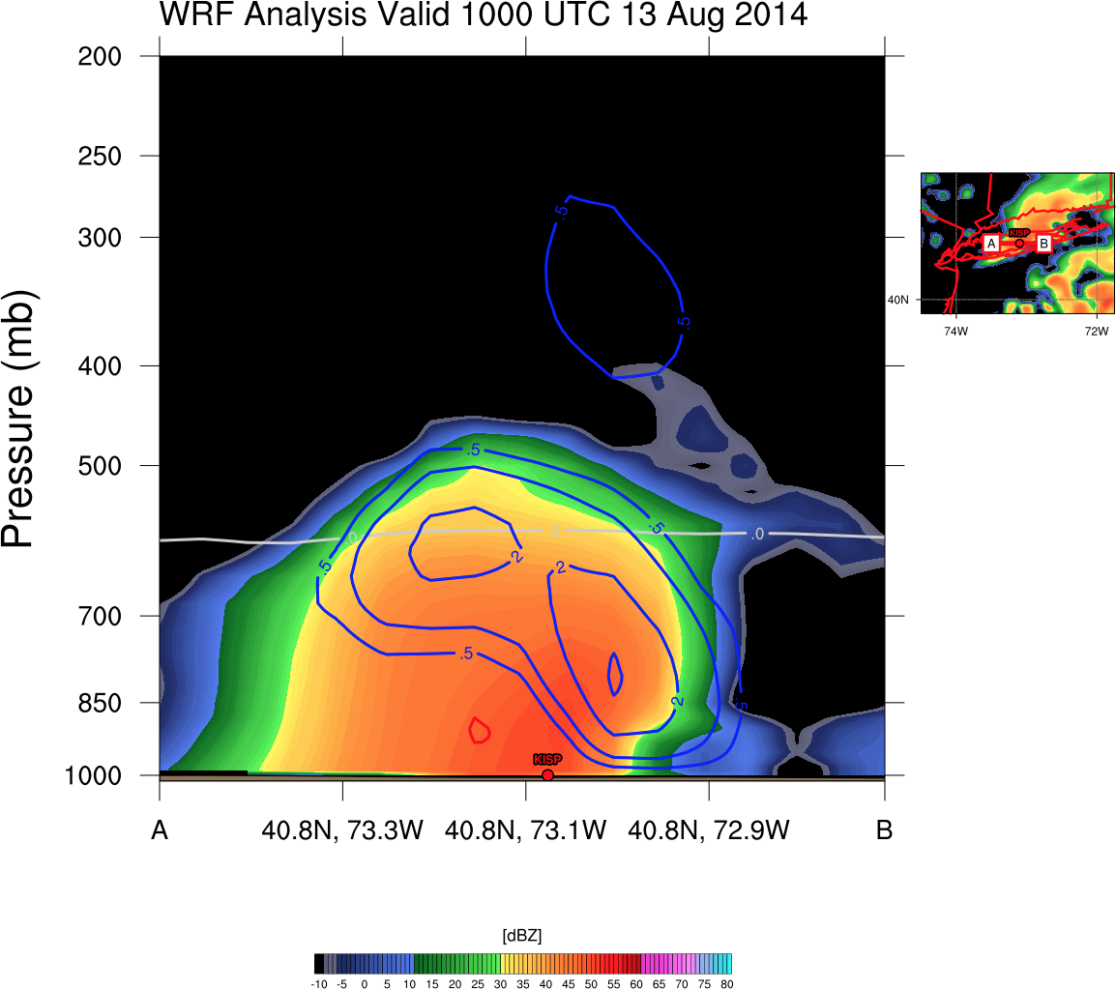
WRF Ensemble
Reflectivity Snapshot
Lowest Layer Reflectivity (shading, dBZ)
10h Forecast 1000 UTC 13 Aug 2014
Best Member
Bad Member
Organized, training reflectivity band evident in best run, while bad run only shows scattered convection

Slide 19
WRF Ensemble
Reflectivity Snapshot
Lowest Layer Reflectivity (shading, dBZ)
10h Forecast 1000 UTC 13 Aug 2014
Best Member
Bad Member
A
B
A
B
Organized, training reflectivity band evident in best run, while bad run only shows scattered convection

Slide 20
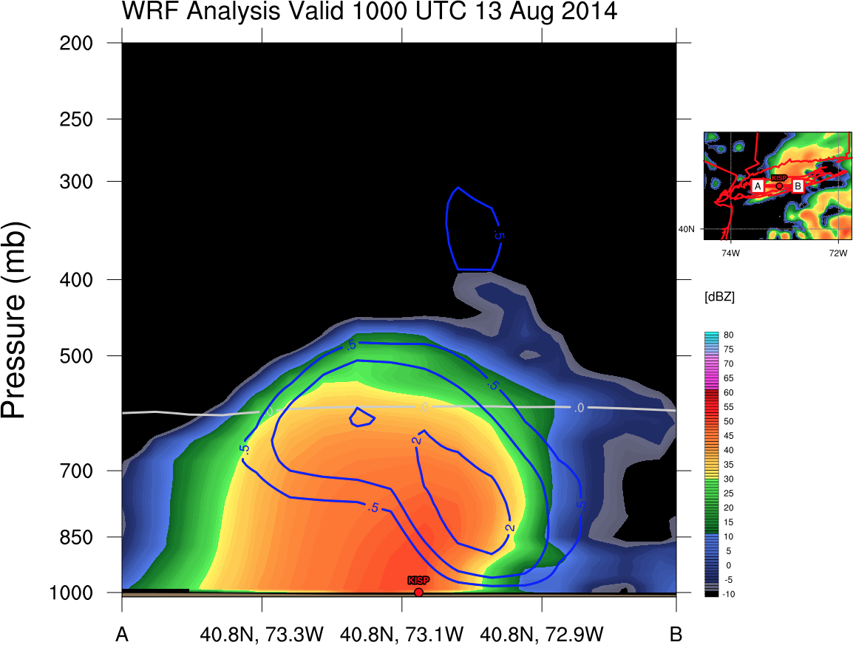
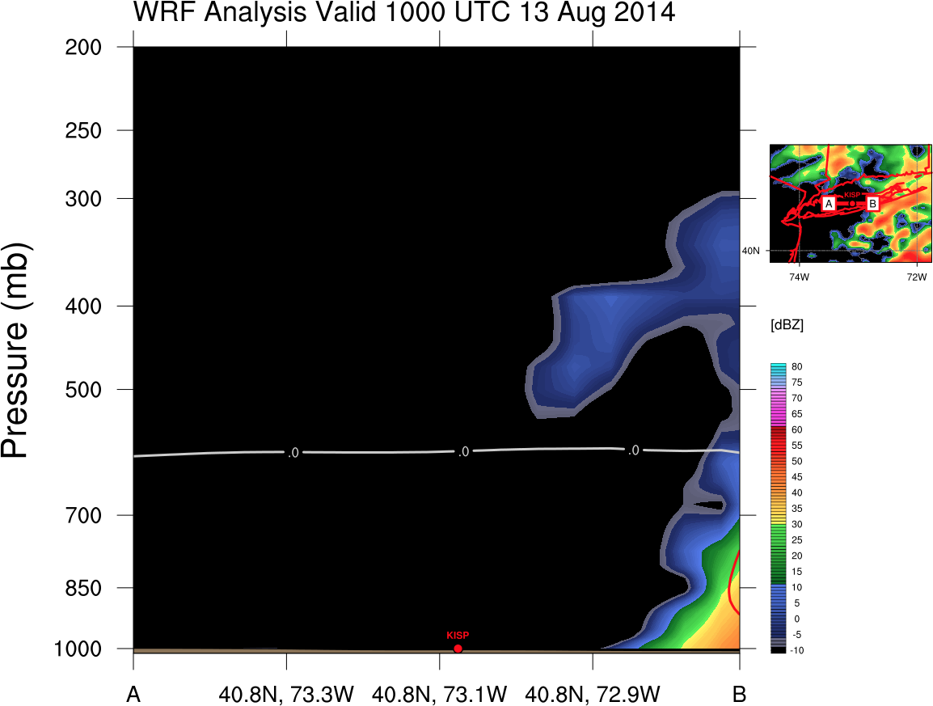
WRF Ensemble
Cross Section Analysis
Reflectivity (shading, dBZ), Vertical Motion (blue contours upward, red contours downward, m s⁻¹), 0ºC Isotherm (gray contour)
10h Forecast 1000 UTC 13 Aug 2014
Best Member
Bad Member
Strongest ascent and reflectivity below 0ºC isotherm

Slide 21
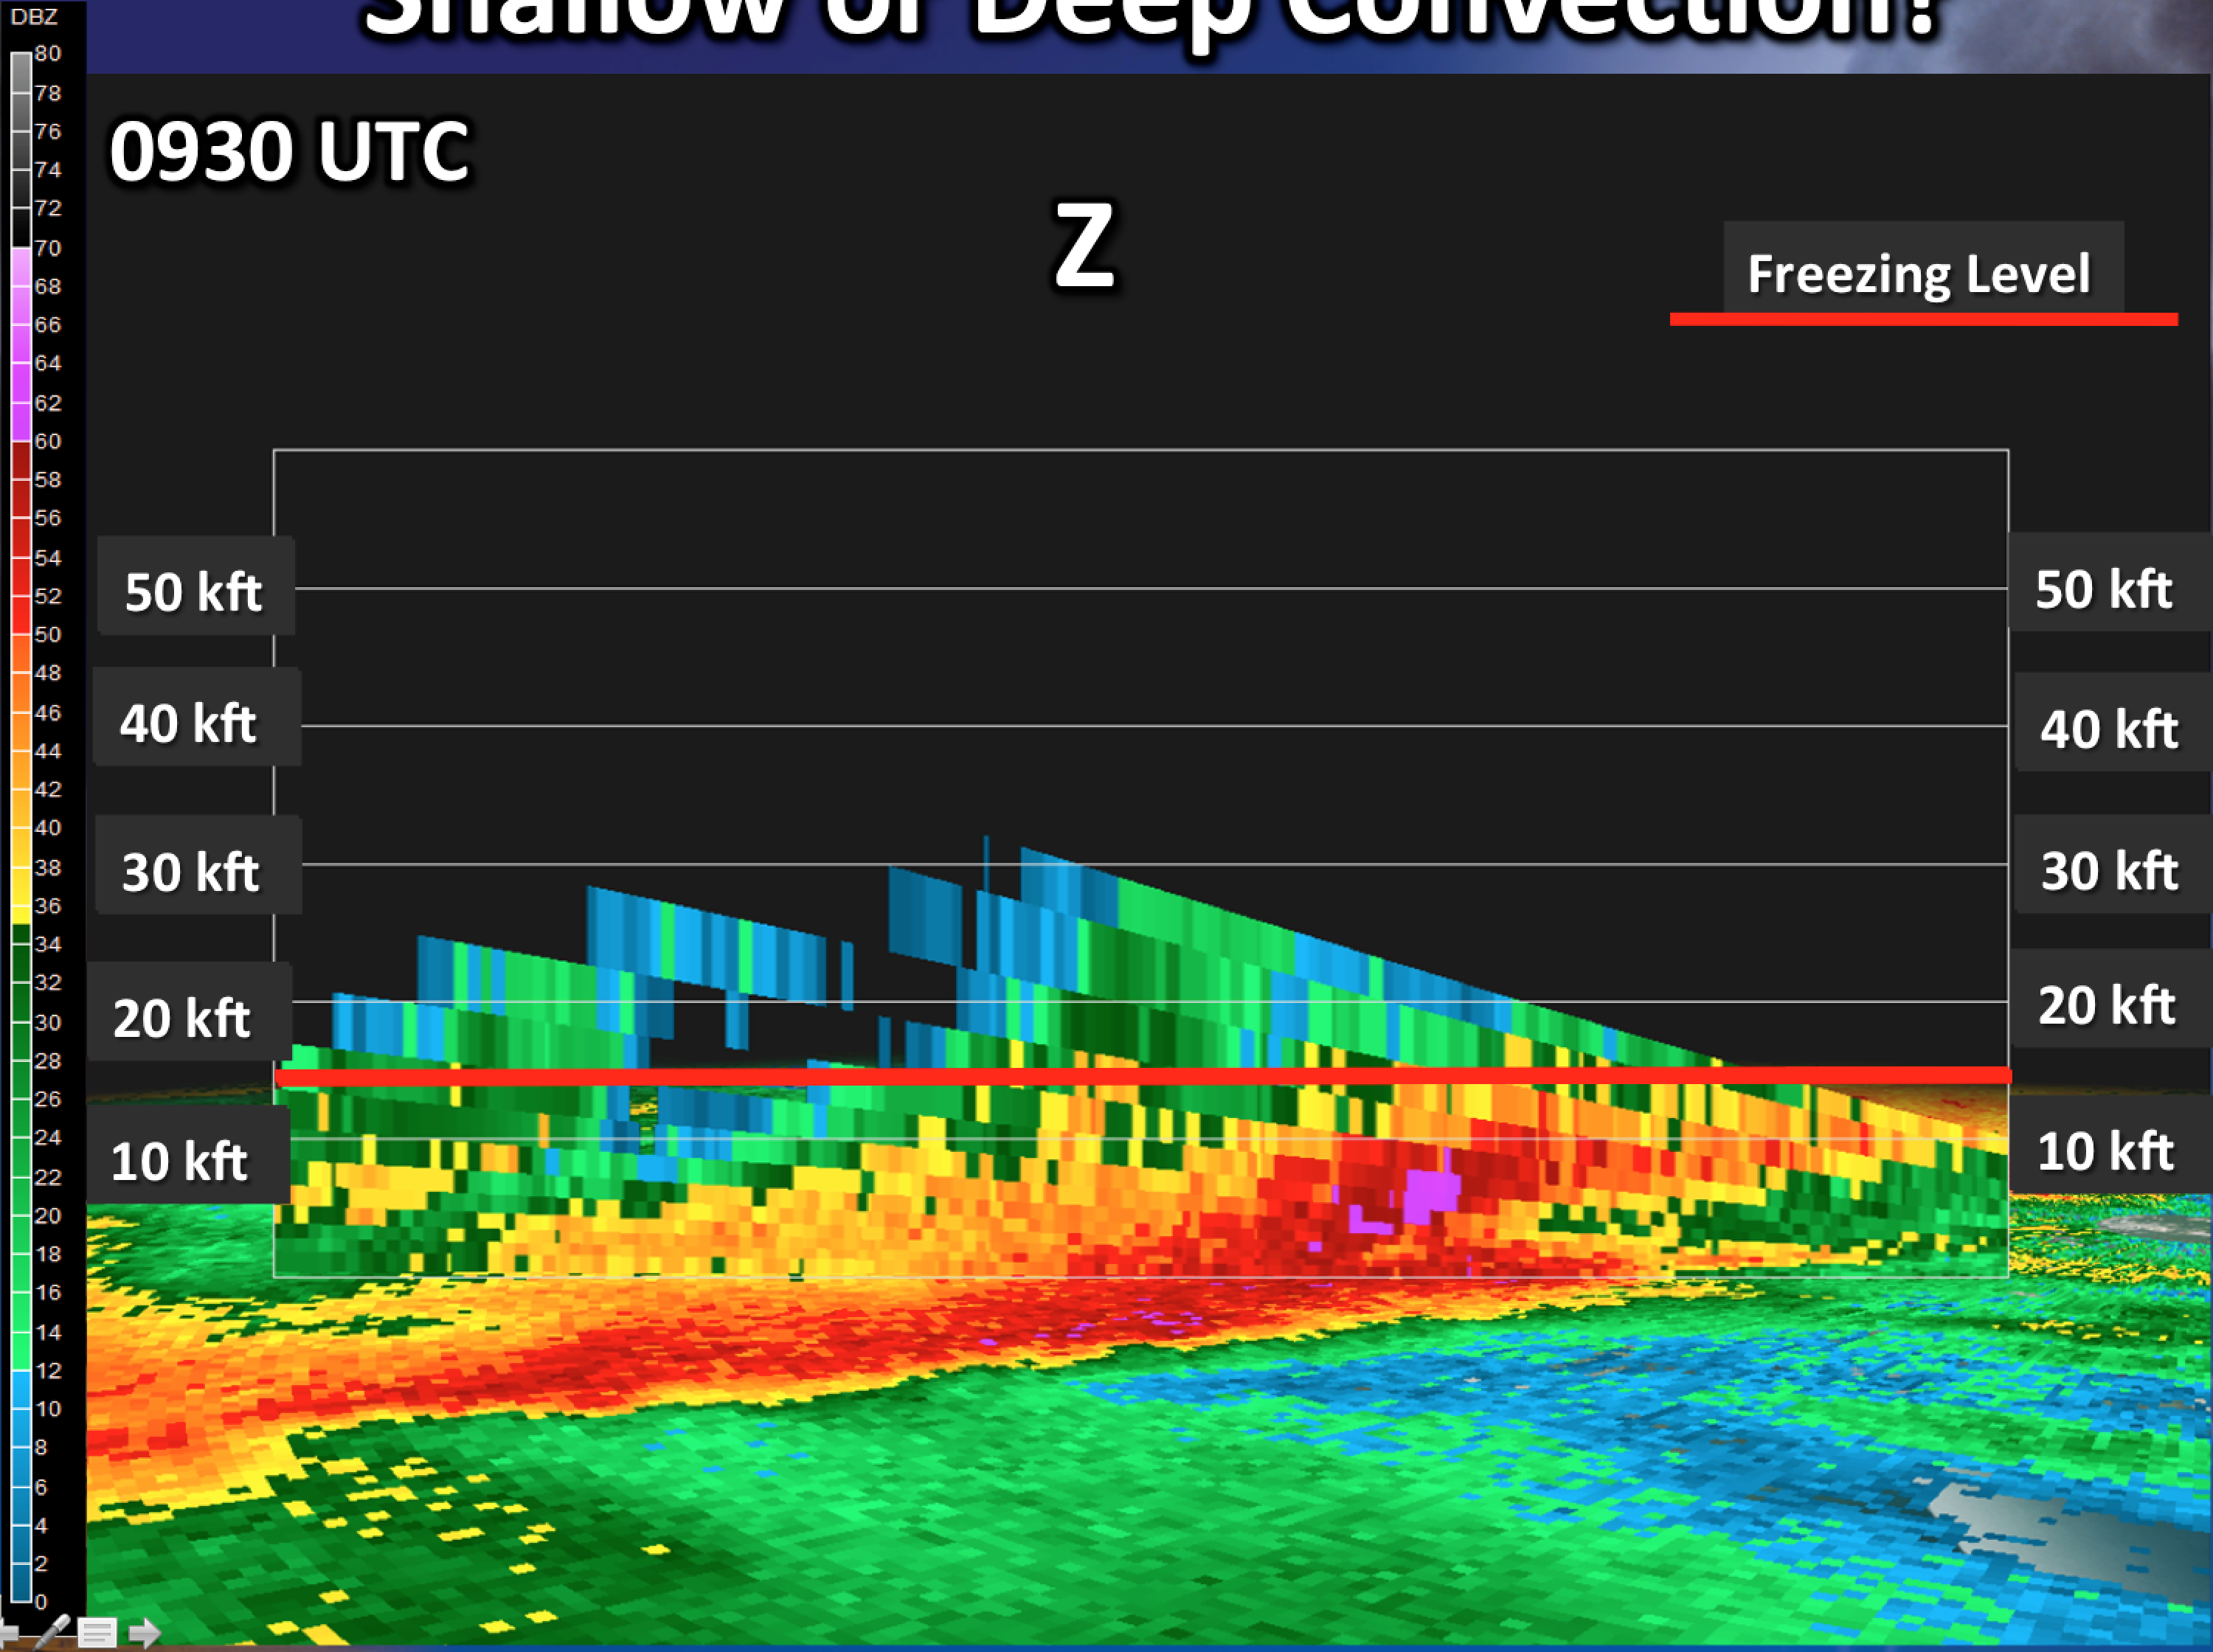
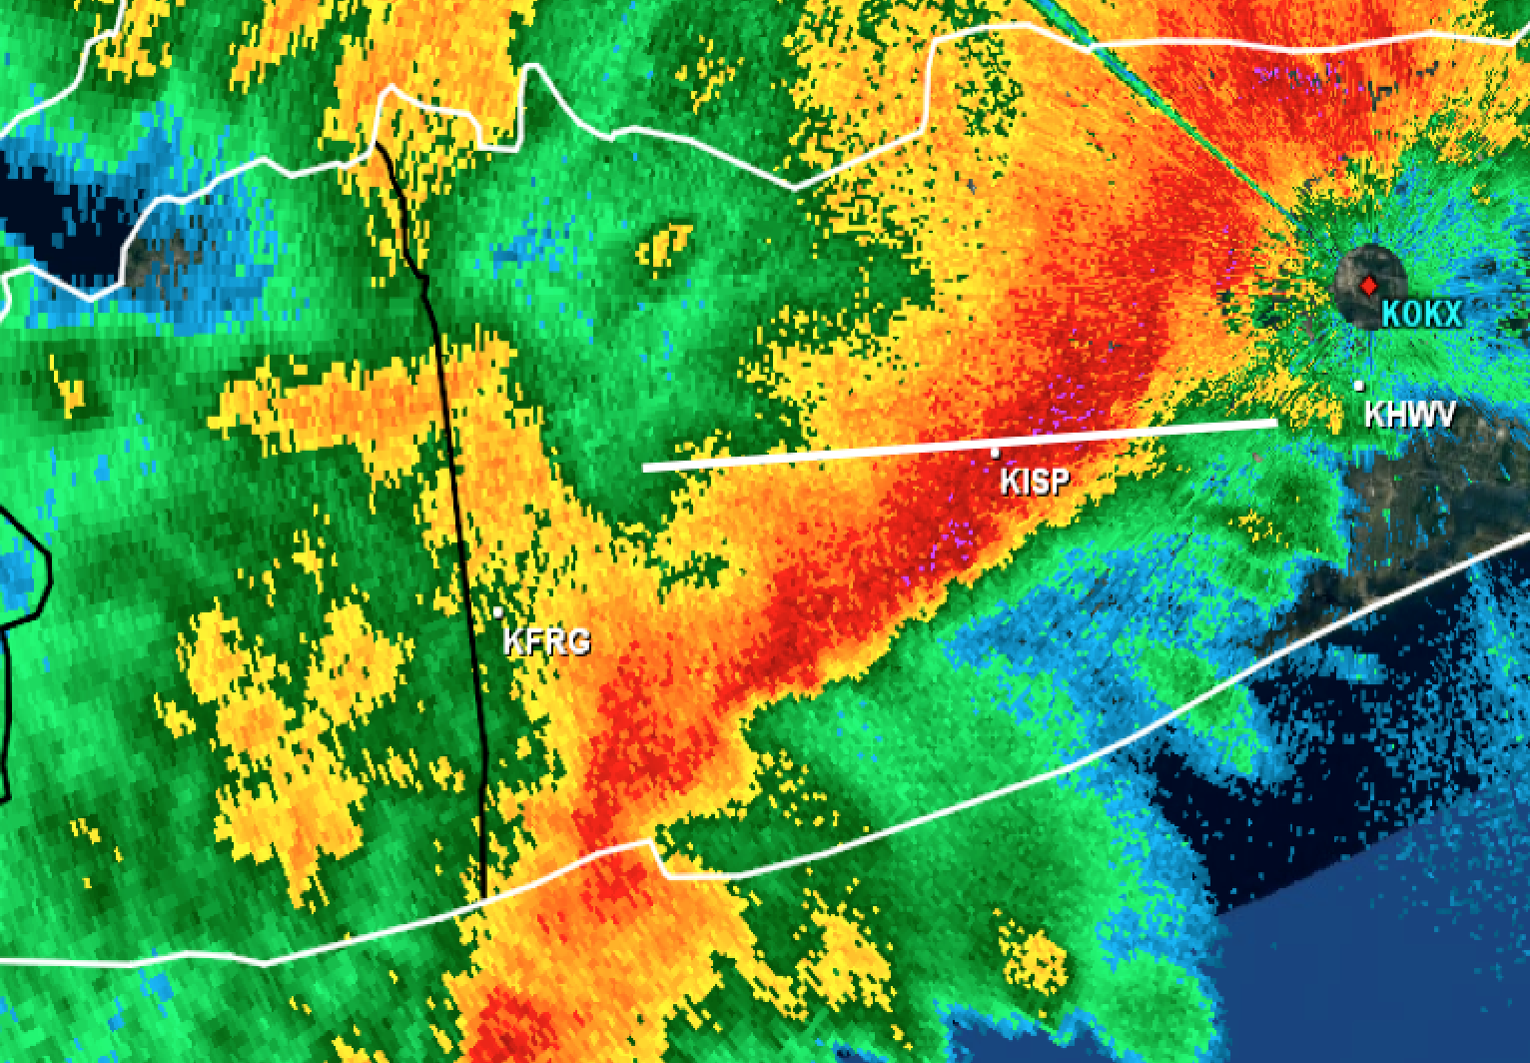
WRF Ensemble
Cross Section Analysis
Reflectivity (shading, dBZ), Vertical Motion (blue contours upward, red contours downward, m s⁻¹), 0ºC Isotherm (gray contour)
10h Forecast 1000 UTC 13 Aug 2014
Best Member
Observed KOAX 0930 UTC
Bad Member
Best simulation closely matches KOKX WSR-88D
A
B
Forcing behind strong low-level ascent?
0ºC

Slide 22
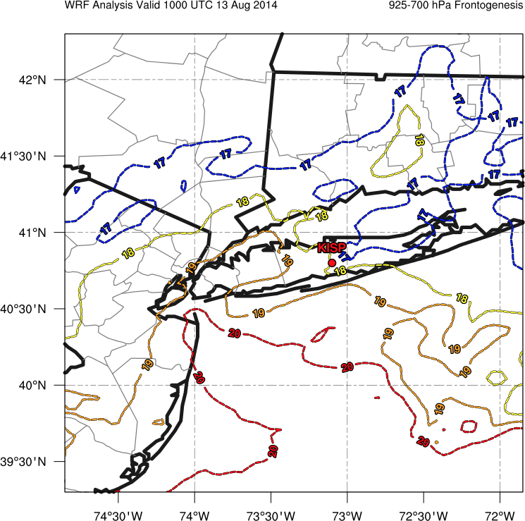
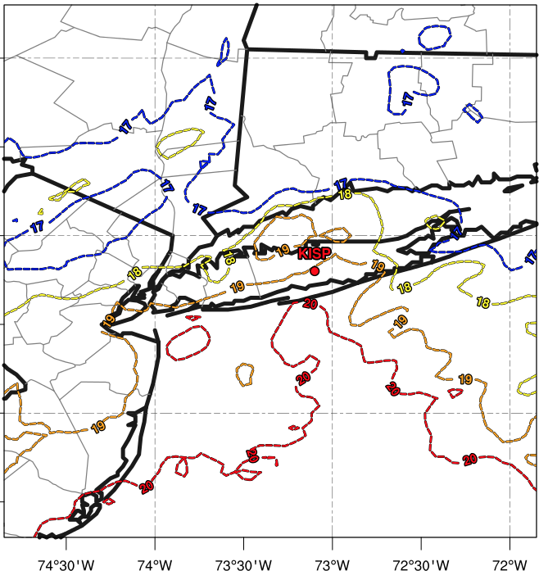
WRF Ensemble
Mesoscale Forcing
1000 – 850-hPa layer mean temperature (ºC, colored dotted contours)
Best Member
10 h Forecast 1000 UTC 13 Aug 2014
Bad Member
Temperature Gradient Along LI Coast
Notes:
Um can you colorize these temperature contours?????

Slide 23
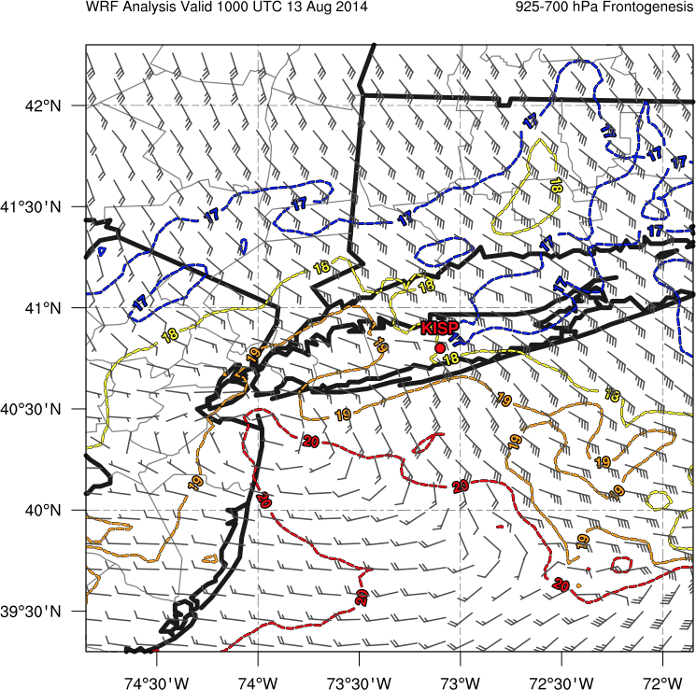
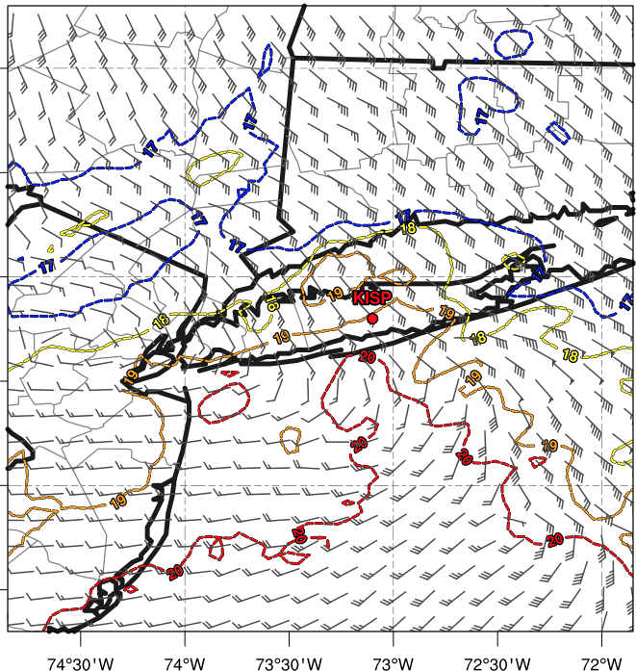
WRF Ensemble
Mesoscale Forcing
1000 – 850-hPa layer mean temperature (ºC, colored dotted contours), 1000 – 850-hPa layer mean winds (kt, barbs)
Best Member
10 h Forecast 1000 UTC 13 Aug 2014
Bad Member
Coastal Front Development
L
L
40+ kt
Notes:
Layer mean frontogenesis?

Slide 24
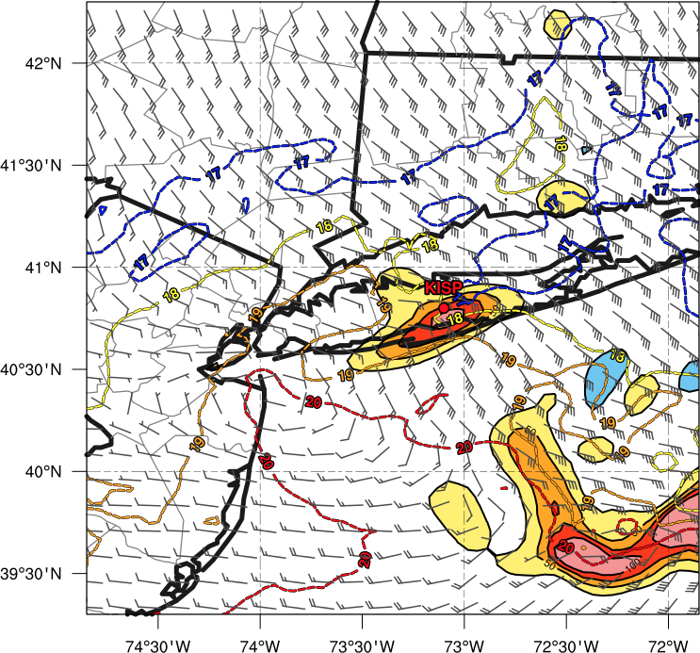
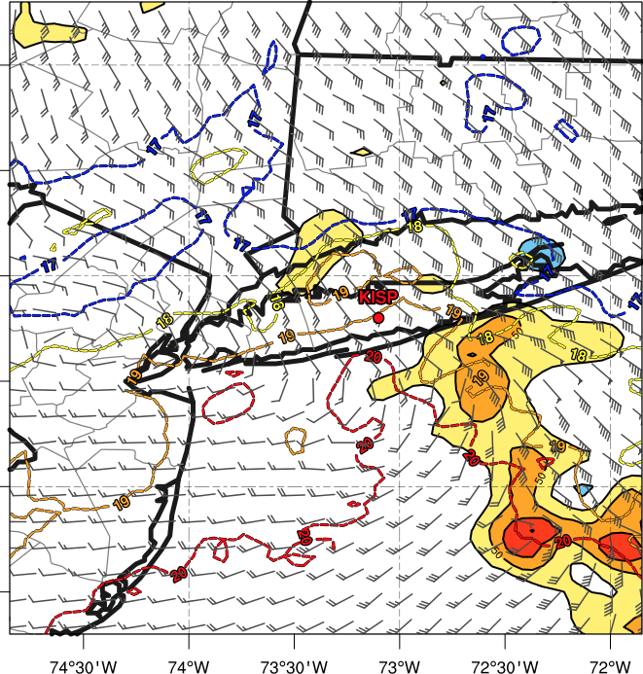
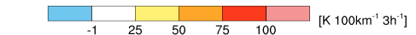
WRF Ensemble
Mesoscale Forcing
1000 – 850-hPa layer mean temperature (ºC, colored dotted contours), 1000 – 850-hPa layer mean winds (kt, barbs), 1000 – 850-hPa layer mean frontogenesis (K 100km ⁻¹ 3h⁻¹, shaded)
Best Member
10 h Forecast 1000 UTC 13 Aug 2014
Bad Member
Strong Frontogenesis
L
L
40+ kt
Notes:
Layer mean frontogenesis?

Slide 25
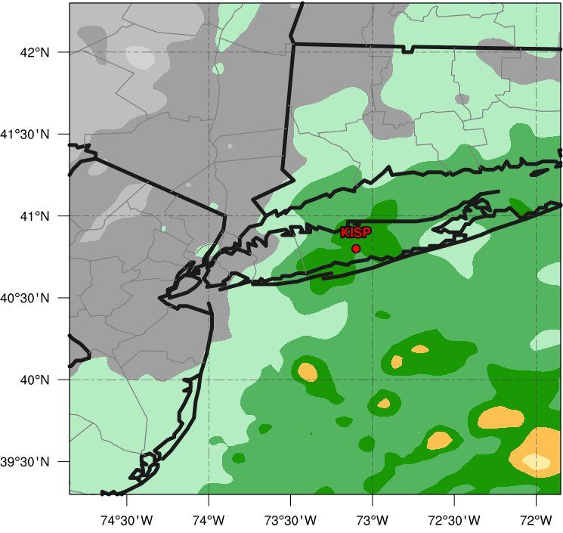
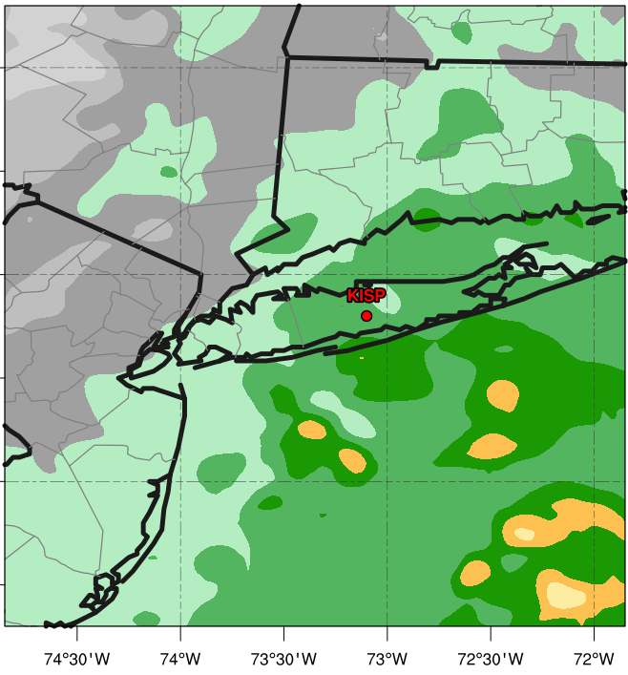
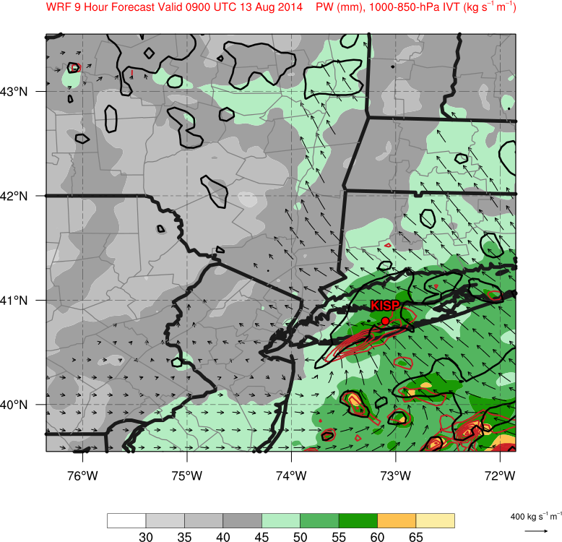
WRF Ensemble
Moisture
Precipitable Water (mm, shaded)
Best Member
9 h Forecast 0900 UTC 13 Aug 2014
Bad Member
55.2 mm PW
[mm]

Slide 26
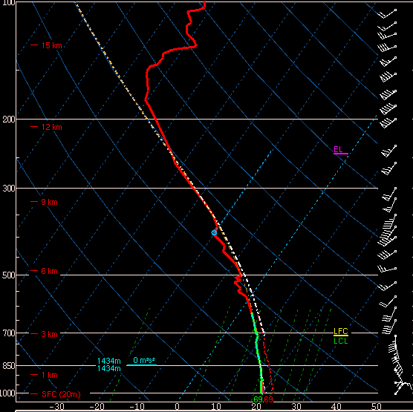
WRF Ensemble
Moisture
Precipitable Water (mm, shaded)
Best Member
9 h Forecast 0900 UTC 13 Aug 2014
Bad Member
1200 UTC KORX Sounding
55.2 mm PW (2.17”)
PW: 1.81” ~ 46 mm
[mm]

Slide 27
WRF Ensemble
Moisture
Precipitable Water (mm, shaded)
Best Member
9 h Forecast 0900 UTC 13 Aug 2014
Bad Member
1200 UTC KORX Sounding
55.2 mm PW (2.17”)
PW _{moist adiabat to 250-hPa}
2.41” ~ 61.2 mm
PW: 1.81” ~ 46 mm
RH sensor failed at 623-hPa
[mm]

Slide 28
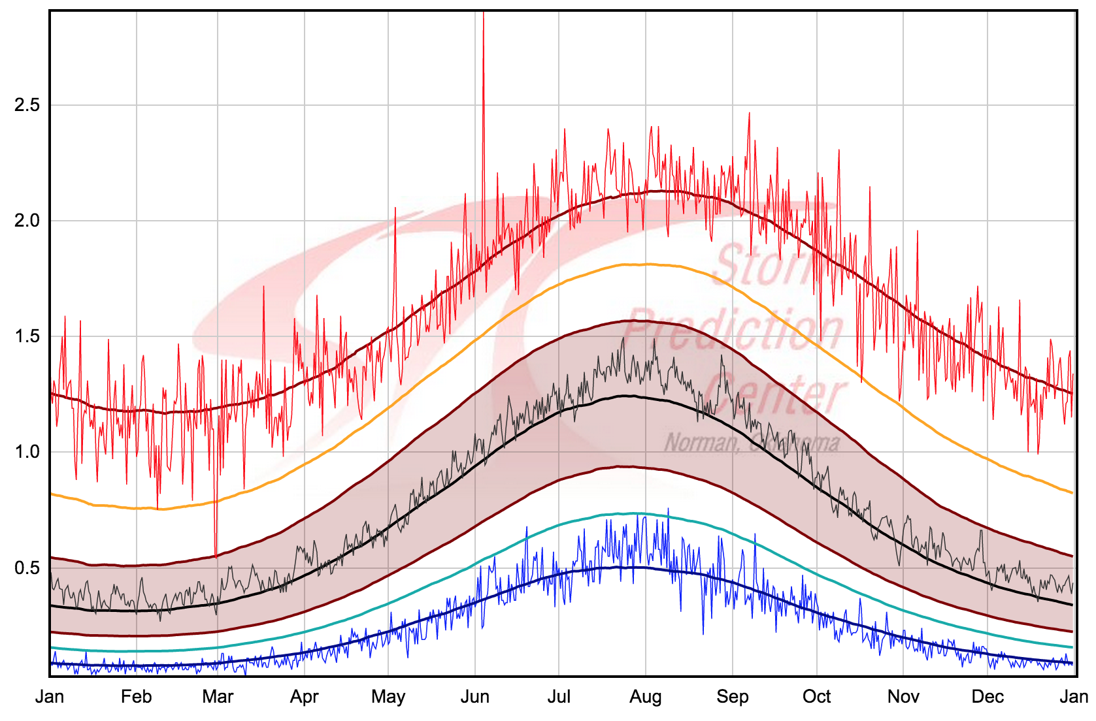
WRF Ensemble
Moisture
Precipitable water (mm, shaded)
Best Member
9 h Forecast 0900 UTC 13 Aug 2014
Bad Member
2.41” PW
Moist Adiabat PW
2.17” PW
WRF Derived PW
1.81” PW
Sounding to 623-hPa
Bottom Line: Near Record Breaking Precipitable Water

Slide 29
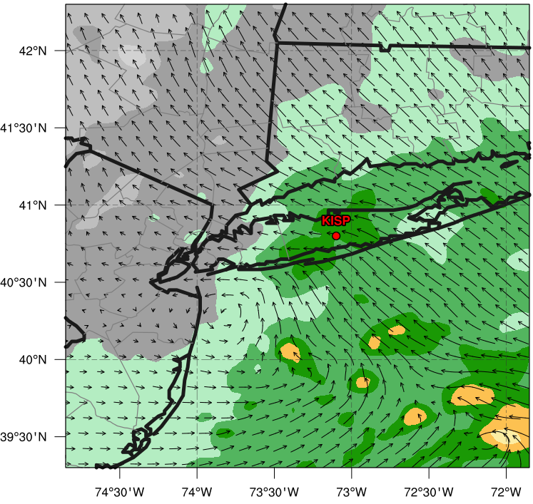
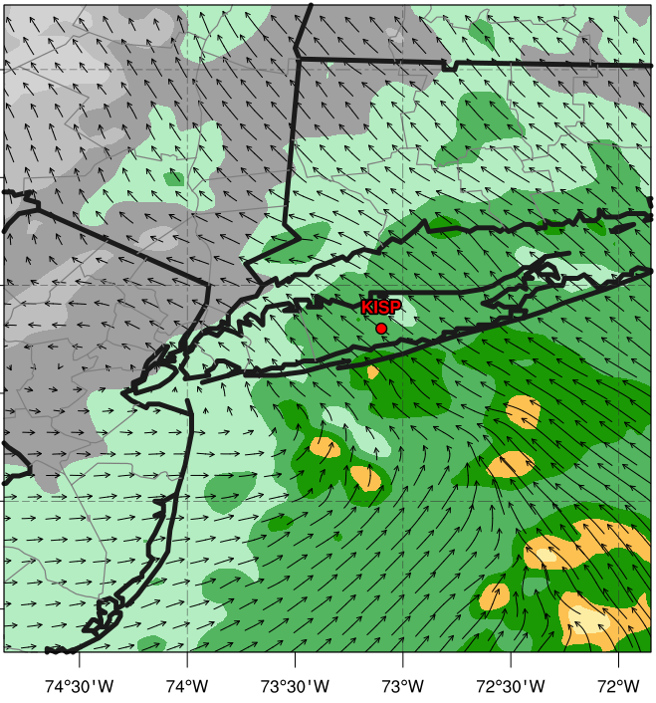
WRF Ensemble
Moisture Transport
Precipitable water (mm, shaded), 1000 – 850-hPa integrated vapor transport (vectors, kg s⁻¹ m⁻¹)
Best Member
9 h Forecast 0900 UTC 13 Aug 2014
Bad Member
L
L

Slide 30
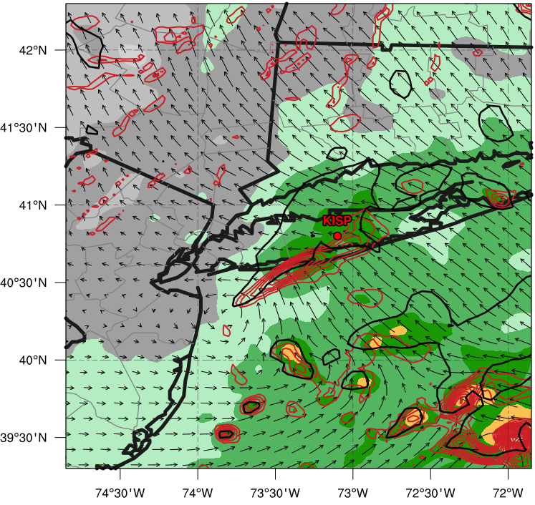
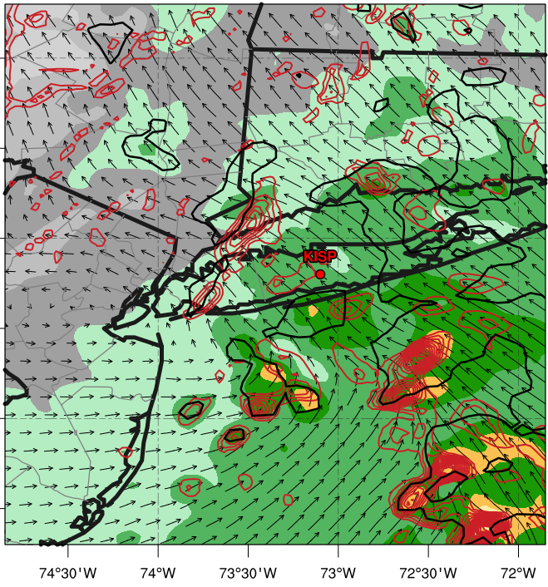
WRF Ensemble
Moisture Transport
Precipitable water (mm, shaded), 1000 – 850-hPa integrated vapor transport (vectors, kg s⁻¹ m⁻¹), 1000 – 850-hPa integrated vapor flux convergence (10⁻³ kg s⁻¹, red contours), reflectivity (> 35 dBZ, black contour)
Best Member
9 h Forecast 0900 UTC 13 Aug 2014
Bad Member
Moisture flux convergence along leading edge of reflectivity
L
L

Slide 31
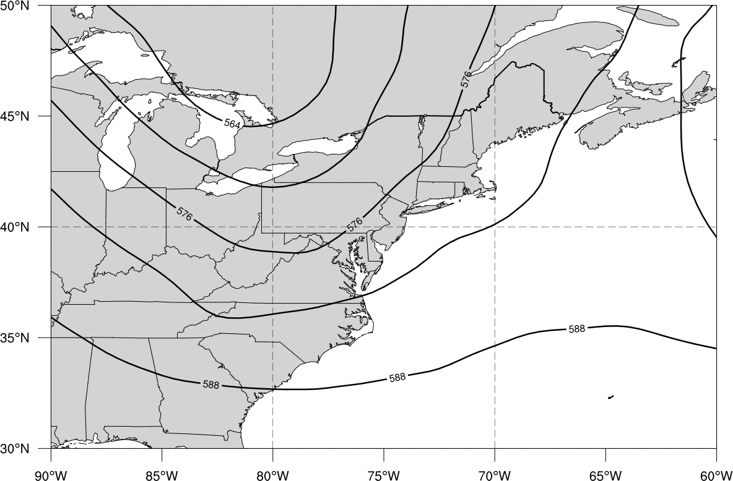
Summary Schematic
500-hPa Trough Axis
Main: 500-hPa geopotential height (black contours, every 6 dam)
Notes:
Maybe build up this slide (synoptic piece first… build the different portions of the schematic next)

Slide 32
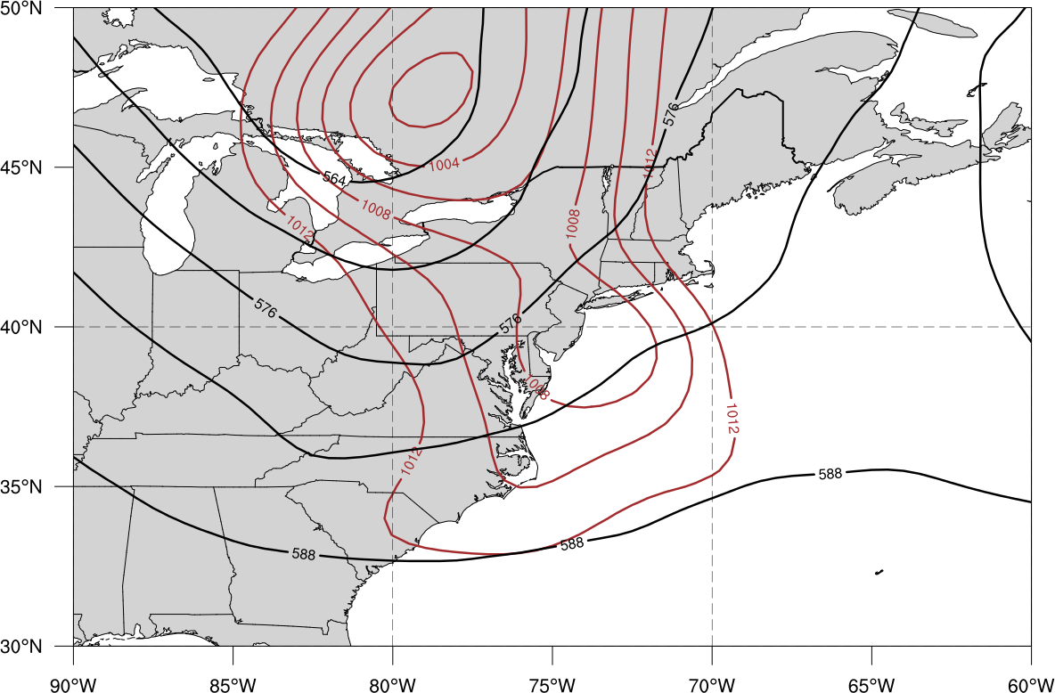
Summary Schematic
L
Secondary Cyclogenesis
L
Main: 500-hPa geopotential height (black contours, every 6 dam), mean sea level pressure (brown contours, every 2 hPa)
Notes:
Maybe build up this slide (synoptic piece first… build the different portions of the schematic next)

Slide 33
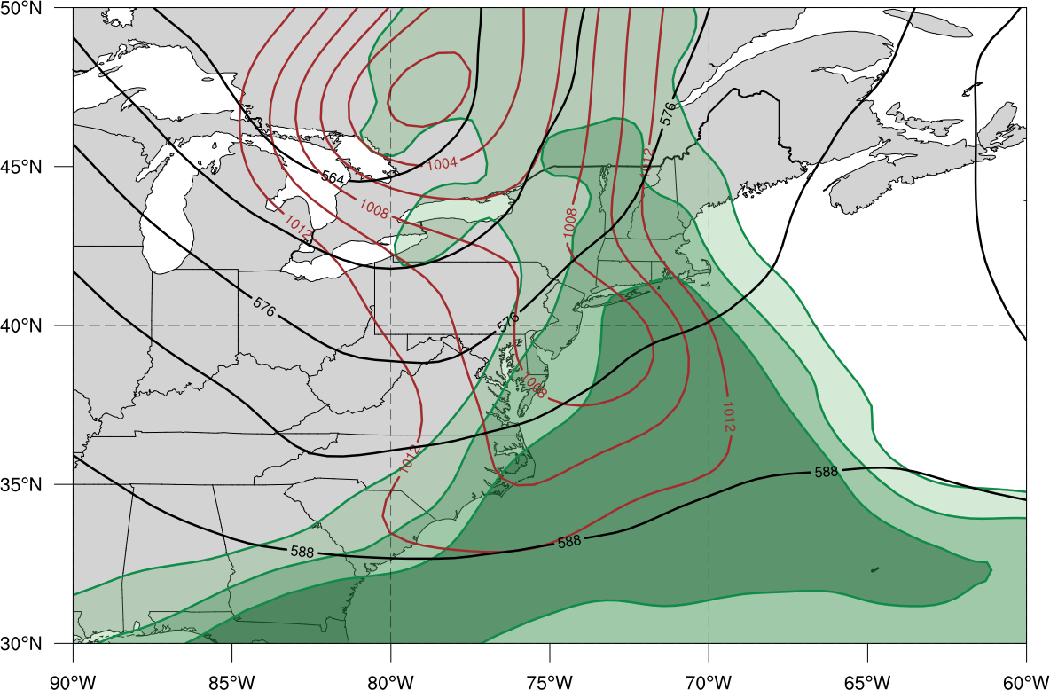

Summary Schematic
L
L
Deep Tropical Moisture
PW > 50mm
Main: 500-hPa geopotential height (black contours, every 6 dam), mean sea level pressure (brown contours, every 2 hPa), precipitable water (shaded, mm)
Notes:
Maybe build up this slide (synoptic piece first… build the different portions of the schematic next)

Slide 34
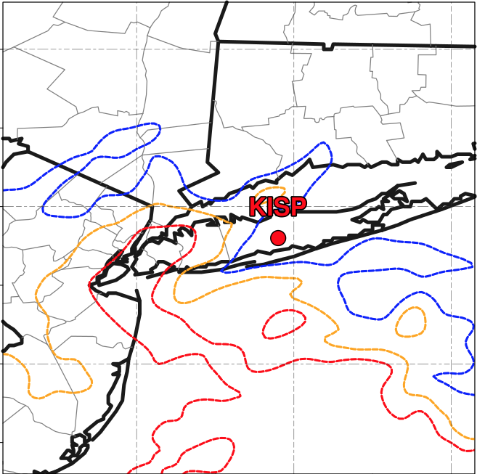
Summary Schematic
L
L
Coastal Temperature Gradient
Coastal Temperature Gradient
PW > 50mm
17ºC
18ºC
Main: 500-hPa geopotential height (black contours, every 6 dam), mean sea level pressure (brown contours, every 2 hPa), precipitable water (shaded, mm)
Inset: 900-hPa temperature (colored contours, from 17-19ºC)
19ºC
Notes:
Maybe build up this slide (synoptic piece first… build the different portions of the schematic next)

Slide 35
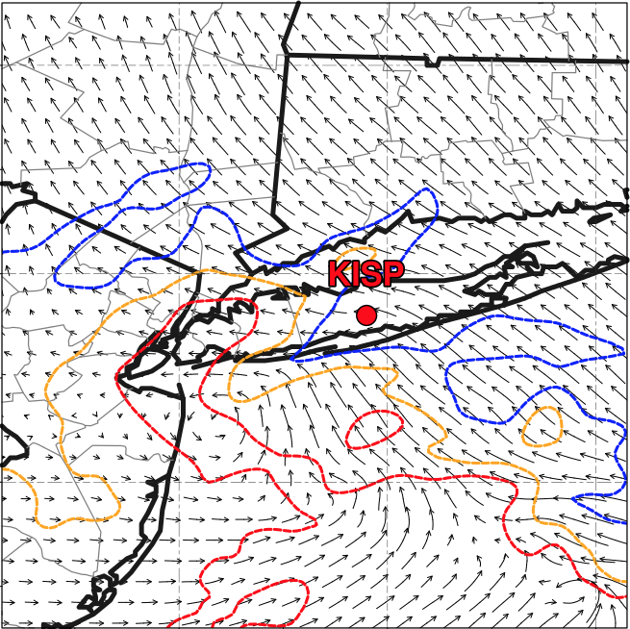
Summary Schematic
L
L
Southeasterly Moisture Transport Along Warm Front
Coastal Temperature Gradient
PW > 50mm
17ºC
18ºC
L
V₁₀₀₀₋₈₅₀
> 20 m s⁻¹
Main: 500-hPa geopotential height (black contours, every 6 dam), mean sea level pressure (brown contours, every 2 hPa), precipitable water (shaded, mm)
Inset: 900-hPa temperature (colored contours, from 17-19ºC)
1000 – 850-hPa integrated vapor transport (vectors, kg s⁻¹ m⁻¹)
19ºC
Notes:
Maybe build up this slide (synoptic piece first… build the different portions of the schematic next)

Slide 36
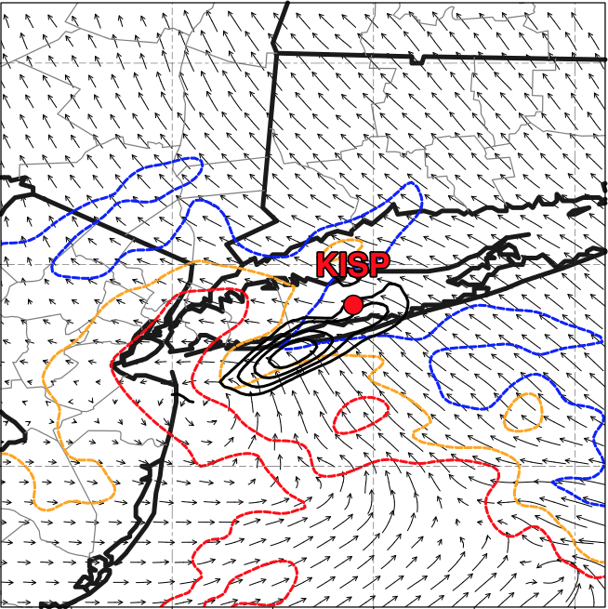
Summary Schematic
L
L
Strong Frontogenesis Along Coastal Front
Coastal Temperature Gradient
17ºC
C_{front}
PW > 50mm
18ºC
F_{gen}
V₁₀₀₀₋₈₅₀
> 20 m s⁻¹
L
Main: 500-hPa geopotential height (black contours, every 6 dam), mean sea level pressure (brown contours, every 2 hPa), precipitable water (shaded, mm)
Inset: 900-hPa temperature (colored contours, from 17-19ºC)
1000 – 850-hPa integrated vapor transport (vectors, kg s⁻¹ m⁻¹)
19ºC
Notes:
Maybe build up this slide (synoptic piece first… build the different portions of the schematic next)

Slide 37
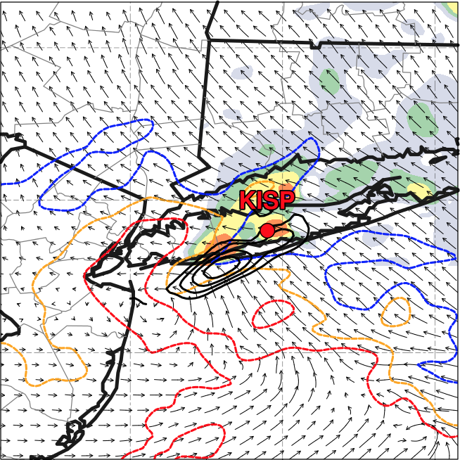
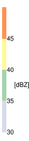
Summary Schematic
L
L
Heavy Training Precipitation Along Coastal Frontal Boundary
Coastal Temperature Gradient
17ºC
C_{front}
PW > 50mm
V_{sfc} < 5 m s⁻¹
18ºC
F_{gen}
V₁₀₀₀₋₈₅₀
> 20 m s⁻¹
L
Main: 500-hPa geopotential height (black contours, every 6 dam), mean sea level pressure (brown contours, every 2 hPa), precipitable water (shaded, mm)
Inset: 900-hPa temperature (colored contours, from 17-19ºC)
1000 – 850-hPa integrated vapor transport (vectors, kg s⁻¹ m⁻¹)
1000 – 850-hPa layer mean frontogenesis (black contours, starting at 30 K 100 km⁻¹ 3h⁻¹)
19ºC
Notes:
Maybe build up this slide (synoptic piece first… build the different portions of the schematic next)

Slide 38
Extra Slides

Slide 39
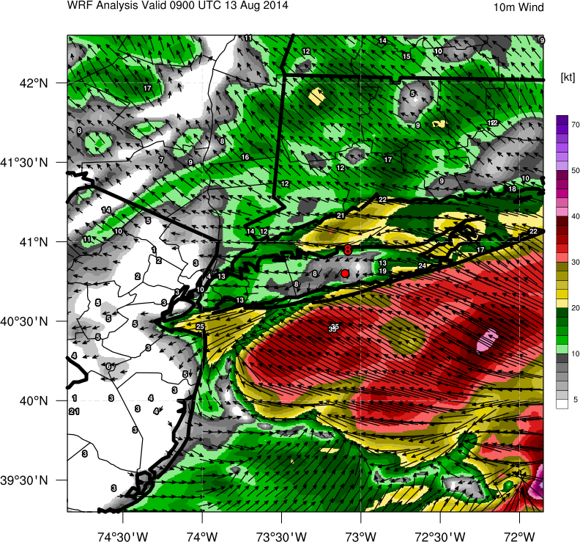
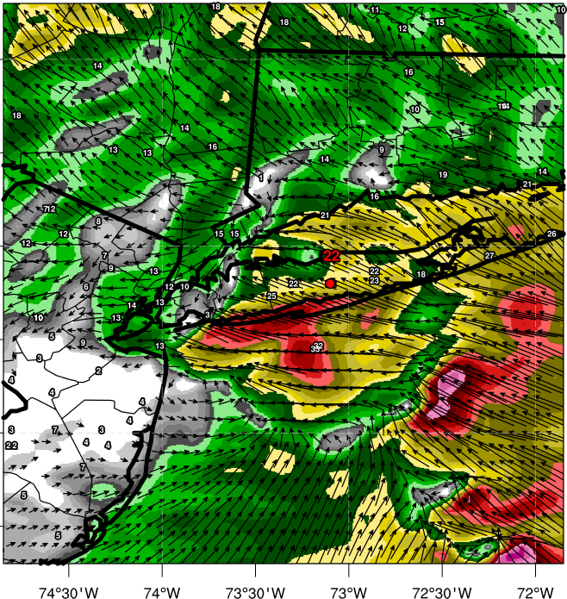
WRF Ensemble
Winds
10 m wind magnitude (shading, kt), 10 m wind direction (vectors, kt)
Best Member
9 h Forecast 0900 UTC 13 Aug 2014
Bad Member
Strong Moisture Flux Convergence
L
L
Notes:
Talk about how PBL and Microphysics could

Slide 40
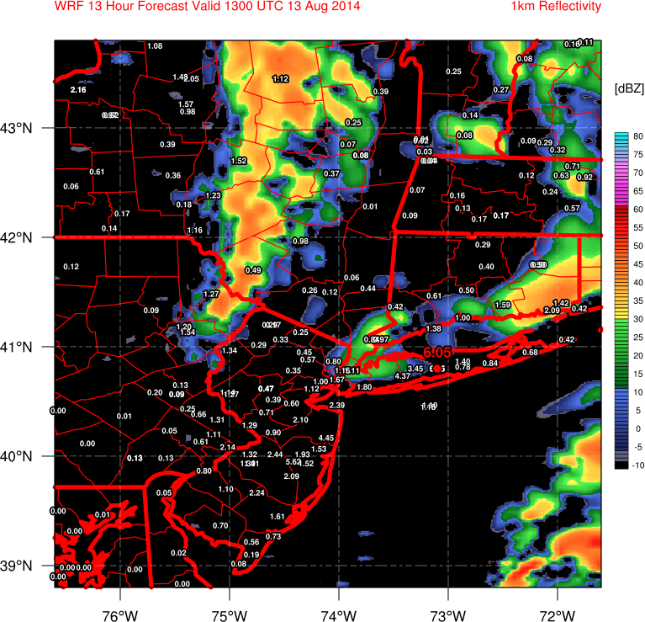
WRF Ensemble
Mesoscale Forcing
Lowest Layer Reflectivity (shading, dBZ)
10h Forecast 1000 UTC 13 Aug 2014
Best Member
Bad Member
A
A
B
B

Slide 41


WRF Ensemble
Cross Section Analysis
Reflectivity (shading, dBZ), Vertical Motion (blue contours upward, red contours downward, m s⁻¹), 0ºC Isotherm (gray contour)
10h Forecast 1000 UTC 13 Aug 2014
Best Member
Bad Member
Strongest ascent and reflectivity occurs below 0ºC isotherm (warm precipitation processes dominate)

Slide 42


WRF Ensemble
Cross Section Analysis
Vertical Motion (upward shaded, m s⁻¹), Isentropes (blue contours, every 1K), zonal wind + vertical wind (scaled vectors to illustrate ascent)
10h Forecast 1000 UTC 13 Aug 2014
Best Member
Bad Member

Slide 43


WRF Ensemble
Comparison by Physics
Microphysics
WSM-6 and Goddard closest to verification
Planetary Boundary Layer
YSU closest to verification
N = 2508 grid points

Slide 44


WRF Ensemble
Comparison by Physics
Microphysics
WSM-6 and Goddard closest to verification
Planetary Boundary Layer
YSU closest to verification
N = 2508 grid points

Slide 45


WRF Ensemble
Mesoscale Forcing
925-hPa Perturbation Temperature (color shading, K), 925-hPa Temperature (black dotted contours, K) 925 – 700-hPa Vertical Wind Shear (barbs, kt)
8 h Forecast 0800 UTC 13 Aug 2014
Best Member
Bad Member

Slide 46


Motivation: Predictability
ECMWF ensemble evolution of forecast precipitation accuracy
Northeast US Domain (35-55ºN / 60-80ºW)
36-h precipitation accumulation forecast valid 1200 UTC 14 Aug
Threat score (TS) given for > 25 mm (1”) amounts (green solid line) and spread (mm)
TS = a / (a+b+c)
Higher than normal predictability of > 1” rainfall region
0.31 WPC average
Decreasing Spread
Notes:
If you plan to keep this slide... Show a reference equitable threat score for this period... How doe the ECMWF ensemble compaire... HPC should have some statistics for similar heavy rainfall events

Slide 47

WRF Ensemble
Simulations organized into 5 “best” and 5 “worst” runs
Grid points restricted to counties near Long Island
Determined by how accurately simulation captures PDF of high end total rainfall
> 100 mm
Best runs more accurately capture tail end of verifying PDF
Better predict high end total rainfall
N = 2508 grid points
Binned every 1 mm

Slide 48


WRF Ensemble
Reflectivity
Lowest layer reflectivity (shading, dBZ)
Best Member
9 h Forecast 0900 UTC 13 Aug 2014
Bad Member
Organized, training reflectivity band evident in best run, while bad run only shows scattered convection

Slide 49


WRF Ensemble
Mesoscale Forcing
1000 – 850-hPa layer mean temperature (ºC, red dotted contours)
Best Member
10 h Forecast 1000 UTC 13 Aug 2014
Bad Member
Weak Temperature Gradient
Notes:
Um can you colorize these temperature contours?????

Slide 50


WRF Ensemble
Mesoscale Forcing
1000 – 850-hPa layer mean temperature (ºC, red dotted contours), 1000 – 850-hPa layer mean winds (kt, barbs)
Best Member
10 h Forecast 1000 UTC 13 Aug 2014
Bad Member
Coastal Front Development
L
L
40+ kt
Notes:
Layer mean frontogenesis?

Slide 51


WRF Ensemble
Mesoscale Forcing
1000 – 850-hPa layer mean temperature (ºC, colored dotted contours), 1000 – 850-hPa layer mean winds (kt, barbs), 1000 – 850-hPa layer mean frontogenesis (K 100km ⁻¹ 3h⁻¹, shaded)
Best Member
10 h Forecast 1000 UTC 13 Aug 2014
Bad Member
Strong Frontogenesis
L
L
40+ kt
Notes:
Layer mean frontogenesis?

Slide 52
Conclusions
ECMWF Ensemble depicts predictable synoptic scale event
Low spread and decent verification of moderate precipitation
Cannot predict concentrated extreme precipitation totals due to coarse resolution among other things
Best WRF member captures event evolution
Strong low-level frontogenesis aids in mesoscale organization of convection
Coastal front well depicted in best simulation, but absent in bad simulation
Strong low-level moisture flux convergence aids in enhancing precipitation totals
Precipitable water over KISP in best simulation > 95th percentile for August
Future work will investigate why particular WRF ensemble members had superior forecast
Microphysics, Boundary Layer Physics?

Slide 53


Summary Schematic
L
L
17ºC
V_{sfc} < 5 m s⁻¹
C_{front}
PW > 50mm
18ºC
F_{gen}
V₁₀₀₀₋₈₅₀
> 20 m s⁻¹
L
Main: 500-hPa geopotential height (black contours, every 6 dam) precipitable water (shaded, mm), mean sea level pressure (brown contours, every 2 hPa)
Inset: 1km Reflectivity (shaded, dBZ), 900-hPa temperature (colored contours, from 17-19ºC), 1000 – 850-hPa layer mean frontogenesis (black contours, starting at 30 K 100 km⁻¹ 3h⁻¹), 1000 – 850-hPa integrated vapor transport (vectors, kg s⁻¹ m⁻¹)
19ºC
Notes:
Maybe build up this slide (synoptic piece first… build the different portions of the schematic next)

Slide 54
Summary Schematic
L
L
PW > 50mm
Main: 500-hPa geopotential height (black contours, every 6 dam), mean sea level pressure (brown contours, every 2 hPa)
Notes:
Maybe build up this slide (synoptic piece first… build the different portions of the schematic next)

Slide 55
Summary Schematic
L
L
17ºC
V_{sfc} < 5 m s⁻¹
C_{front}
PW > 50mm
18ºC
F_{gen}
V₁₀₀₀₋₈₅₀
> 20 m s⁻¹
L
Main: 500-hPa geopotential height (black contours, every 6 dam), mean sea level pressure (brown contours, every 2 hPa), precipitable water (shaded, mm)
Inset: 900-hPa temperature (colored contours, from 17-19ºC)
1000 – 850-hPa integrated vapor transport (vectors, kg s⁻¹ m⁻¹)
1000 – 850-hPa layer mean frontogenesis (black contours, starting at 30 K 100 km⁻¹ 3h⁻¹), 1km Reflectivity (shaded, dBZ)
19ºC
Notes:
Maybe build up this slide (synoptic piece first… build the different portions of the schematic next)

