Slide 1
A Multi-Scale Investigation of the Historic Long Island Flash Flood on 13 August 2014
Philippe P. Papin, Benjamin J. Moore, Nick P. Bassill, Josh J. Alland, Michael S. Fischer, Casey M. Peirano, Stephanie N. Stevenson, and Lance F. Bosart
Northeast Storms Conference, 7th March 2015
Department of Atmospheric and Environmental Sciences, University at Albany, State University of New York

Slide 2
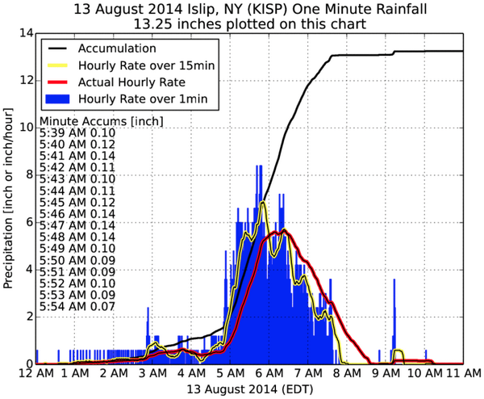
Motivation: Event Recap
24 hour NY precipitation record set at Islip, NY: 345 mm (13.57”)
250 mm (~10”) in 2 h
Convective band of high reflectivity
Training over Islip
Part of larger synoptic scale trough
Accumulation Total (in)
1 min running mean rain rate (in/h)
15 min running mean rain rate (in/h)
1 h running mean rain rate (in/h)
Courtesy of Daryl Herzmann from Iowa State University

Slide 3
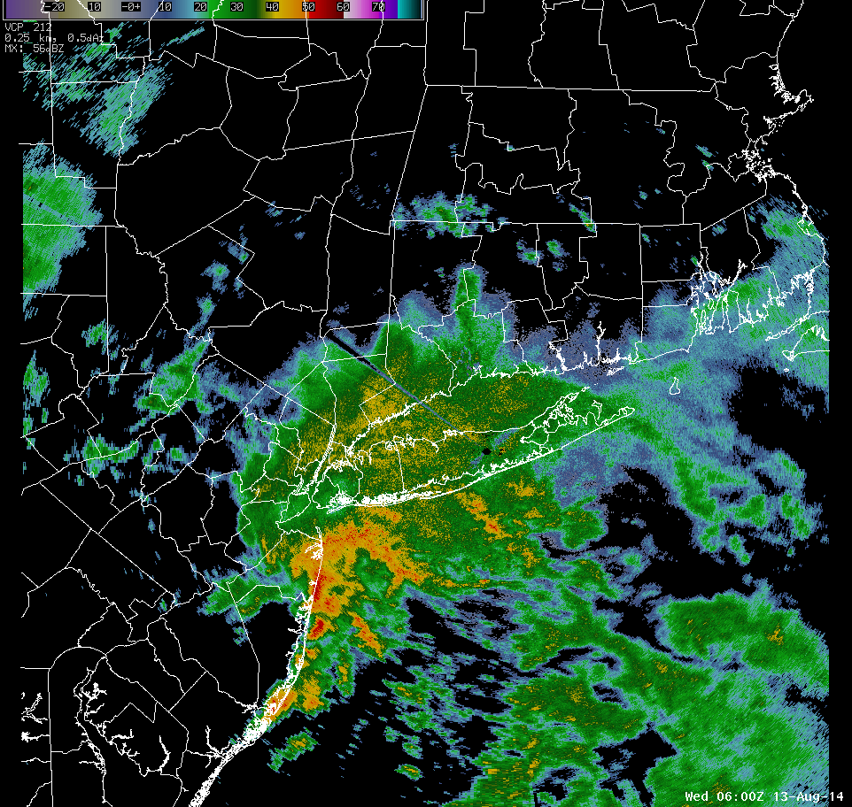
Motivation: Event Recap
24 hour NY precipitation record set at Islip, NY: 345 mm (13.57”)
250 mm (~10”) in 2 h
Convective band of high reflectivity
Training over Islip
Part of larger synoptic scale trough
Courtesy of Mt. Holly NWS

Slide 4
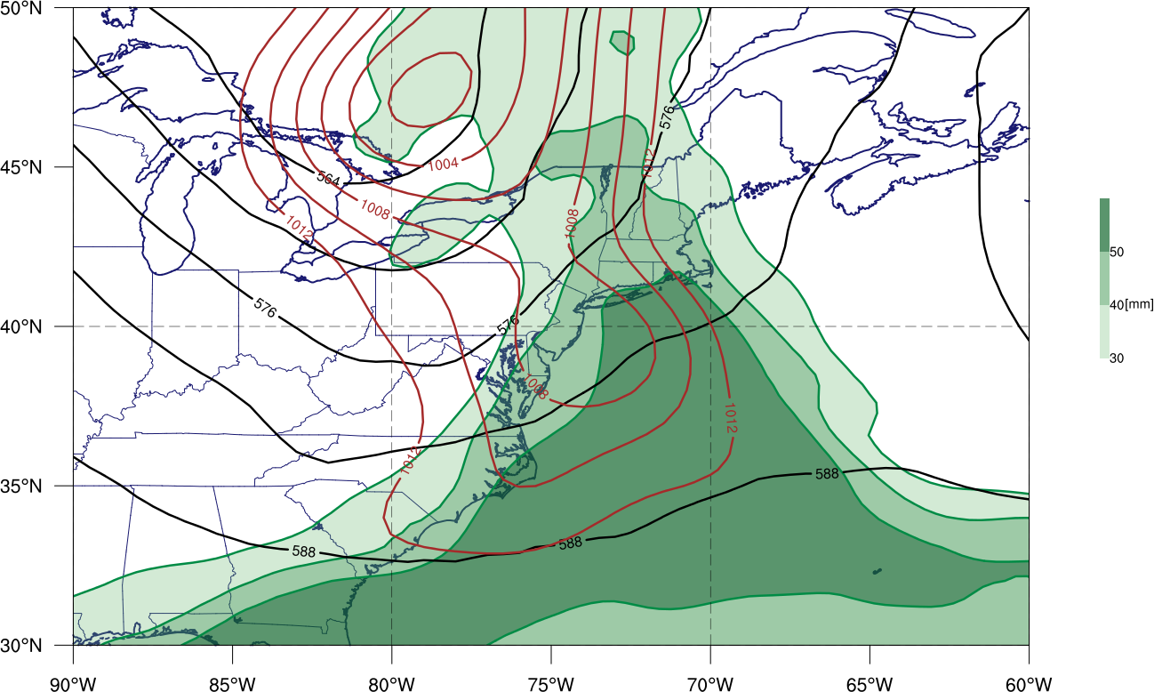
Motivation: Event Recap
24 hour NY precipitation record set at Islip, NY: 345 mm (13.57”)
250 mm (~10”) in 2 h
Convective band of high reflectivity
Training over Islip
Part of larger synoptic scale trough
1200 UTC 13 Aug 2014 Precipitable water (shading, mm), 500-hPa geopotential height (black contours, dam), mean sea level pressure (brown contours, hPa)
L
500-hPa Trough Axis
L
GFS Analysis

Slide 5
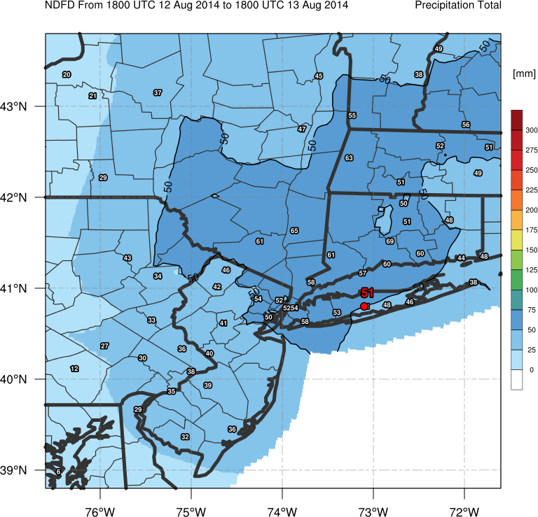
Motivation: Predictability
NDFD Forecast Precipitation Total (0000 UTC – 1800 UTC 13 Aug 2014)
Large region of > 50 mm (2”) of precipitation forecasted across New England
Over forecast of rainfall in Hudson River valley
Under forecast of rainfall in NJ and Long Island
Focus of talk on predictability and meteorology behind Long Island rainfall.
2 – 3”
1 – 2”

Slide 6
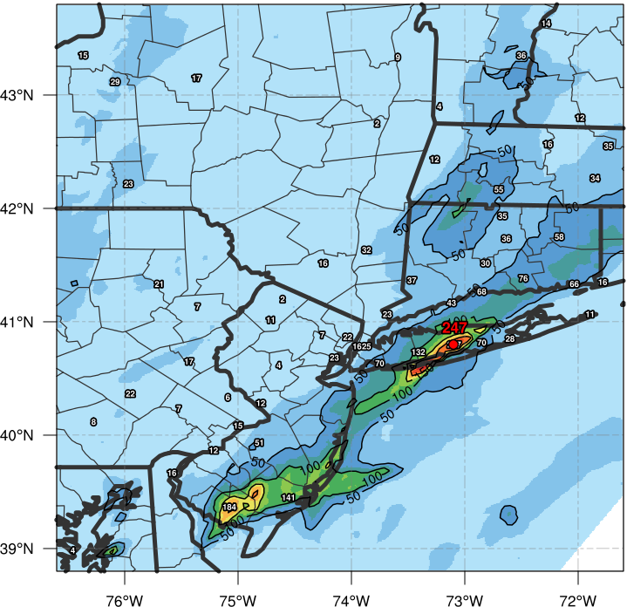
Motivation: Predictability
Stage IV Precipitation Total (0000 UTC – 1800 UTC 13 Aug 2014)
Large region of > 50 mm (2”) of precipitation forecasted across New England
Over forecast of rainfall in Hudson River valley
Under forecast of rainfall in NJ and Long Island
Focus of talk on predictability and meteorology behind Long Island rainfall.
< 1”
> 10”

Slide 7
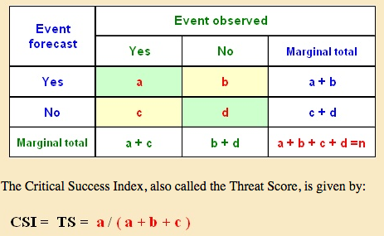
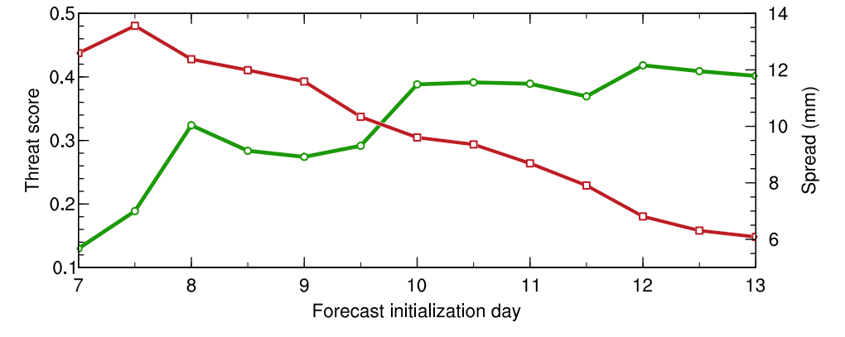
Motivation: Predictability
ECMWF ensemble evolution of forecast precipitation accuracy
Northeast US Domain (35-55ºN / 60-80ºW)
36-h precipitation accumulation forecast valid 1200 UTC 14 Aug
Threat score (TS) given for > 25 mm (1”) amounts (green solid line) and spread (mm)
TS = a / (a+b+c)
Higher than normal predictability of > 1” rainfall region
0.31 WPC average
Decreasing Spread
Notes:
If you plan to keep this slide... Show a reference equitable threat score for this period... How doe the ECMWF ensemble compaire... HPC should have some statistics for similar heavy rainfall events

Slide 8
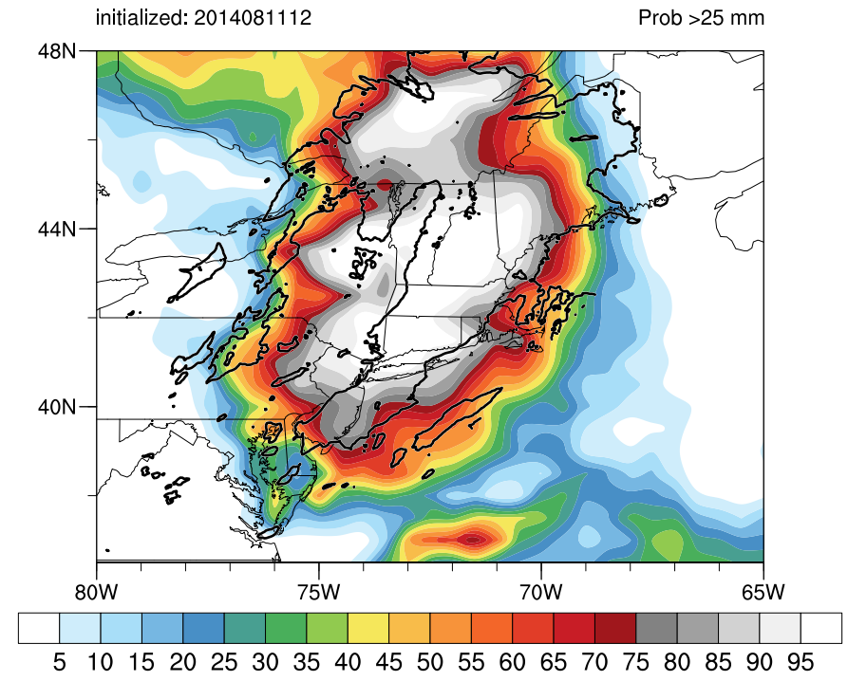
Motivation: Predictability
Precipitation Probabilities
ECMWF Ensemble probability of > 25 mm of precipitation (shaded, %)
Verifying > 25 mm precipitation (black contour, 25 mm)
ECMWF Forecast accurately depicted region of moderate precipitation (> 25 mm)
ECMWF Forecast did not accurately forecast of extreme precipitation amounts (> 100 mm)

Slide 9
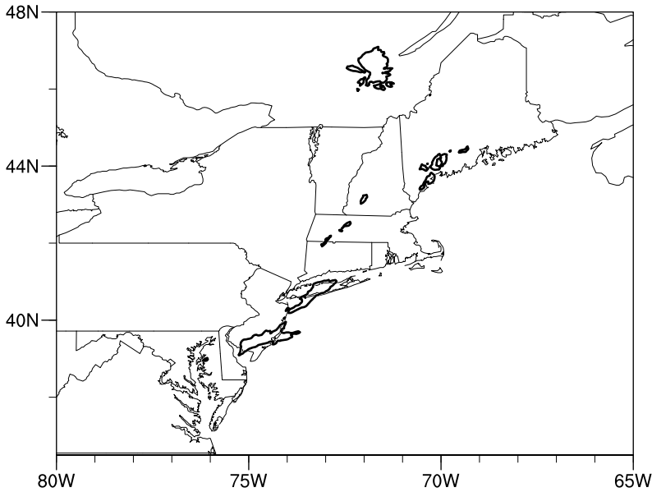
Motivation: Predictability
Precipitation Probabilities
ECMWF Ensemble probability of > 100 mm of precipitation (shaded, %)
Verifying > 100 mm precipitation (black contour, 100 mm)
ECMWF Forecast accurately depicted region of moderate precipitation (> 25 mm)
ECMWF Forecast did not accurately forecast of extreme precipitation amounts (> 100 mm)
ECMWF ensemble does not have sufficient horizontal resolution to resolve this mesoscale event
Failure to forecast extreme precipitation over Long Island

Slide 10
Datasets
51 member ECMWF ensemble
Primarily used to assess synoptic variability
15 member convective permitting WRF ensemble
Investigated in detail to assess mesoscale variability

Slide 11
WRF Ensemble
WRF 15-Member Ensemble
Initialized on 0000 UTC 13 August 2014
Display results of 5 km gridded resolution (inner nest)
All initialized with same 0.5º GFS Analysis
Convective permitting
Physics based ensemble
5 different microphysics parameterizations
3 different boundary layer physics
Results in 15 possible combinations
Planetary Boundary Layer Physics | Microphysics
 | Lin | Ferrier | Goddard | WSM-6 | Thompson
Yonsei University (YSU) | Run_01 | Run_04 | Run_07 | Run_10 | Run_13
Mellor-Yamada-Janic (MYJ) | Run_02 | Run_05 | Run_08 | Run_11 | Run_14
Mellor-Yamada Nakanishi and Niino Level 2.5 (MYNN) | Run_03 | Run_06 | Run_09 | Run_12 | Run_15

Slide 12
WRF Ensemble
Stage IV Precipitation Total (0000 UTC – 1800 UTC 13 Aug 2014)
Simulations organized into 5 “best” and 5 “worst” runs
Determined by how accurately simulation captures PDF of high end total rainfall
> 100 mm
Grid points restricted to counties near Long Island
Best runs more accurately capture tail end of verifying PDF
Better predict high end total rainfall

Slide 13
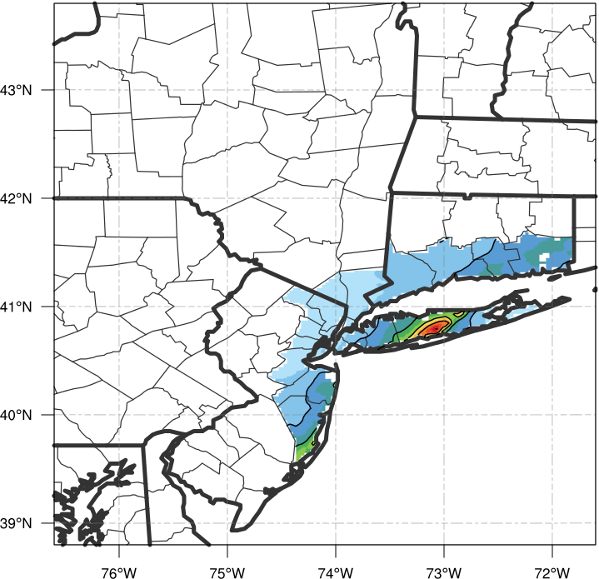
WRF Ensemble
Stage IV Precipitation Total (0000 UTC – 1800 UTC 13 Aug 2014)
Simulations organized into 5 “best” and 5 “worst” runs
Determined by how accurately simulation captures PDF of high end total rainfall
> 100 mm
Grid points restricted to counties near Long Island
Best runs more accurately capture tail end of verifying PDF
Better predict high end total rainfall

Slide 14
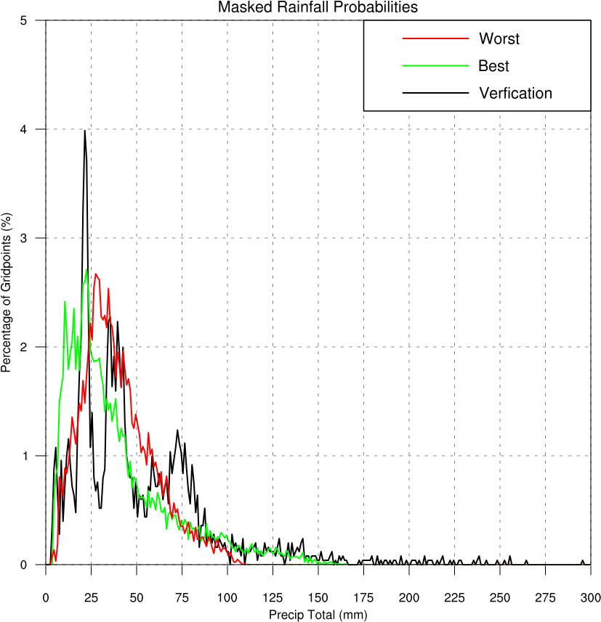
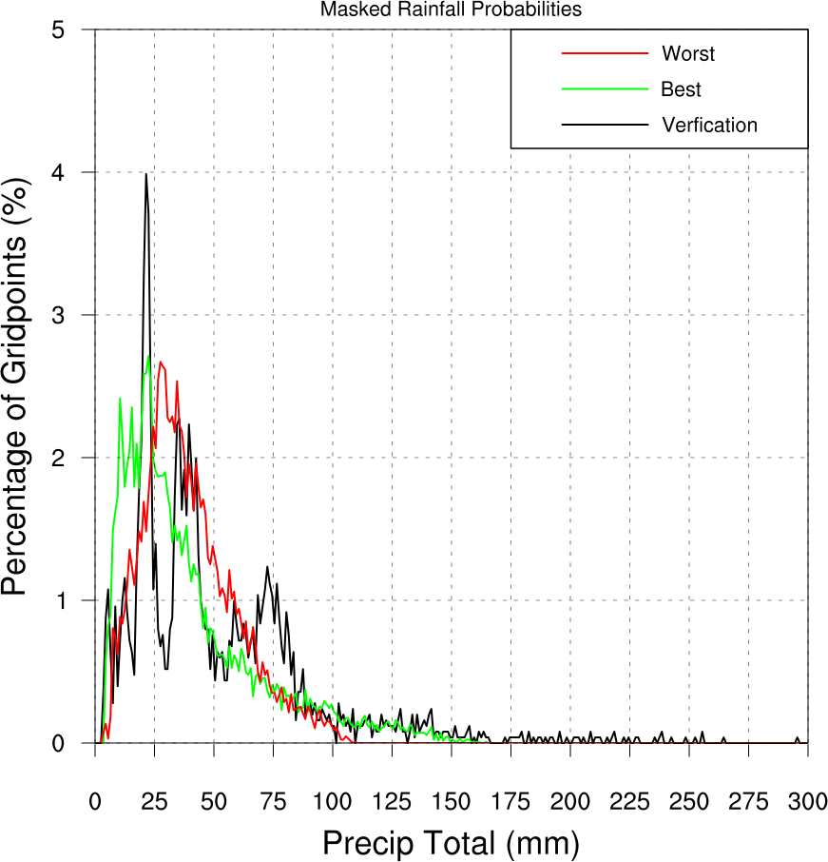
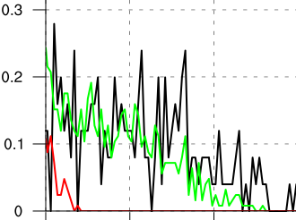
WRF Ensemble
Simulations organized into 5 “best” and 5 “worst” runs
Determined by how accurately simulation captures PDF of high end total rainfall
> 100 mm
Grid points restricted to counties near Long Island
Best runs more accurately capture tail end of verifying PDF
Better predict high end total rainfall
N = 2508 grid points
Binned every 1 mm

Slide 15
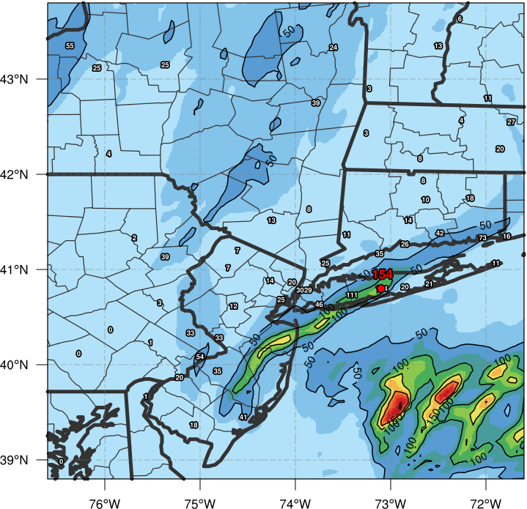
WRF Ensemble
Run 07 Precipitation Total (0000 UTC – 1800 UTC 13 Aug 2014)
Compare Runs
Best Simulation (run_07)
Goddard Microphysics
YSU Boundary Layer Physics
Bad Simulation (run_02)
Lin Microphysics
MYJ Boundary Layer Physics
Linear band of > 100 mm totals close to verification

Slide 16
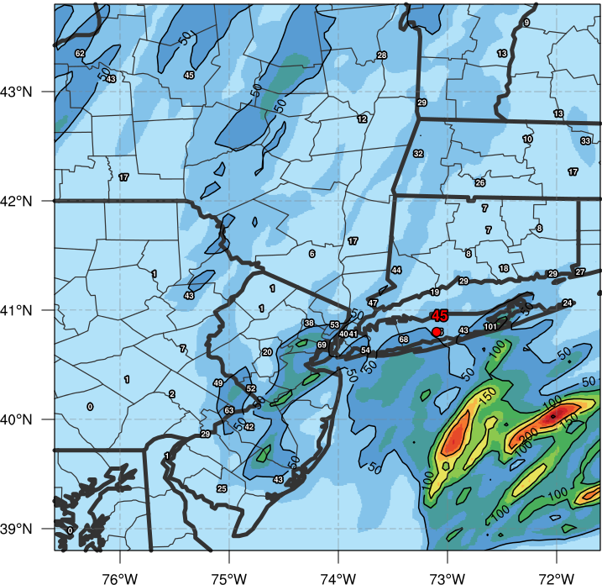
WRF Ensemble
Run 02 Precipitation Total (0000 UTC – 1800 UTC 13 Aug 2014)
Compare Runs
Best Simulation (run_07)
Goddard Microphysics
YSU Boundary Layer Physics
Bad Simulation (run_02)
Lin Microphysics
MYJ Boundary Layer Physics
Lack of focused precipitation totals
Remainder of talk will compare these two simulations

Slide 17
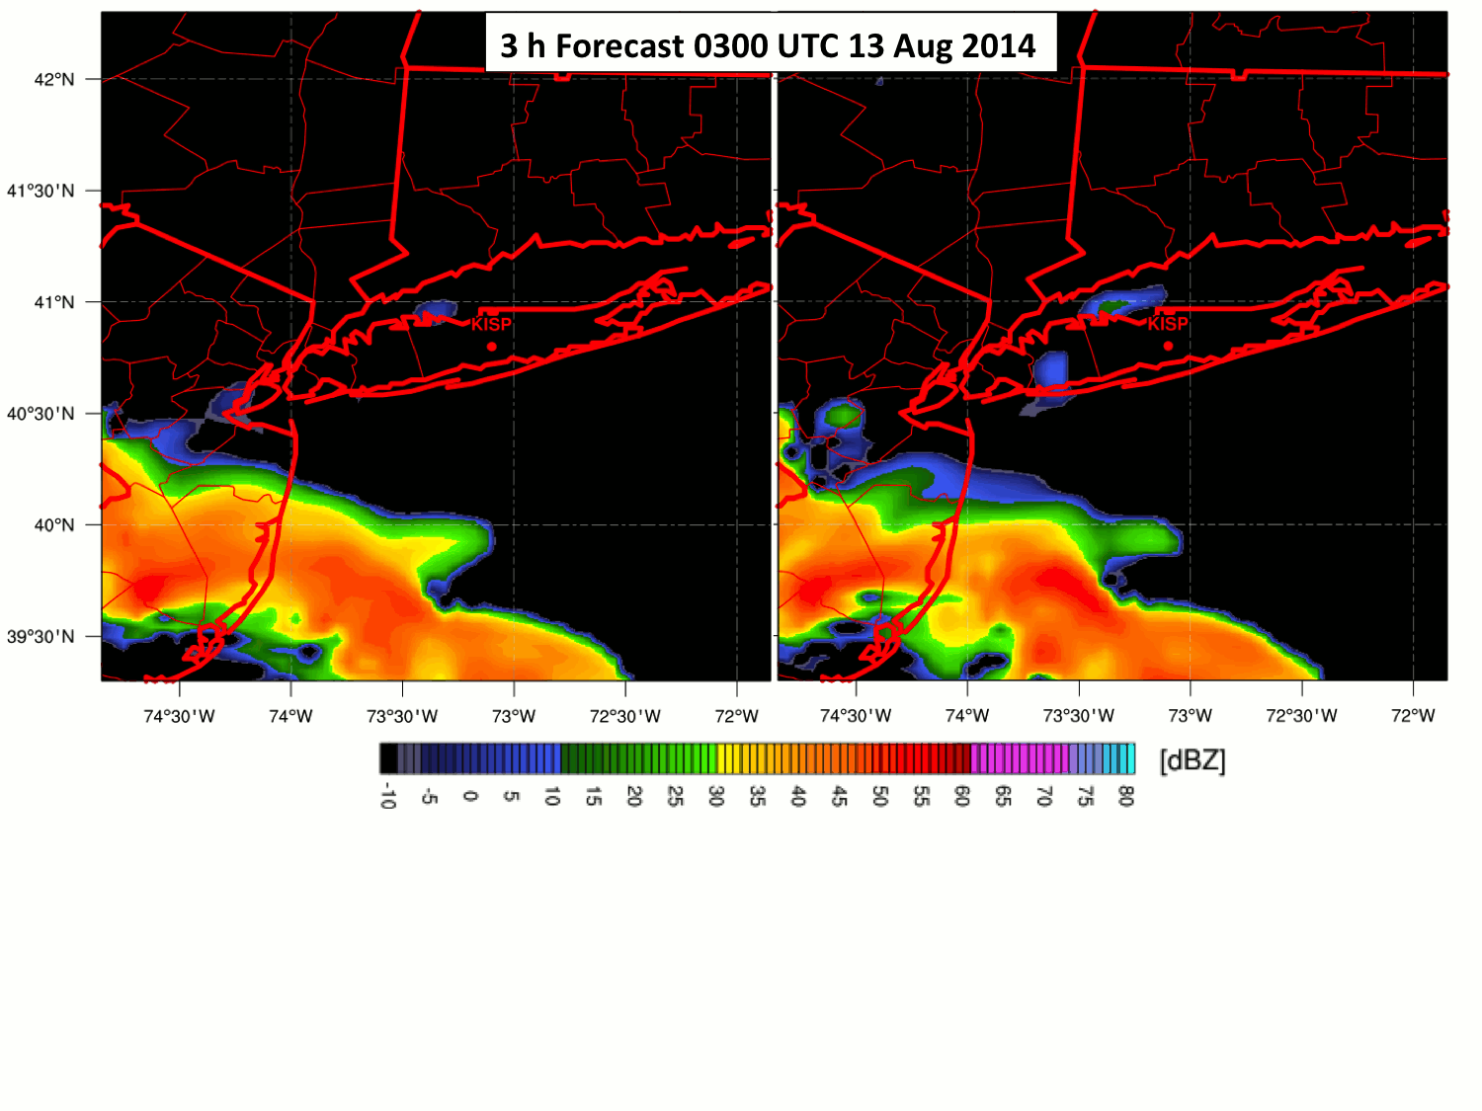
WRF Ensemble
Reflectivity Animation
Lowest layer reflectivity (shading, dBZ)
Best Member
Bad Member

Slide 18
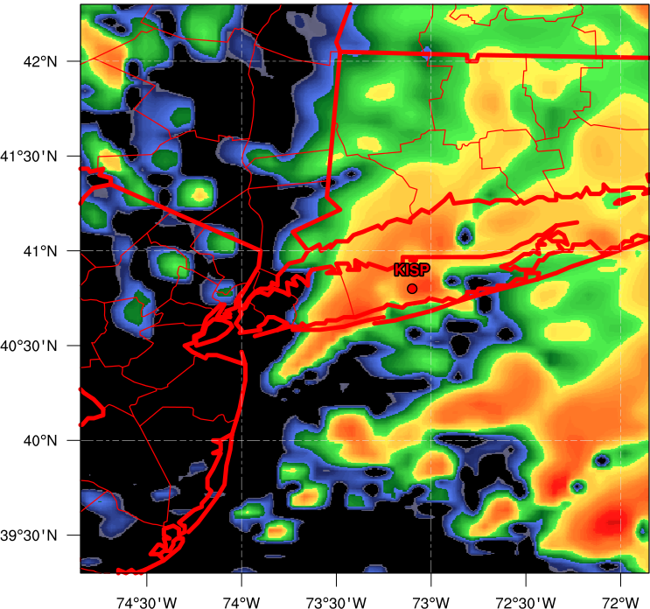
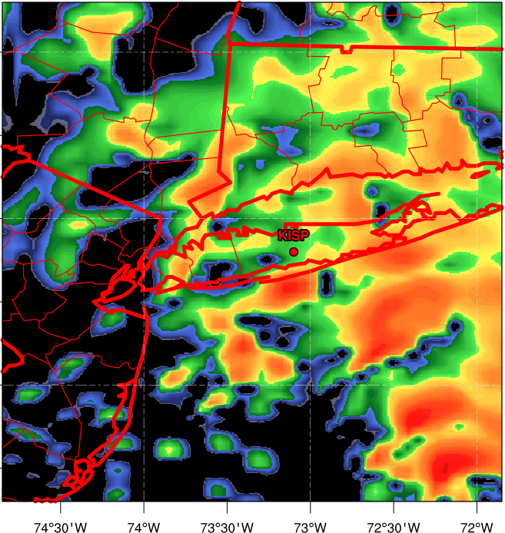
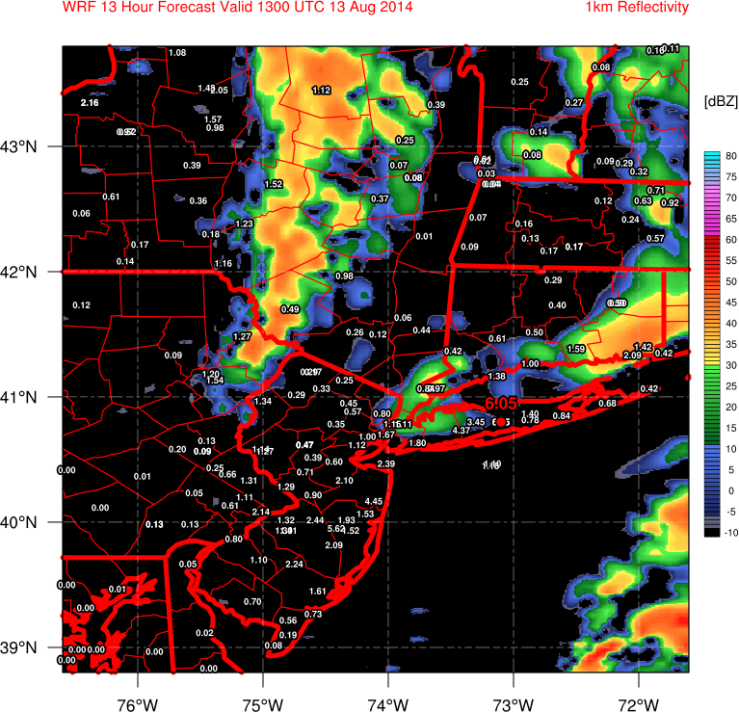
WRF Ensemble
Reflectivity
Lowest layer reflectivity (shading, dBZ)
Best Member
9 h Forecast 0900 UTC 13 Aug 2014
Bad Member
Organized, training reflectivity band evident in best run, while bad run only shows scattered convection

Slide 19
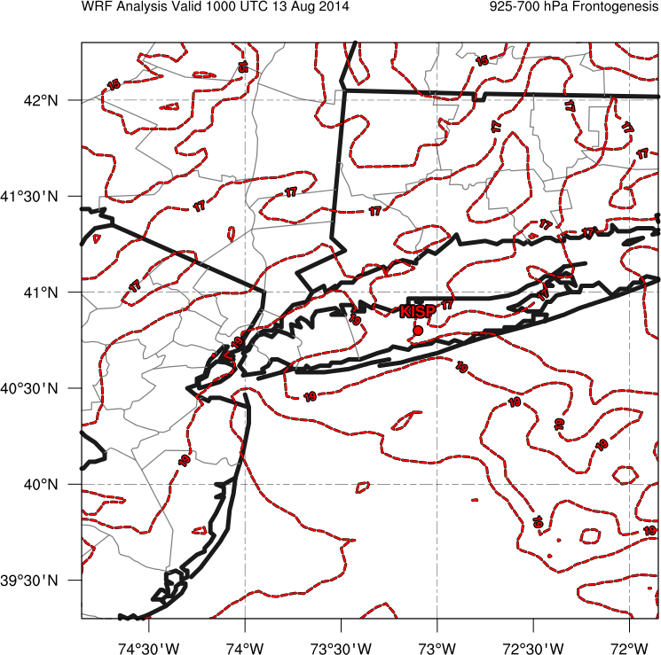
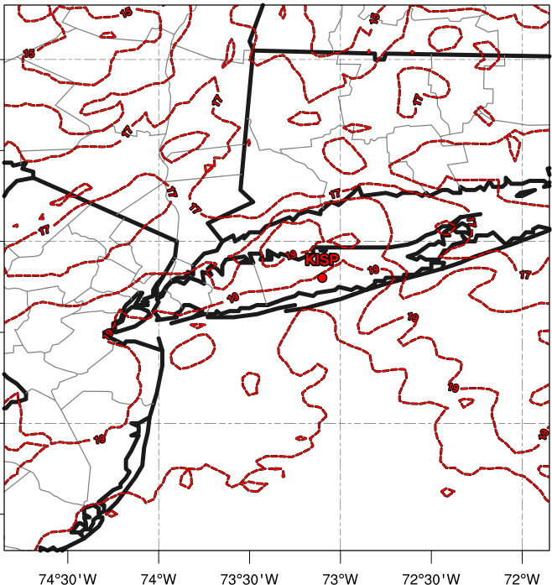
WRF Ensemble
Mesoscale Forcing
1000 – 850-hPa layer mean temperature (ºC, red dotted contours)
Best Member
10 h Forecast 1000 UTC 13 Aug 2014
Bad Member
Weak Temperature Gradient
Notes:
Layer mean frontogenesis?

Slide 20
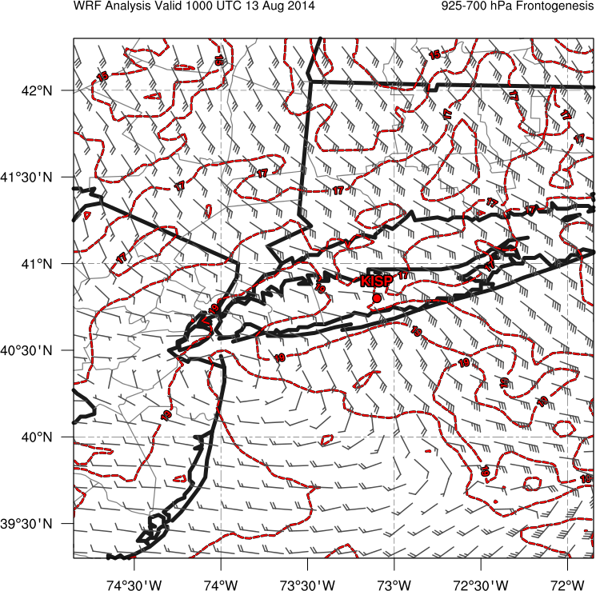
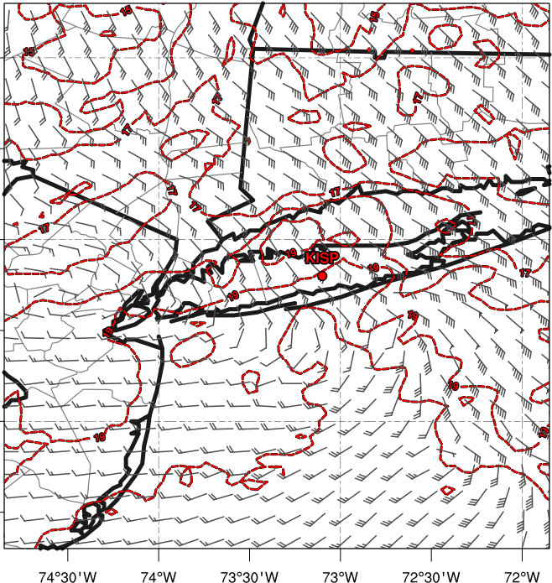
WRF Ensemble
Mesoscale Forcing
1000 – 850-hPa layer mean temperature (ºC, red dotted contours), 1000 – 850-hPa layer mean winds (kt, barbs)
Best Member
10 h Forecast 1000 UTC 13 Aug 2014
Bad Member
L
L
40+ kt
Notes:
Layer mean frontogenesis?

Slide 21
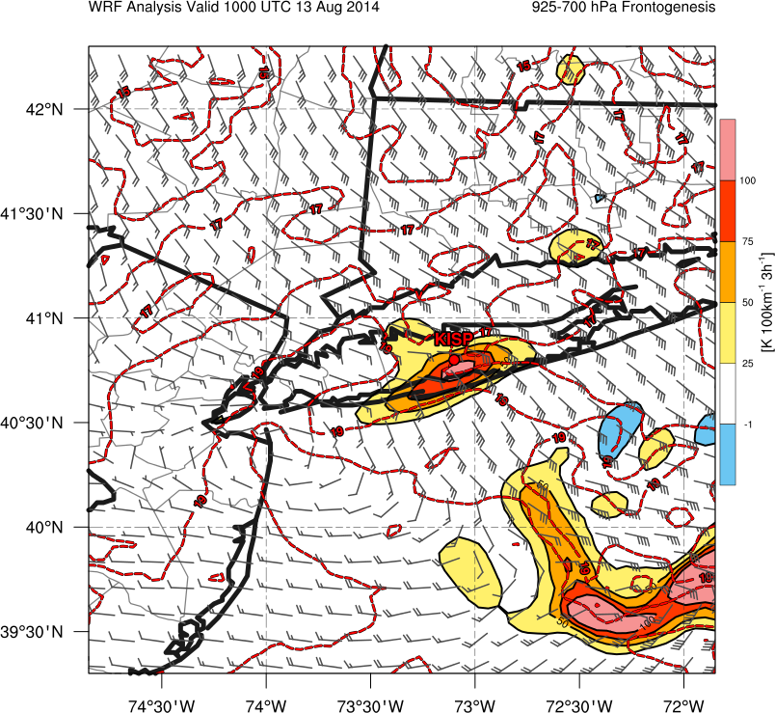
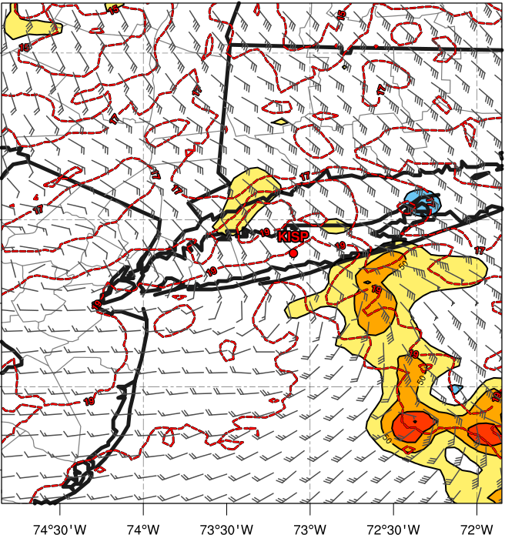
WRF Ensemble
Mesoscale Forcing
1000 – 850-hPa layer mean temperature (ºC, red dotted contours), 1000 – 850-hPa layer mean winds (kt, barbs), 1000 – 850-hPa layer mean frontogenesis (K 100km ⁻¹ 3h⁻¹, shaded)
Best Member
10 h Forecast 1000 UTC 13 Aug 2014
Bad Member
Strong Frontogenesis
L
L
40+ kt
Notes:
Layer mean frontogenesis?

Slide 22
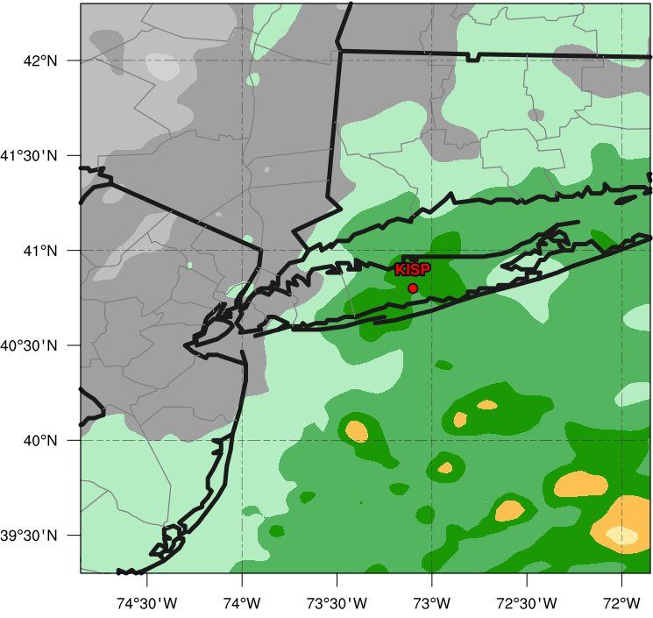
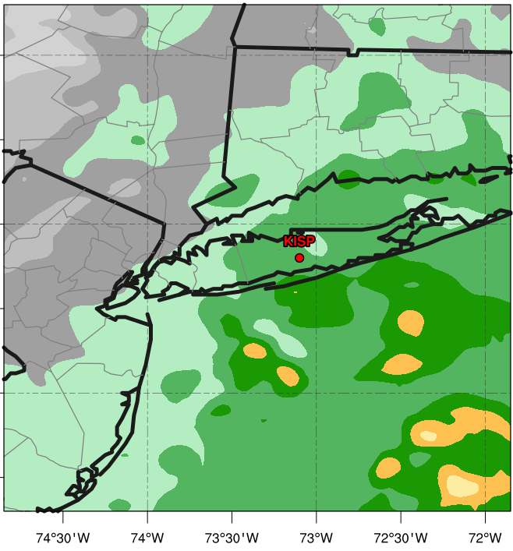
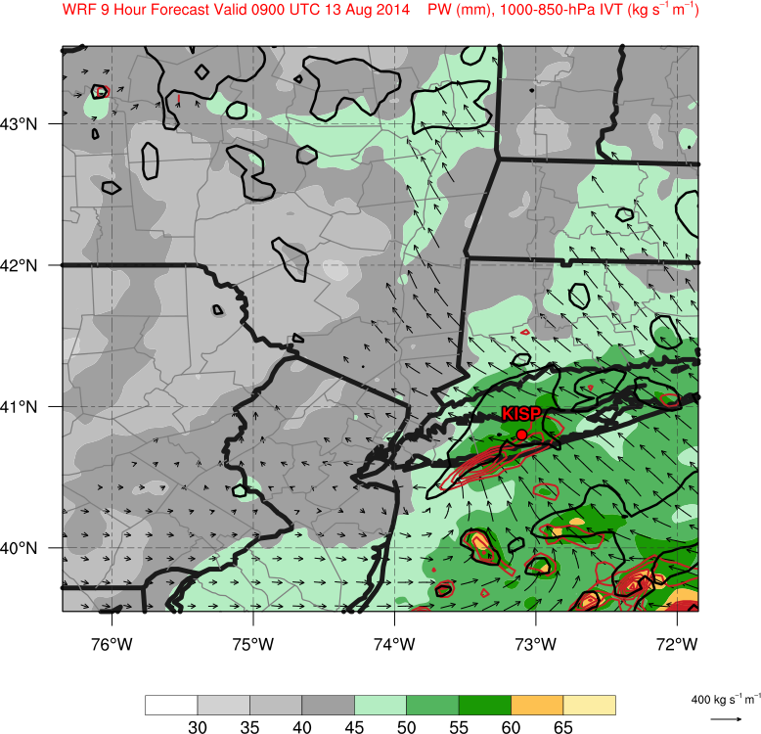
WRF Ensemble
Moisture
Precipitable Water (mm, shaded)
Best Member
9 h Forecast 0900 UTC 13 Aug 2014
Bad Member
55.2 mm PW

Slide 23
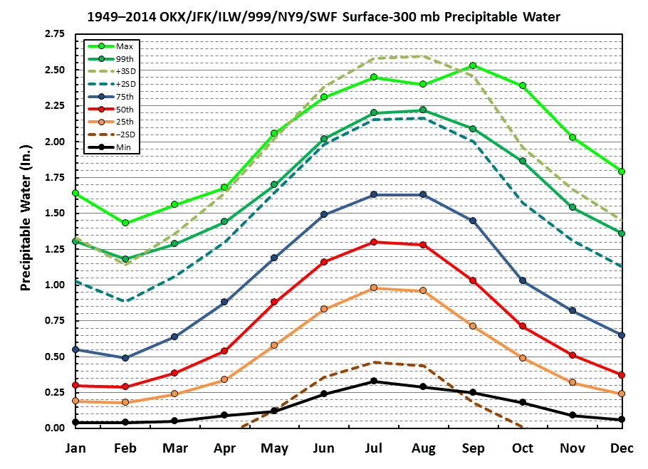
WRF Ensemble
Moisture
Precipitable water (mm, shaded)
Best Member
9 h Forecast 0900 UTC 13 Aug 2014
Bad Member
2.17” PW
> 95th percentile

Slide 24
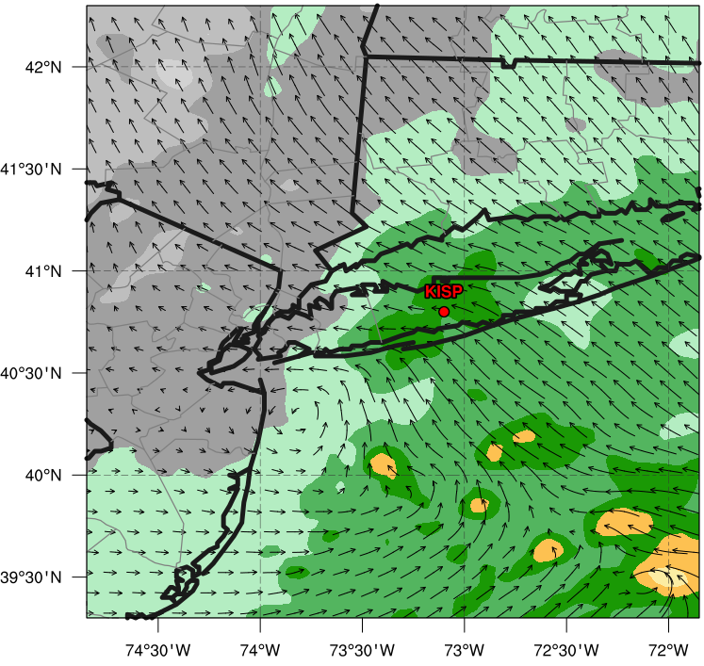
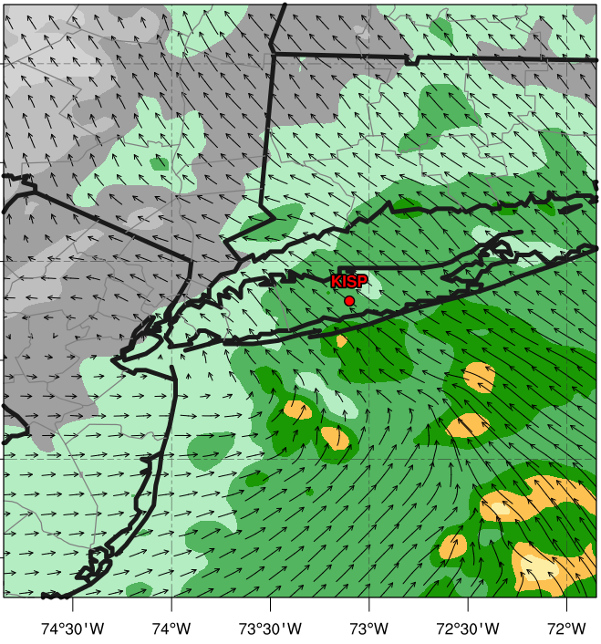
WRF Ensemble
Moisture Transport
Precipitable water (mm, shaded), 1000 – 850-hPa integrated vapor transport (vectors, kg s⁻¹ m⁻¹)
Best Member
9 h Forecast 0900 UTC 13 Aug 2014
Bad Member
L
L

Slide 25
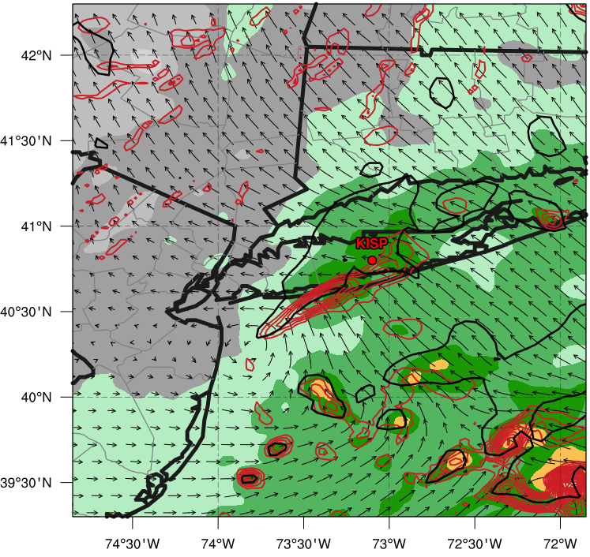
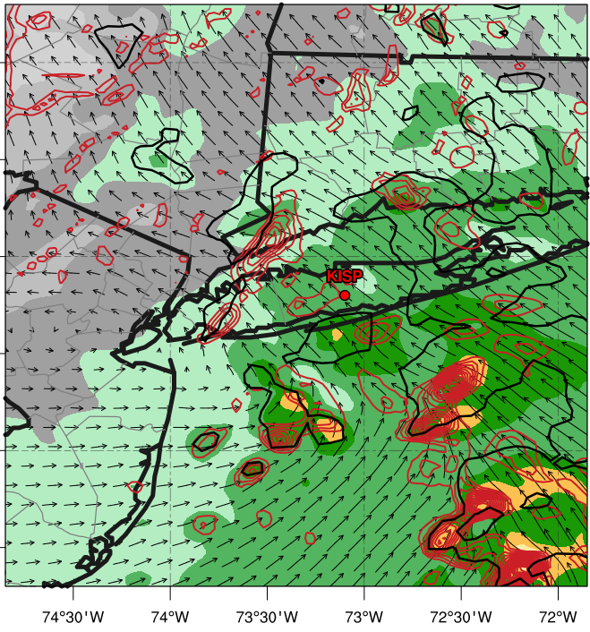
WRF Ensemble
Moisture Transport
Precipitable water (mm, shaded), 1000 – 850-hPa integrated vapor transport (vectors, kg s⁻¹ m⁻¹), 1000 – 850-hPa integrated vapor flux convergence (10⁻³ kg s⁻¹, red contours), reflectivity (> 35 dBZ, black contour)
Best Member
9 h Forecast 0900 UTC 13 Aug 2014
Bad Member
Moisture flux convergence along leading edge of reflectivity
L
L

Slide 26
Conclusions
ECMWF Ensemble depicts predictable synoptic scale event
Low spread and decent verification of moderate precipitation
Cannot predict concentrated extreme precipitation totals due to coarse resolution among other things
Best WRF member captures event evolution
Strong low-level frontogenesis aids in mesoscale organization of convection
Coastal front well depicted in best simulation, but absent in bad simulation
Strong low-level moisture flux convergence aids in enhancing precipitation totals
Precipitable water over KISP in best simulation > 95th percentile for August
Future work will investigate why particular WRF ensemble members had superior forecast
Microphysics, Boundary Layer Physics?

Slide 27

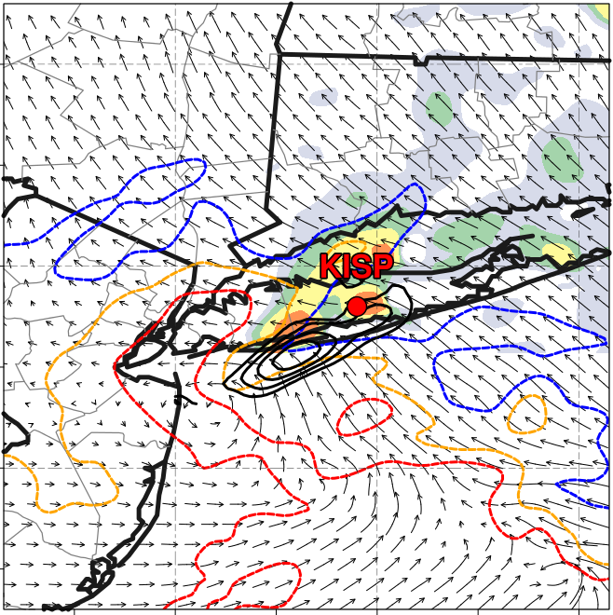

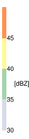
Summary Schematic
L
L
17ºC
V_{sfc} < 5 m s⁻¹
C_{front}
PW > 50mm
18ºC
F_{gen}
V₁₀₀₀₋₈₅₀
> 20 m s⁻¹
L
Main: 500-hPa geopotential height (black contours, every 6 dam) precipitable water (shaded, mm), mean sea level pressure (brown contours, every 2 hPa)
Inset: 1km Reflectivity (shaded, dBZ), 900-hPa temperature (colored contours, from 17-19ºC), 1000 – 850-hPa layer mean frontogenesis (black contours, starting at 30 K 100 km⁻¹ 3h⁻¹), 1000 – 850-hPa integrated vapor transport (vectors, kg s⁻¹ m⁻¹)
19ºC

Slide 28
Extra Slides

Slide 29
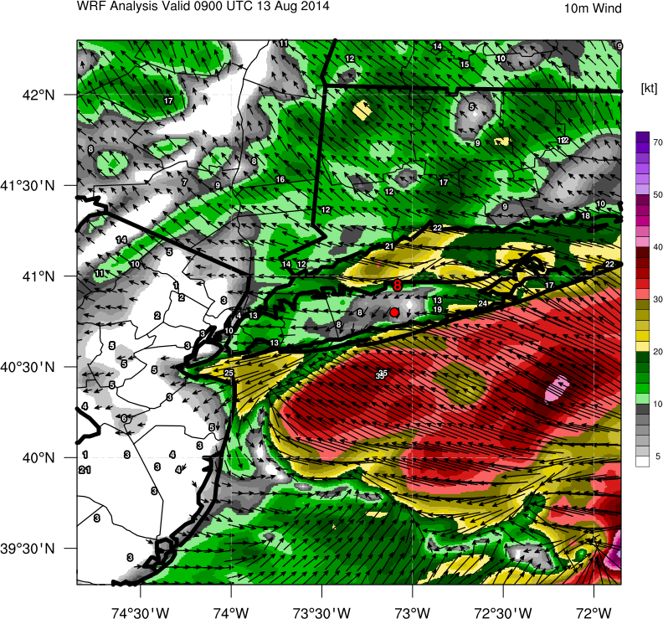
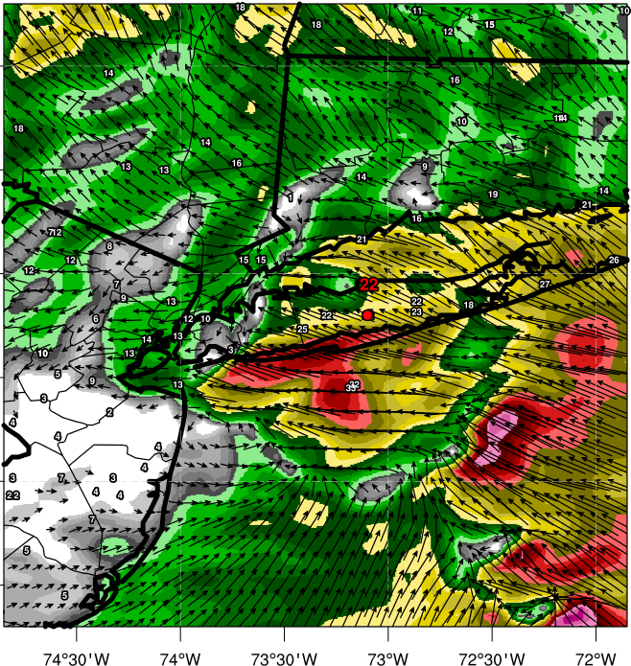
WRF Ensemble
Winds
10 m wind magnitude (shading, kt), 10 m wind direction (vectors, kt)
Best Member
9 h Forecast 0900 UTC 13 Aug 2014
Bad Member
Strong Moisture Flux Convergence
L
L

Slide 30
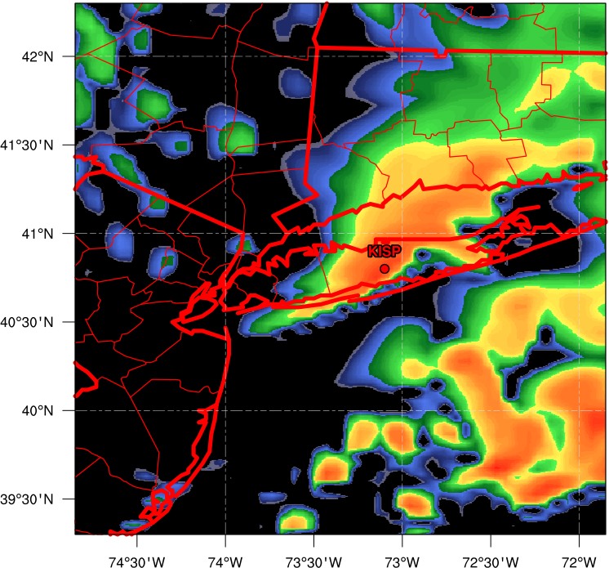
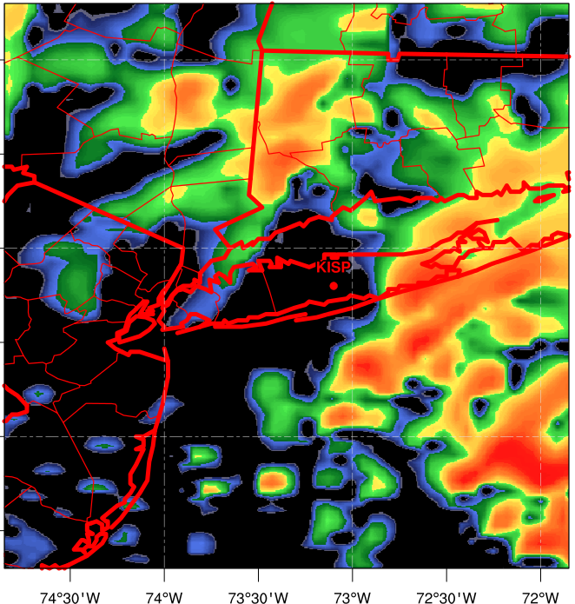
WRF Ensemble
Mesoscale Forcing
Lowest Layer Reflectivity (shading, dBZ)
10h Forecast 1000 UTC 13 Aug 2014
Best Member
Bad Member
A
A
B
B

Slide 31
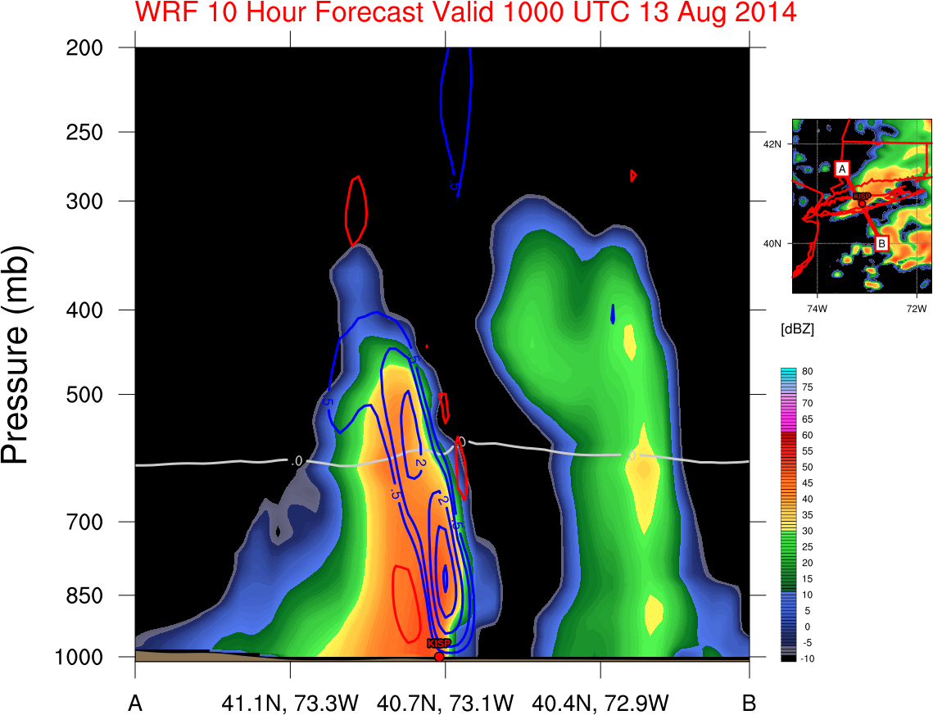
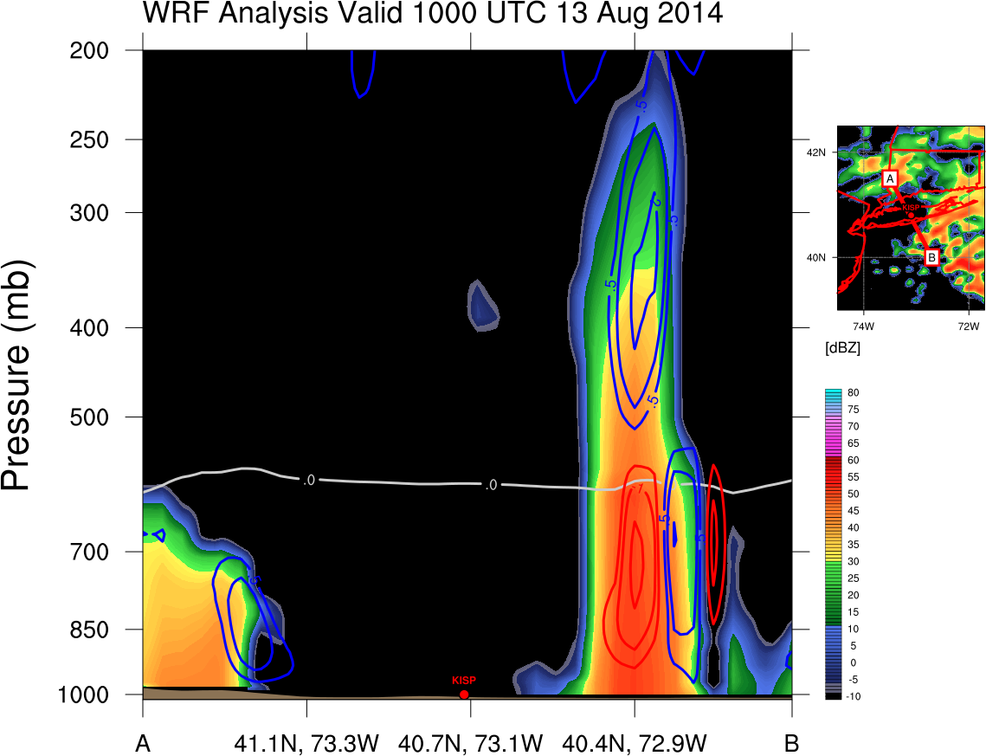
WRF Ensemble
Cross Section Analysis
Reflectivity (shading, dBZ), Vertical Motion (blue contours upward, red contours downward, m s⁻¹), 0ºC Isotherm (gray contour)
10h Forecast 1000 UTC 13 Aug 2014
Best Member
Bad Member
Strongest ascent and reflectivity occurs below 0ºC isotherm (warm precipitation processes dominate)

Slide 32
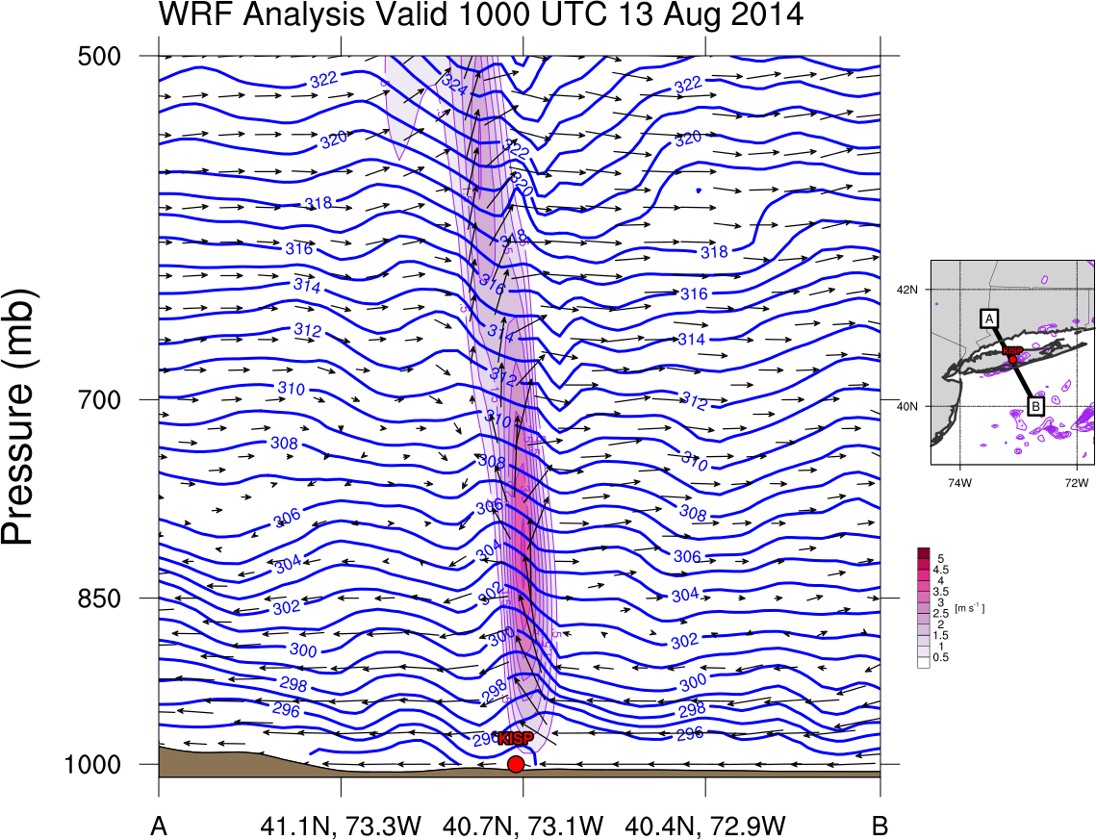
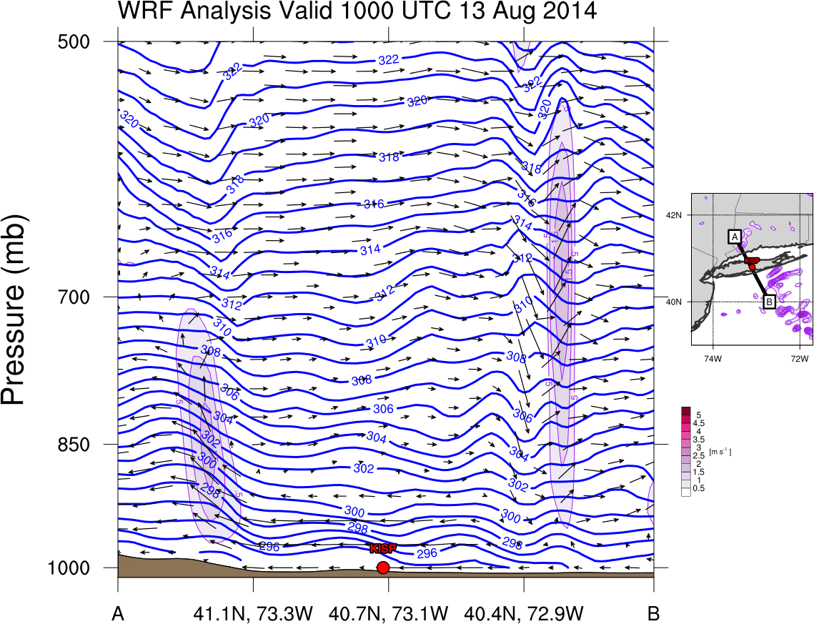
WRF Ensemble
Cross Section Analysis
Vertical Motion (upward shaded, m s⁻¹), Isentropes (blue contours, every 1K), zonal wind + vertical wind (scaled vectors to illustrate ascent)
10h Forecast 1000 UTC 13 Aug 2014
Best Member
Bad Member

Slide 33
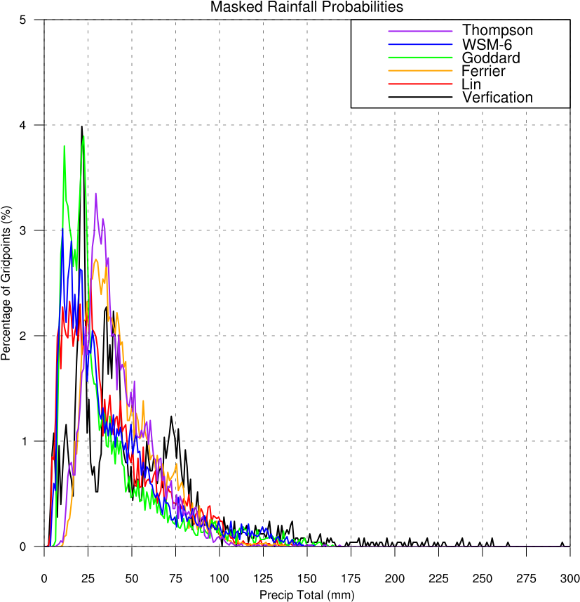
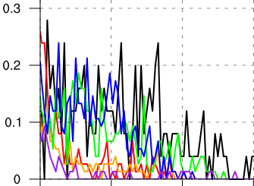
WRF Ensemble
Comparison by Physics
Microphysics
WSM-6 and Goddard closest to verification
Planetary Boundary Layer
YSU closest to verification
N = 2508 grid points

Slide 34
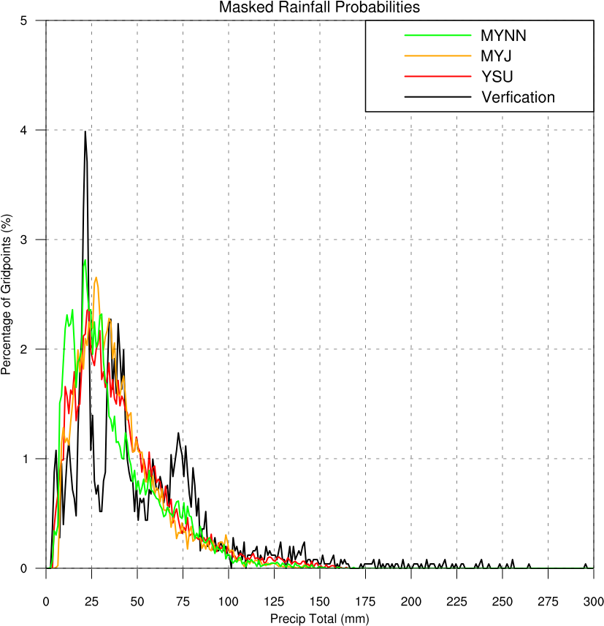
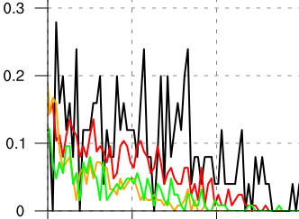
WRF Ensemble
Comparison by Physics
Microphysics
WSM-6 and Goddard closest to verification
Planetary Boundary Layer
YSU closest to verification
N = 2508 grid points

Slide 35
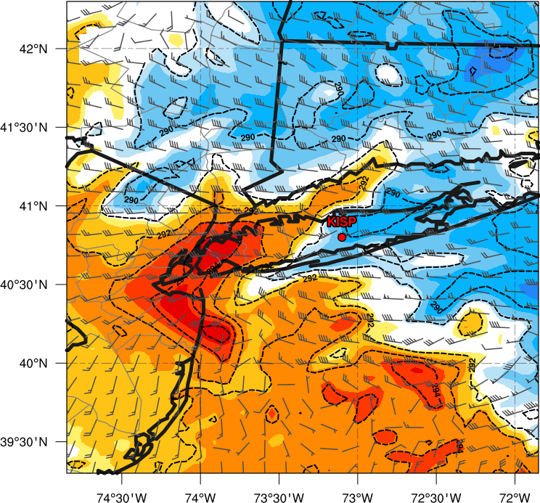
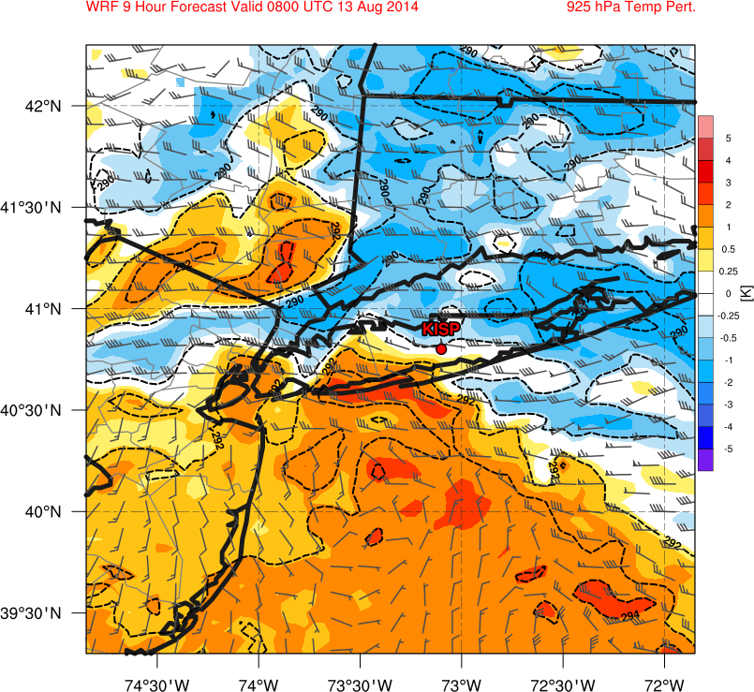
WRF Ensemble
Mesoscale Forcing
925-hPa Perturbation Temperature (color shading, K), 925-hPa Temperature (black dotted contours, K) 925 – 700-hPa Vertical Wind Shear (barbs, kt)
8 h Forecast 0800 UTC 13 Aug 2014
Best Member
Bad Member

