Slide 1
Tropical Cyclone Interactions Within Gyre Circulations in the Atlantic Basin
Philippe P. Papin, Ryan D. Torn, Lance F. Bosart
Department of Atmospheric and Environmental Sciences
University at Albany, State University of New York
International Conference on Mesoscale Meteorology and Tropical Cyclones
15 September 2014
Funding provided by NSF grant ATM-0849491

Slide 2
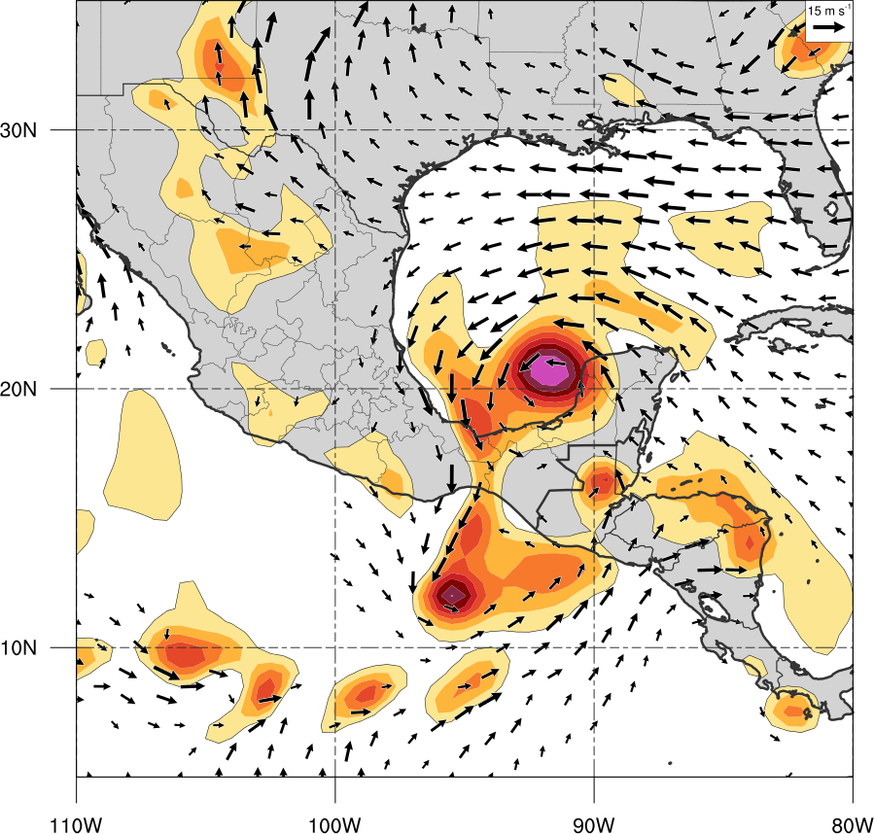
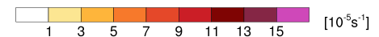
Motivation
850-hPa cyclonic vorticity (shaded, > 1 x 10⁻⁵ s⁻¹)
850-hPa Winds (vectors, 5-15 m s⁻¹)
Gyre circulations are rarely studied in the Atlantic basin
Sometimes associated with Tropical Cyclones (TCs)
Frequently result in significant societal impact (flooding)
Track uncertainty resulting from gyre – tropical cyclone (TC) interactions
TC Stan (2005)
1200 UTC 3 Oct 2005

Slide 3
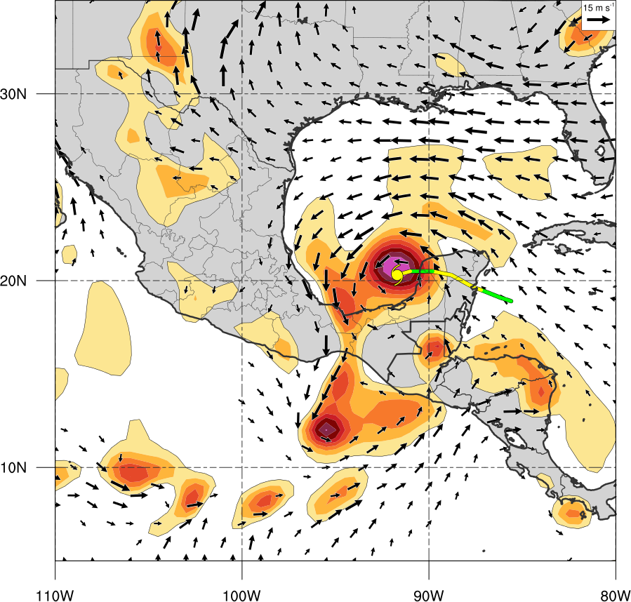
Motivation
850-hPa cyclonic vorticity (shaded, > 1 x 10⁻⁵ s⁻¹)
850-hPa winds (vectors, 5-15 m s⁻¹)
Gyre circulations are rarely studied in the Atlantic basin
Sometimes associated with Tropical Cyclones (TCs)
Frequently result in significant societal impact (flooding)
Track uncertainty resulting from gyre – tropical cyclone (TC) interactions
TC Stan (2005)
1200 UTC 3 Oct 2005
TC Stan

Slide 4
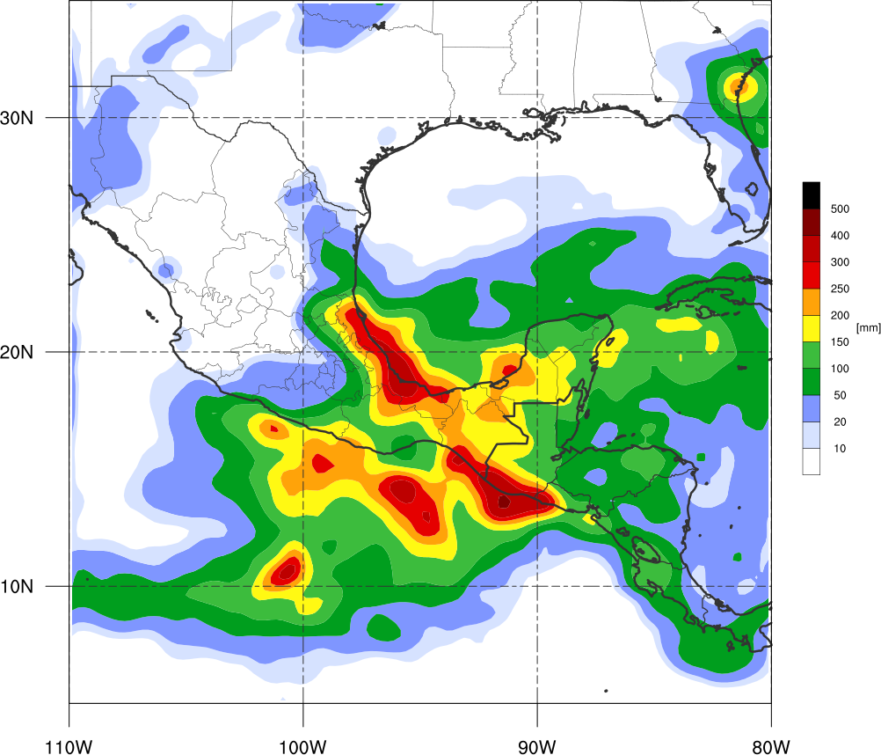
Motivation
TRMM rainfall totals 01 Oct – 06 Oct 2005
Gyre circulations are rarely studied in the Atlantic basin
Sometimes associated with Tropical Cyclones (TCs)
Frequently result in significant societal impact (flooding)
Track uncertainty resulting from gyre – tropical cyclone (TC) interactions
TC Stan (2005)
TC Stan + Central American Gyre
1000-2000 deaths due to flooding (Pasch and Roberts 2006)

Slide 5
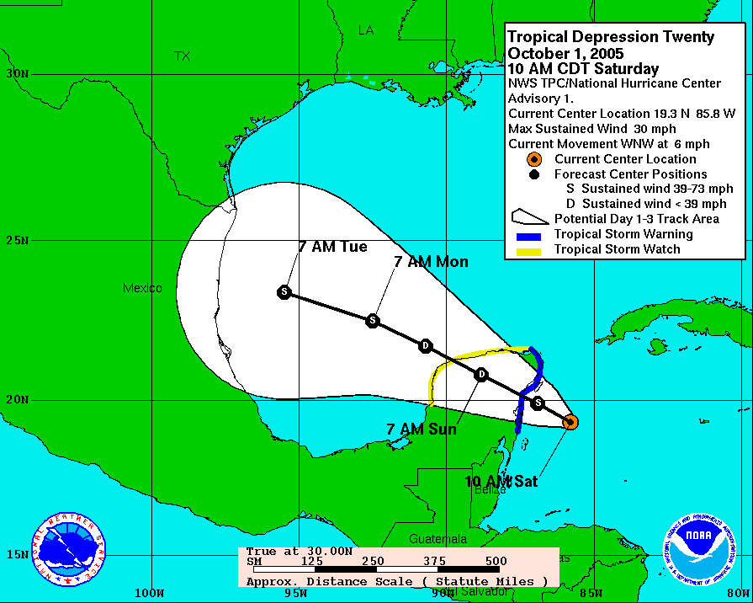
Motivation
Gyre circulations are rarely studied in the Atlantic basin
Sometimes associated with Tropical Cyclones (TCs)
Frequently result in significant societal impact (flooding)
Track uncertainty resulting from gyre – tropical cyclone (TC) interactions
TC Stan (2005)
TC Stan

Slide 6
Motivation
Gyre circulations are rarely studied in the Atlantic basin
Sometimes associated with Tropical Cyclones (TCs)
Frequently result in significant societal impact (flooding)
Track uncertainty resulting from gyre – tropical cyclone (TC) interactions
TC Stan (2005)
TC Stan
Actual 72 h Track

Slide 7
Motivation
Gyre circulations are rarely studied in the Atlantic basin
Sometimes associated with Tropical Cyclones (TCs)
Frequently result in significant societal impact (flooding)
Track uncertainty resulting from gyre – tropical cyclone (TC) interactions
TC Stan (2005)
TC Stan + Central American Gyre
Actual 72 h Track
Gyre?

Slide 8
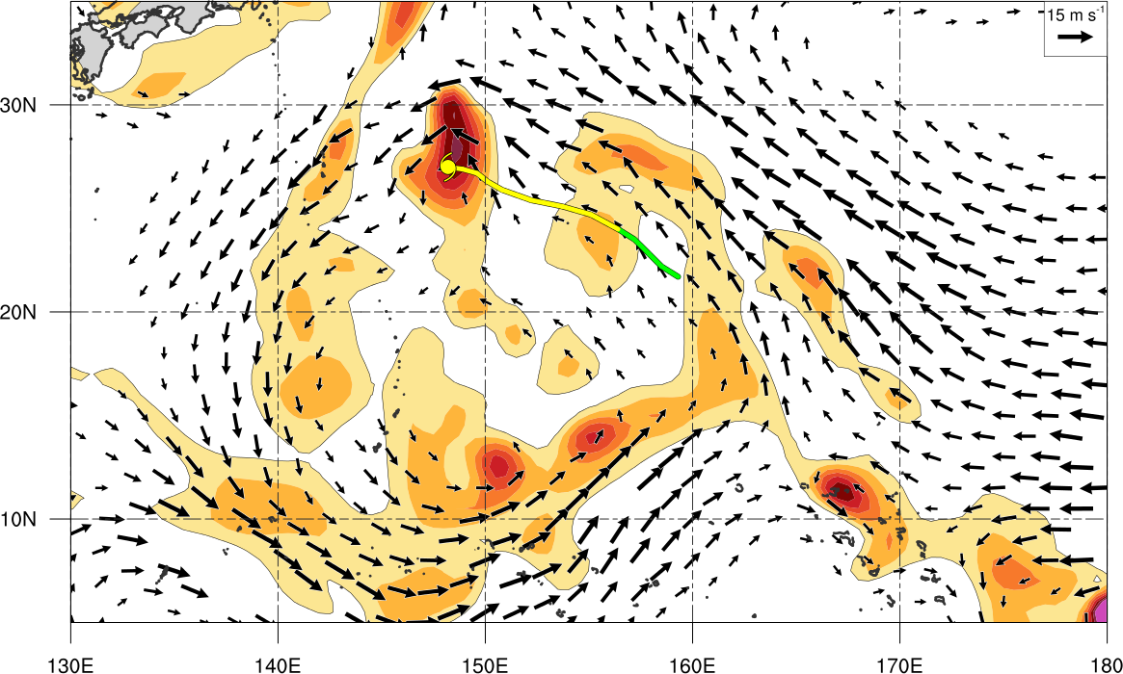
Literature Review
Monsoon Gyre (MG)
Lander (1994), Carr and Elsberry (1995), Molinari and Vollaro (2012)
1200 UTC 12 Aug 1991
TC Ellie
Gyre identified by Lander (1994)
850-hPa cyclonic vorticity (shaded, > 1 x 10⁻⁵ s⁻¹)
850-hPa winds (vectors, 5-15 m s⁻¹)

Slide 9

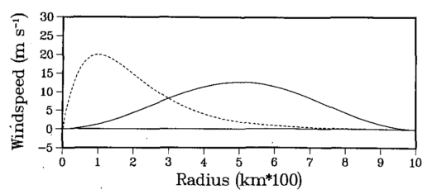
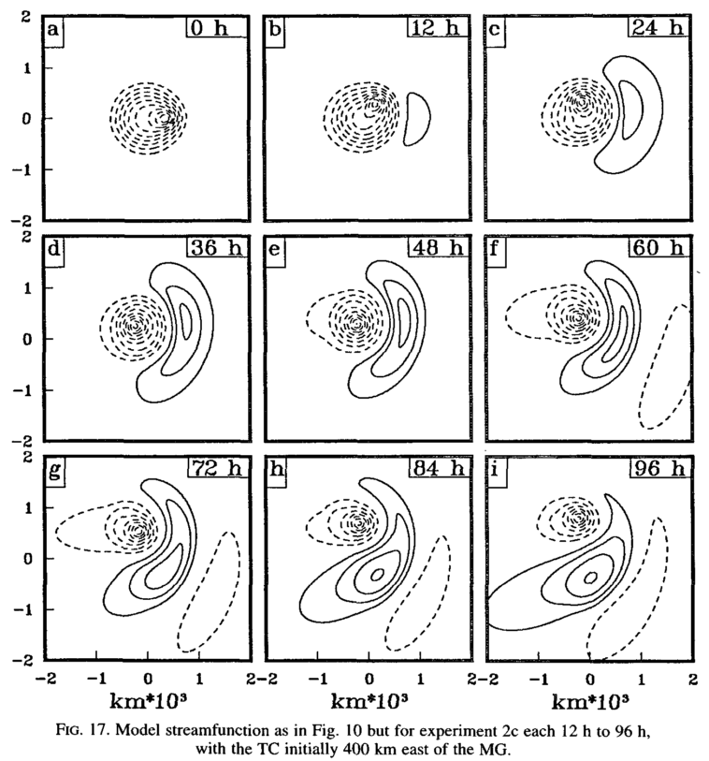
Literature Review
Carr and Elseberry (1995)
Nondivergent barotropic model
Simulated interaction between MG and TC
TC
400 km apart
MG
TC
MG
Initial radial distribution of tangential wind

Slide 10
Literature Review
Carr and Elseberry (1995)
Nondivergent barotropic model
Simulated interaction between MG and TC
Binary interaction of smaller TC within larger MG, resulting in cyclonic track of TC ending in absorption into MG.
Propagation of MG primarily due to beta drift induced by this streamfunction asymmetry (Boos and Hurley 2014)
Advection of planetary vorticity around MG circulation
TC
MG
Streamfunction: contour interval 1 x 10⁶ m² s⁻¹ negative (positive) dashed (solid)

Slide 11
Literature Review
Carr and Elseberry (1995)
Nondivergent barotropic model
Simulated interaction between MG and TC
Binary interaction of smaller TC within larger MG, resulting in cyclonic track of TC ending in absorption into MG.
Propagation of MG primarily due to beta drift induced by this streamfunction asymmetry (Boos and Hurley 2014)
Advection of planetary vorticity around MG circulation
Streamfunction: contour interval 1 x 10⁶ m² s⁻¹ negative (positive) dashed (solid)

Slide 12
Literature Review
Carr and Elseberry (1995)
Nondivergent barotropic model
Simulated interaction between MG and TC
Binary interaction of smaller TC within larger MG, resulting in cyclonic track of TC ending in absorption into MG.
Propagation of MG primarily due to beta drift induced by this streamfunction asymmetry (Boos and Hurley 2014)
Advection of planetary vorticity around MG circulation
Streamfunction: contour interval 1 x 10⁶ m² s⁻¹ negative (positive) dashed (solid)

Slide 13
Literature Review
Carr and Elseberry (1995)
Nondivergent barotropic model
Simulated interaction between MG and TC
Binary interaction of smaller TC within larger MG, resulting in cyclonic track of TC ending in absorption into MG.
Propagation of MG primarily due to beta drift induced by this streamfunction asymmetry (Boos and Hurley 2014)
Advection of planetary vorticity around MG circulation
Streamfunction: contour interval 1 x 10⁶ m² s⁻¹ negative (positive) dashed (solid)

Slide 14
Literature Review
Carr and Elseberry (1995)
Nondivergent barotropic model
Simulated interaction between MG and TC
Binary interaction of smaller TC within larger MG, resulting in cyclonic track of TC ending in absorption into MG.
Propagation of MG primarily due to beta drift induced by this streamfunction asymmetry (Boos and Hurley 2014)
Advection of planetary vorticity around MG circulation
Streamfunction: contour interval 1 x 10⁶ m² s⁻¹ negative (positive) dashed (solid)
Can we apply these ideas to a case study of a Central America Gyre (CAG)?

Slide 15
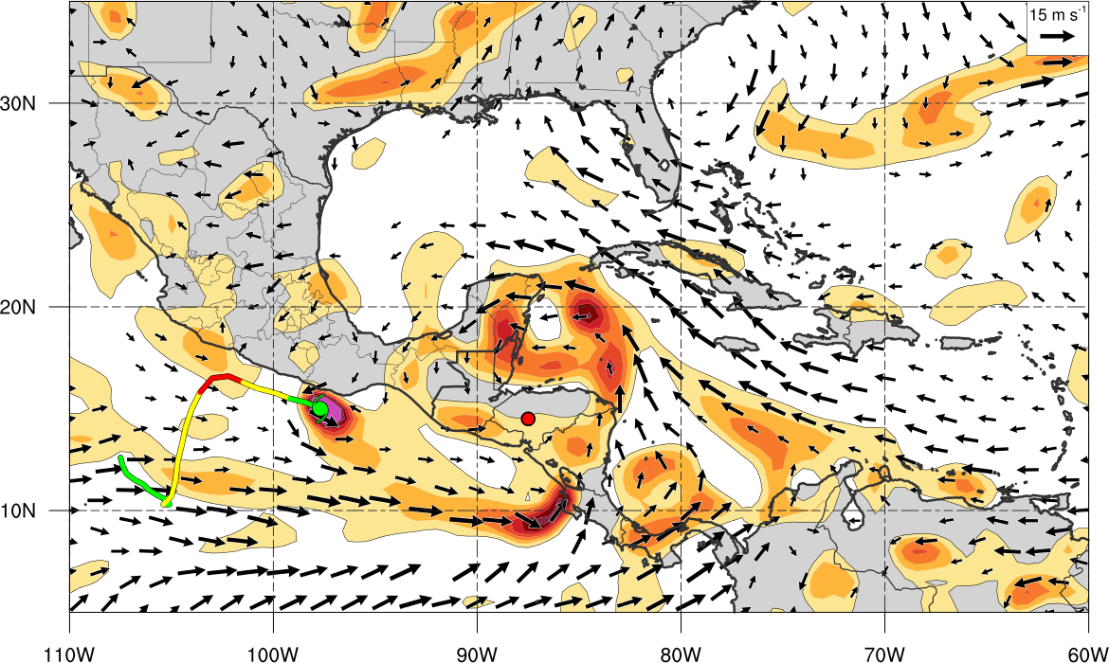
Literature Review
In reality, gyre circulations are composed of multiple vorticity maxima rather than one broad maxima
0000 UTC 28 May 1986
Central American Gyre
TC Agatha
Objectively Defined CAG by Papin (2014)
850-hPa cyclonic vorticity (shaded, > 1 x 10⁻⁵ s⁻¹)
850-hPa winds (vectors, 5-15 m s⁻¹)

Slide 16
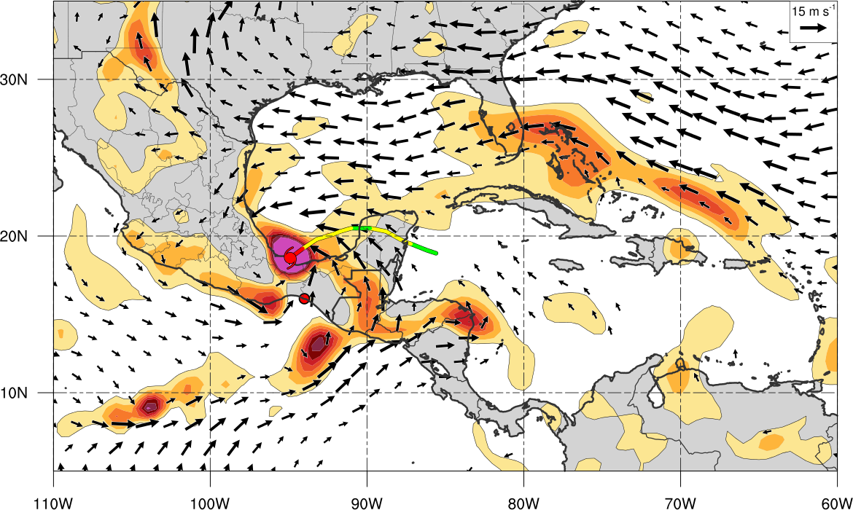
Literature Review
In reality, gyre circulations are composed of multiple vorticity maxima rather than one broad maxima
1200 UTC 04 Oct 2005
Central American Gyre
TC Stan
Objectively Defined CAG by Papin (2014)
850-hPa cyclonic vorticity (shaded, > 1 x 10⁻⁵ s⁻¹)
850-hPa winds (vectors, 5-15 m s⁻¹)

Slide 17
Objective
Investigate a case study where a TC and CAG interact
October 2005: TC Stan
Datasets
0.5º CFSR
1.0º GFS Forecast Initialized 0600 UTC 1 Oct 2005

Slide 18
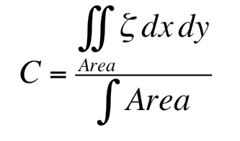
CAG Identification
Circulation (area average vorticity)
Macroscopic measure of rotation
Objective algorithm created for CAG identification in cases that persist longer than 48 h (Papin 2014)
Filtered out other large-scale disturbances
Large TCs
Tropical Waves
Low Level Jets
Monsoon Troughs
500 – 1000 km
Circulation
Using Stokes’s theorem
Value > 1*10⁻⁵ s⁻¹
500 km
1000 km

Slide 19
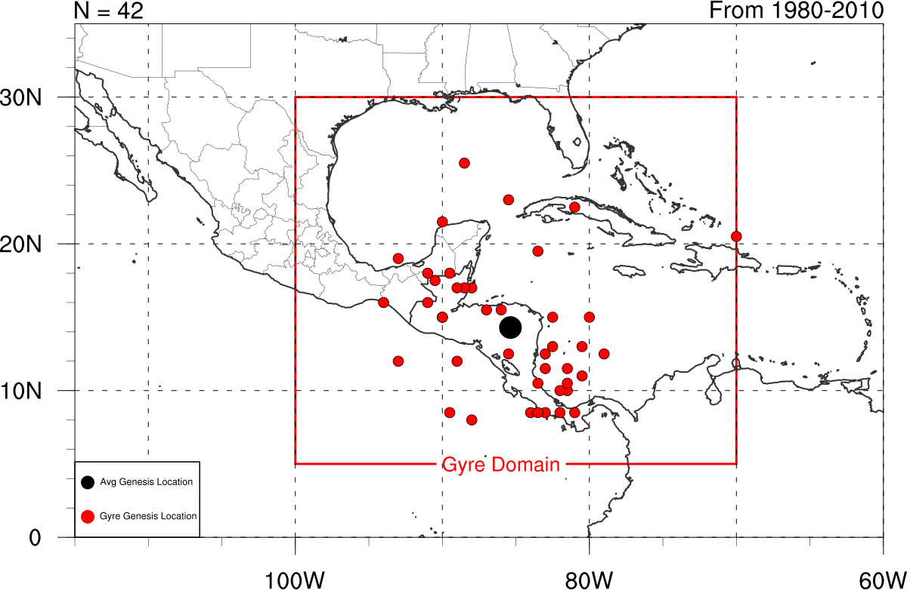
CAG Climatology
42 Cases over a 31 year period (1980-2010)
Case of CAG that occurred in October 2005 (large blue dot)
CAG 1: Oct 3 – Oct 6

Slide 20
Synoptic Evolution

Slide 21
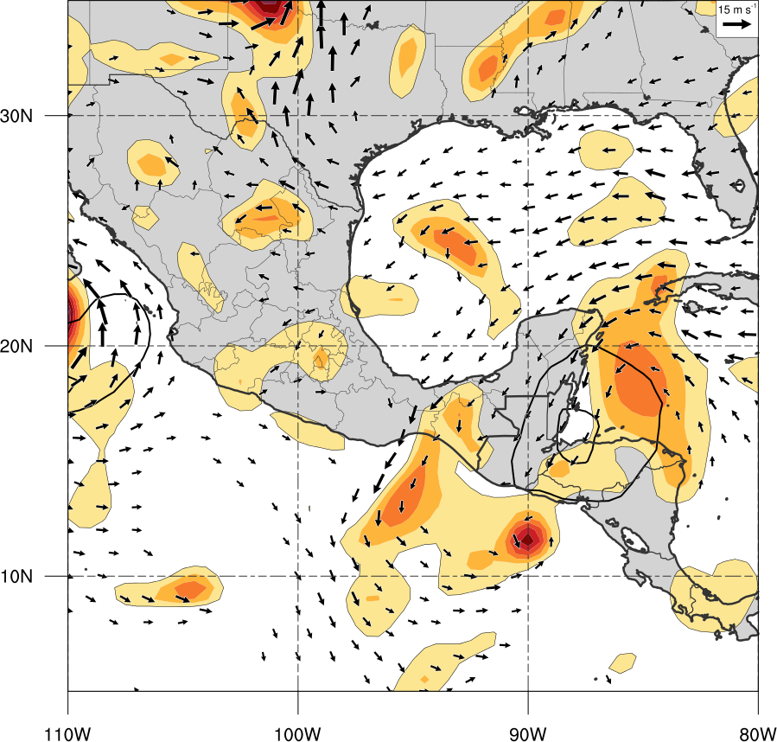
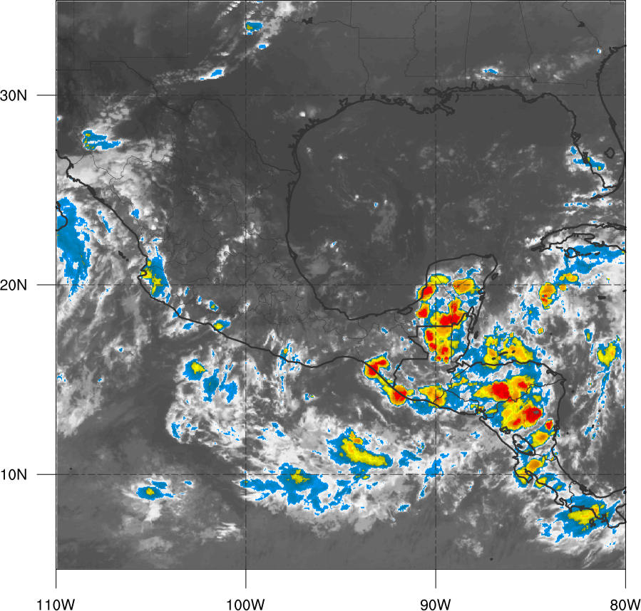
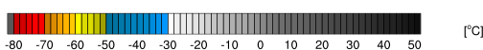
Synoptic Evolution
850-hPa cyclonic vorticity (shaded, > 1 x 10⁻⁵ s⁻¹)
500-1000 km layer mean 850-hPa area average Vorticity (black contours, > 1 x 10⁻⁵ s⁻¹)
850-hPa winds (vectors, 5-15 m s⁻¹)
Infrared Brightness Temperature (shaded, ºC)
0000 UTC 1 Oct 2005

Slide 22
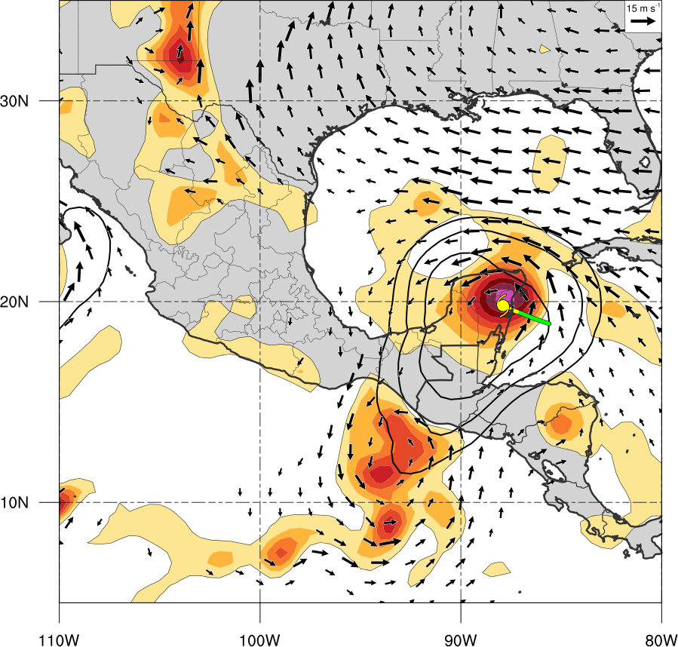
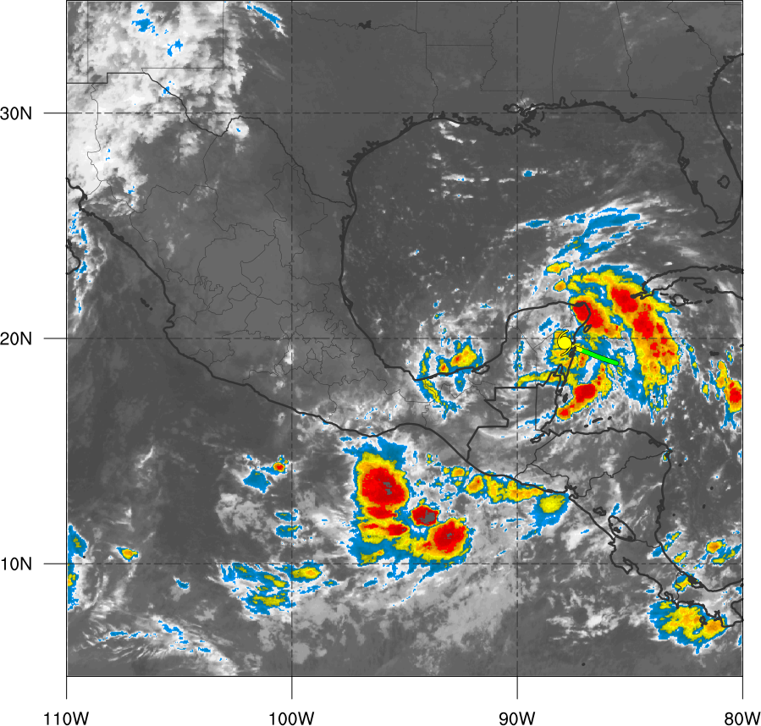
Synoptic Evolution
850-hPa cyclonic vorticity (shaded, > 1 x 10⁻⁵ s⁻¹)
500-1000 km layer mean 850-hPa area average Vorticity (black contours, > 1 x 10⁻⁵ s⁻¹)
850-hPa winds (vectors, 5-15 m s⁻¹)
Infrared Brightness Temperature (shaded, ºC)
1200 UTC 2 Oct 2005

Slide 23
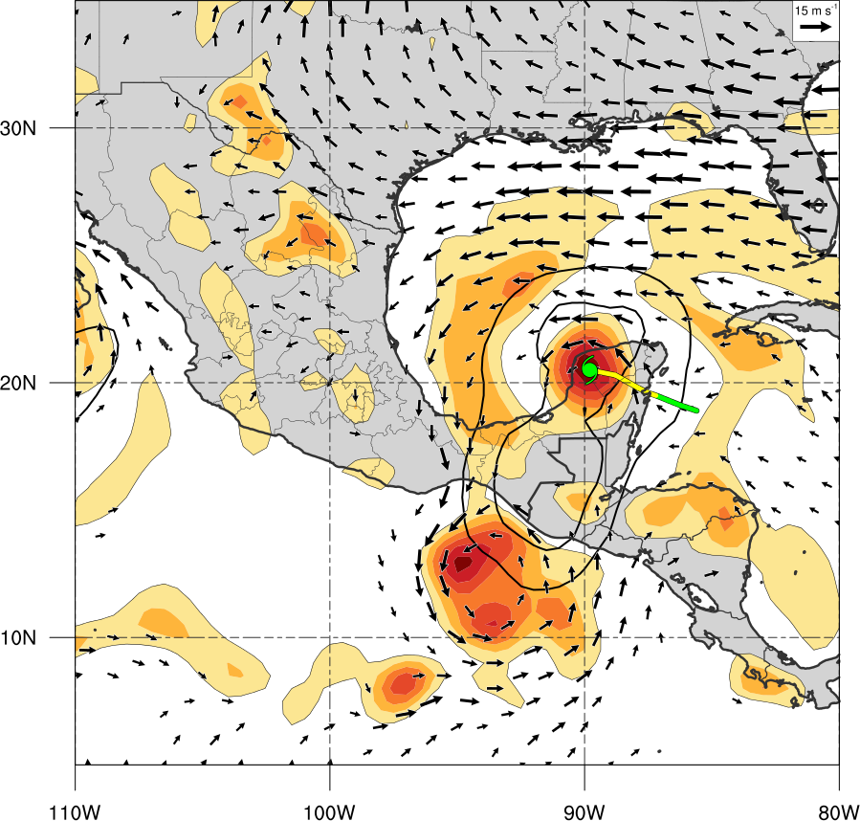
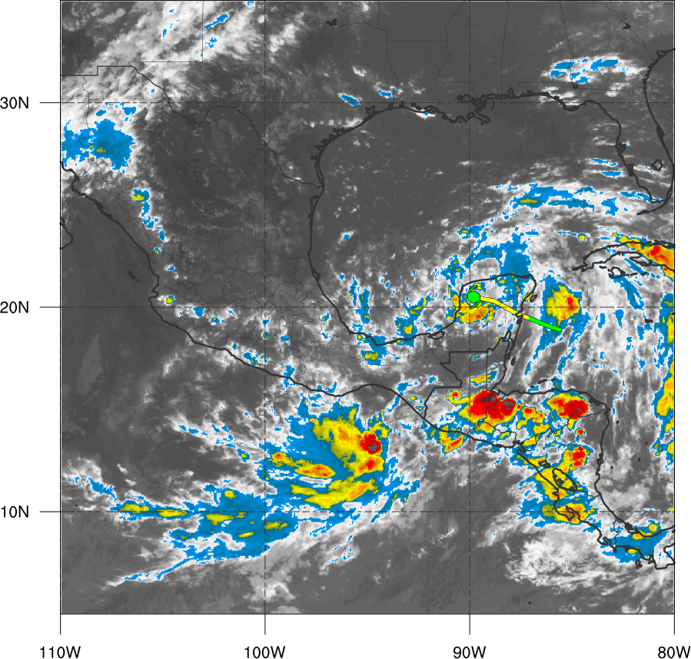
Synoptic Evolution
850-hPa cyclonic vorticity (shaded, > 1 x 10⁻⁵ s⁻¹)
500-1000 km layer mean 850-hPa area average Vorticity (black contours, > 1 x 10⁻⁵ s⁻¹)
850-hPa winds (vectors, 5-15 m s⁻¹)
Infrared Brightness Temperature (shaded, ºC)
0000 UTC 3 Oct 2005

Slide 24
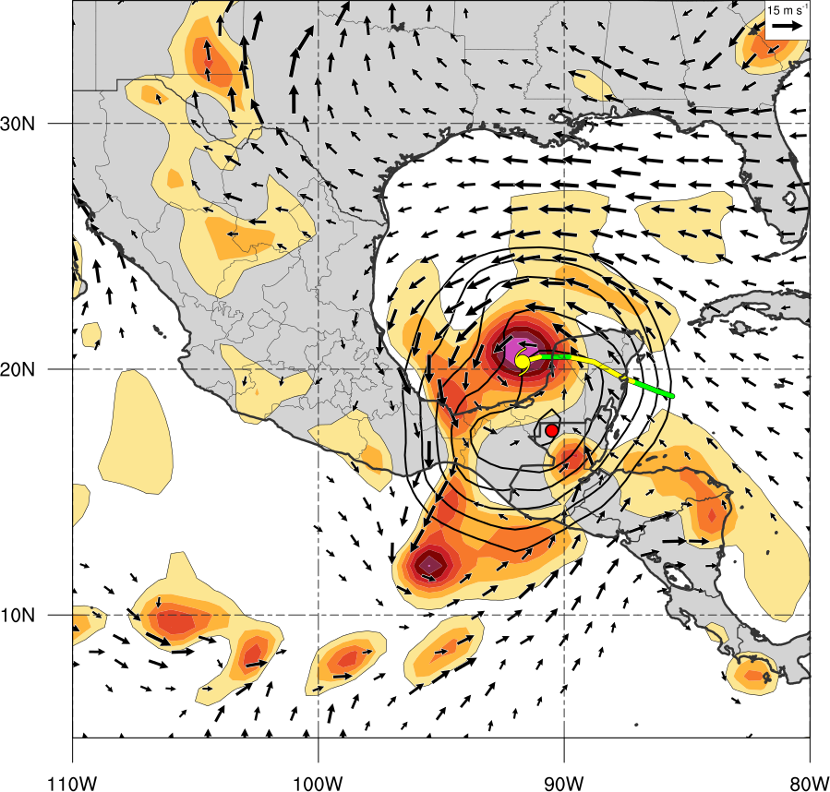
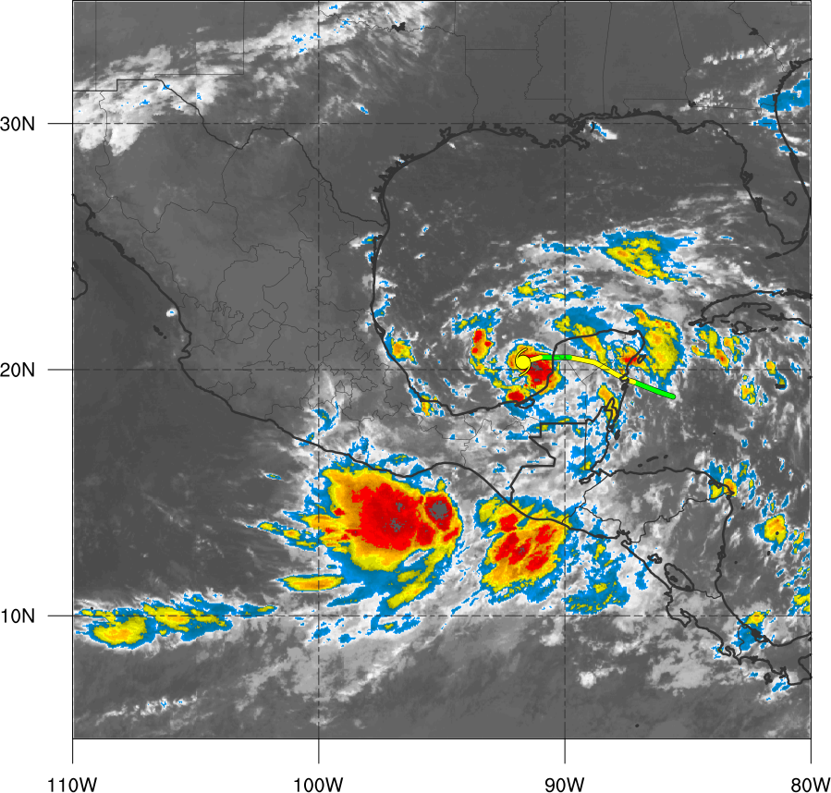
Synoptic Evolution
850-hPa cyclonic vorticity (shaded, > 1 x 10⁻⁵ s⁻¹)
500-1000 km layer mean 850-hPa area average Vorticity (black contours, > 1 x 10⁻⁵ s⁻¹)
850-hPa winds (vectors, 5-15 m s⁻¹)
Infrared Brightness Temperature (shaded, ºC)
1200 UTC 3 Oct 2005

Slide 25
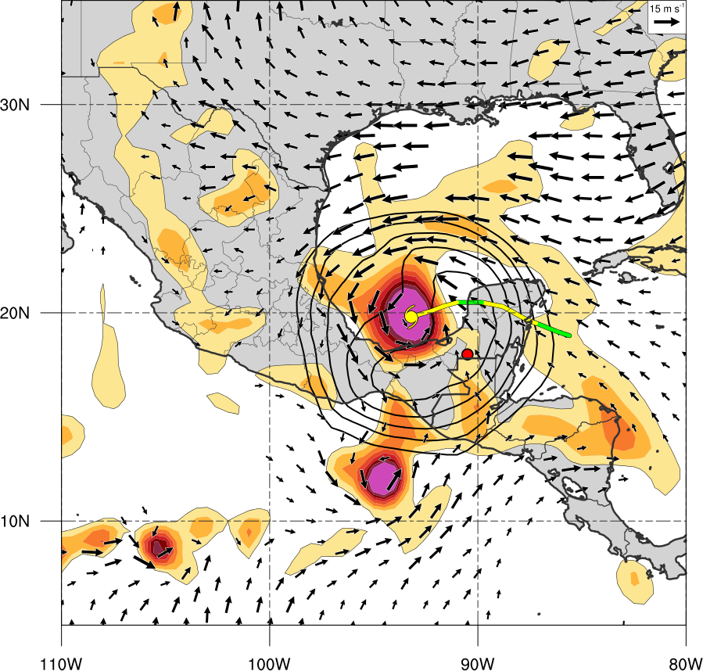
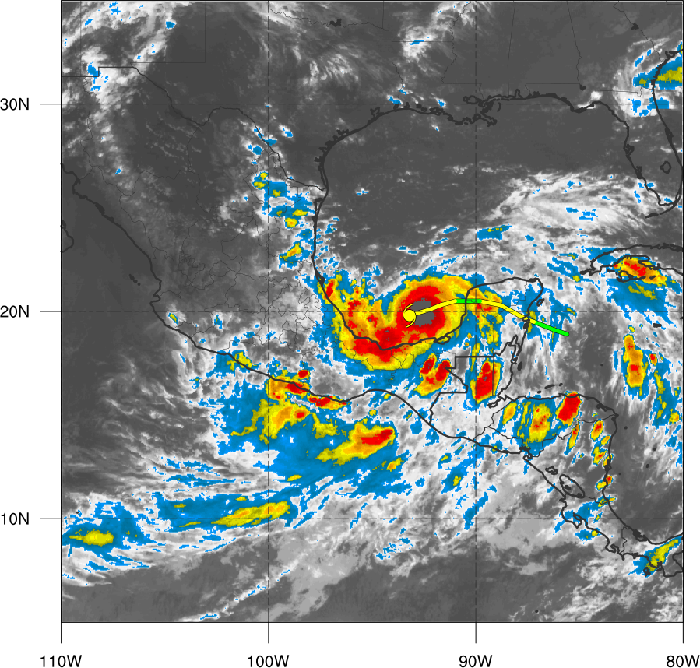
Synoptic Evolution
850-hPa cyclonic vorticity (shaded, > 1 x 10⁻⁵ s⁻¹)
500-1000 km layer mean 850-hPa area average Vorticity (black contours, > 1 x 10⁻⁵ s⁻¹)
850-hPa winds (vectors, 5-15 m s⁻¹)
Infrared Brightness Temperature (shaded, ºC)
0000 UTC 4 Oct 2005

Slide 26
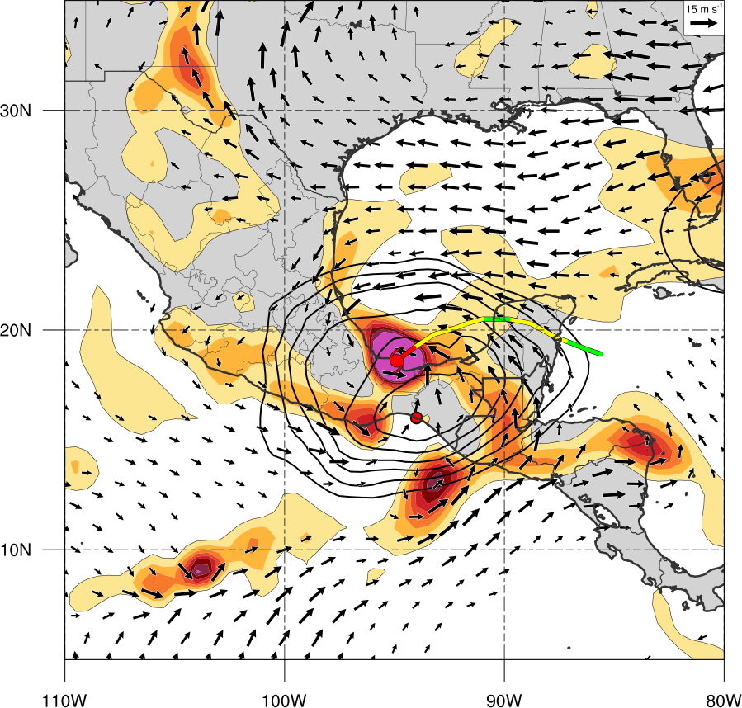
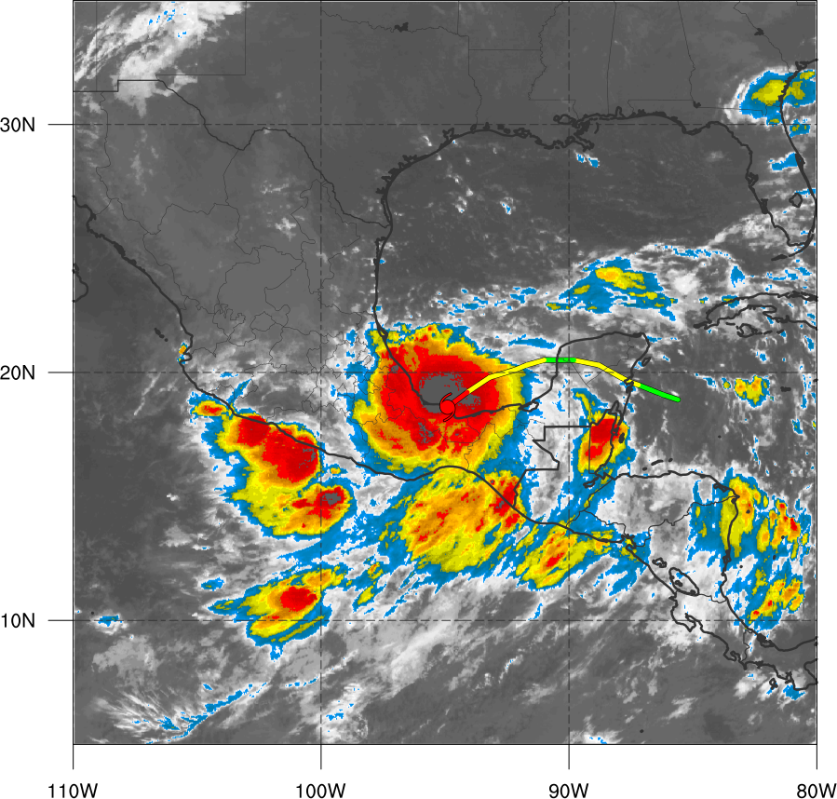
Synoptic Evolution
850-hPa cyclonic vorticity (shaded, > 1 x 10⁻⁵ s⁻¹)
500-1000 km layer mean 850-hPa area average Vorticity (black contours, > 1 x 10⁻⁵ s⁻¹)
850-hPa winds (vectors, 5-15 m s⁻¹)
Infrared Brightness Temperature (shaded, ºC)
1200 UTC 4 Oct 2005

Slide 27
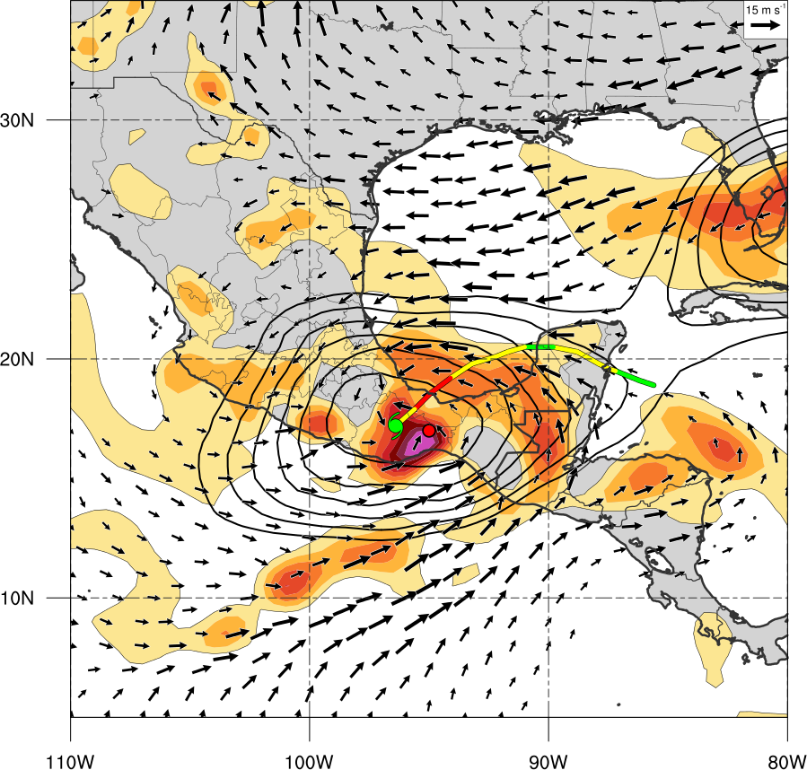
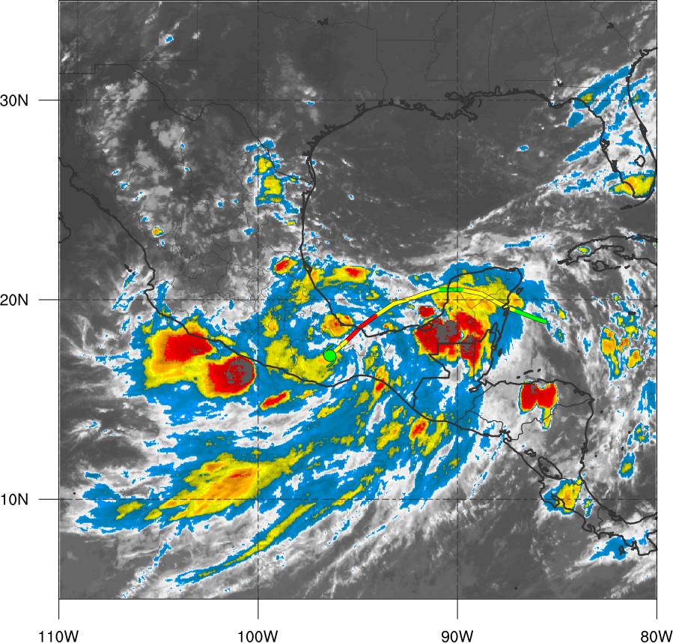
Synoptic Evolution
850-hPa cyclonic vorticity (shaded, > 1 x 10⁻⁵ s⁻¹)
500-1000 km layer mean 850-hPa area average Vorticity (black contours, > 1 x 10⁻⁵ s⁻¹)
850-hPa winds (vectors, 5-15 m s⁻¹)
Infrared Brightness Temperature (shaded, ºC)
0000 UTC 5 Oct 2005

Slide 28
Comparison with GFS Forecast

Slide 29
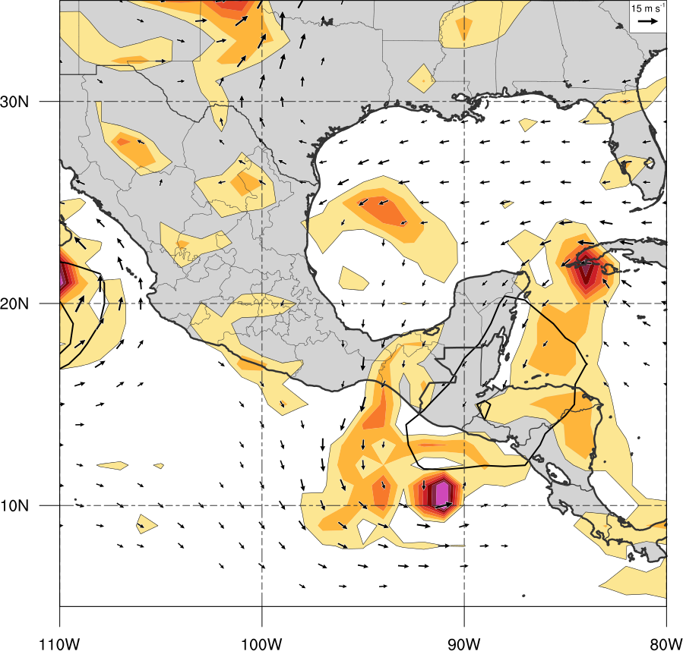
Synoptic Evolution
850-hPa cyclonic vorticity (shaded, > 1 x 10⁻⁵ s⁻¹)
500-1000 km layer mean 850-hPa area average Vorticity (black contours, > 1 x 10⁻⁵ s⁻¹)
850-hPa winds (vectors, 5-15 m s⁻¹)
0.5º CFSR
1.0º GFS
0000 UTC 1 Oct 2005
Large Position Error

Slide 30
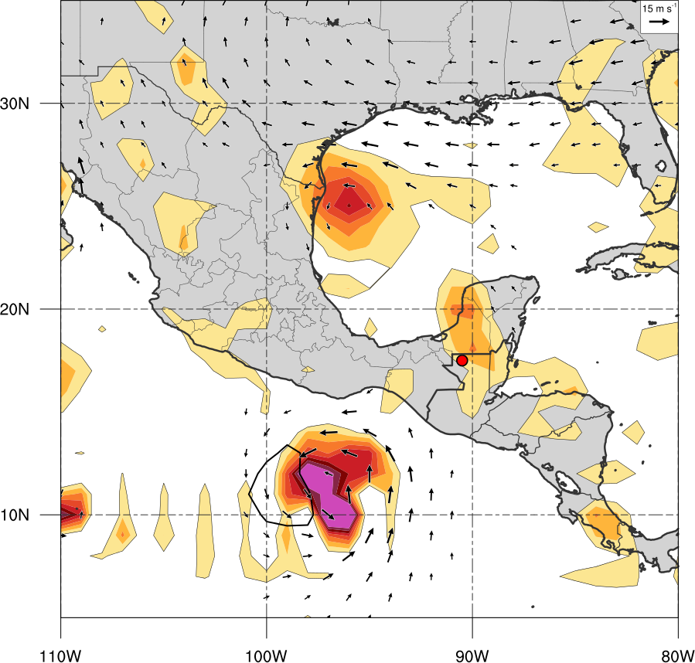
Synoptic Evolution
850-hPa cyclonic vorticity (shaded, > 1 x 10⁻⁵ s⁻¹)
500-1000 km layer mean 850-hPa area average Vorticity (black contours, > 1 x 10⁻⁵ s⁻¹)
850-hPa winds (vectors, 5-15 m s⁻¹)
0.5º CFSR
1.0º GFS
1200 UTC 3 Oct 2005
Faster and Poleward
No CAG!

Slide 31
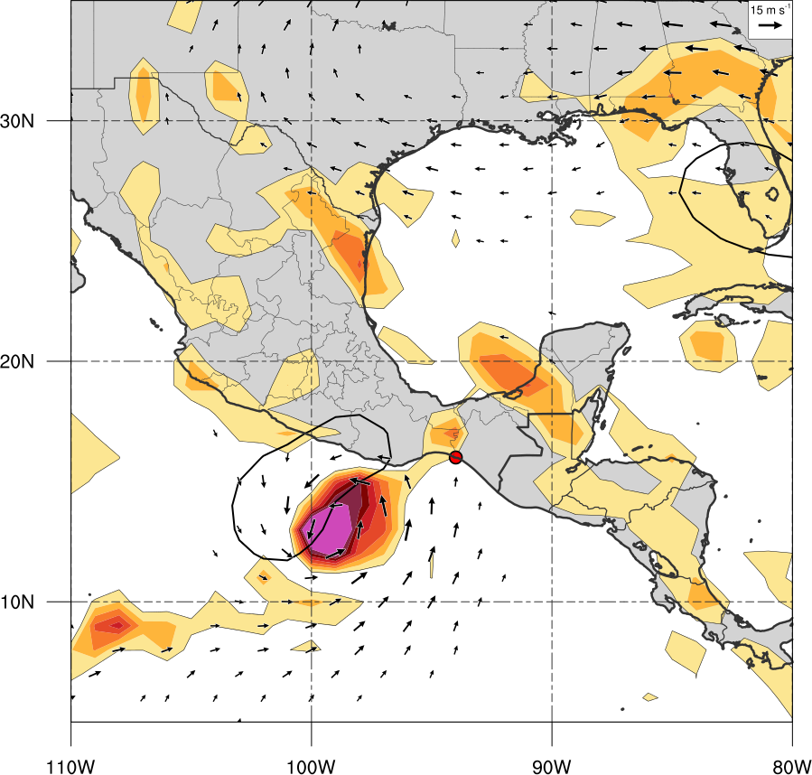
Synoptic Evolution
850-hPa cyclonic vorticity (shaded, > 1 x 10⁻⁵ s⁻¹)
500-1000 km layer mean 850-hPa area average Vorticity (black contours, > 1 x 10⁻⁵ s⁻¹)
850-hPa winds (vectors, 5-15 m s⁻¹)
0.5º CFSR
1.0º GFS
1200 UTC 4 Oct 2005
Southwesterly motion attributed to CAG

Slide 32
Quantifying Role of CAG of TC Stan Motion

Slide 33
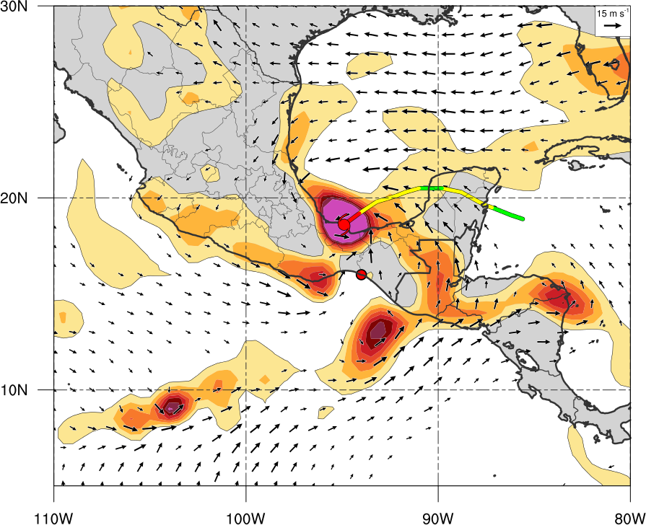
Piecewise Vorticity Inversion
Want to quantify what impact the CAG wind field has on the track of TC Stan
Invert the vorticity field only over the CAG
Remove TC Stan vortex to obtain steering flow
Also look at steering flow without CAG circulation
Steering layer flow 925 – 500-hPa layer mean

Slide 34
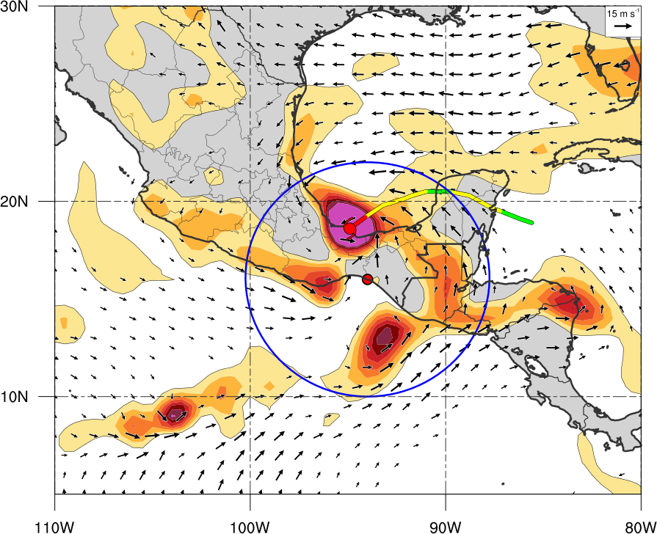
Piecewise Vorticity Inversion
Want to quantify what impact the CAG wind field has on the track of TC Stan
Invert the vorticity field only over the CAG
Remove TC Stan vortex to obtain steering flow
Also look at steering flow without CAG circulation
Steering layer flow 925 – 500-hPa layer mean
Invert Vorticity over 7º Circle

Slide 35

Piecewise Vorticity Inversion
Want to quantify impact of the CAG wind field on the track of TC Stan
Invert the vorticity field only over the CAG
Remove TC Stan vortex to obtain steering flow
Also look at steering flow without CAG circulation
Steering layer flow 925 – 500-hPa layer mean
Remove Vorticity over TC Stan (2.5º)

Slide 36
Piecewise Vorticity Inversion
Want to quantify impact of the CAG wind field on the track of TC Stan
Invert the vorticity field only over the CAG
Remove TC Stan vortex to obtain steering flow
Also look at steering flow without CAG circulation
Steering layer flow 925 – 500-hPa layer mean
Remove CAG and TC to see Environmental Flow

Slide 37
Piecewise Vorticity Inversion
Want to quantify impact of the CAG wind field on the track of TC Stan
Invert the vorticity field only over the CAG
Remove TC Stan vortex to obtain steering flow
Also look at steering flow without CAG circulation
Steering layer flow 925 – 500-hPa layer mean
Remove CAG and TC to see Environmental Flow

Slide 38
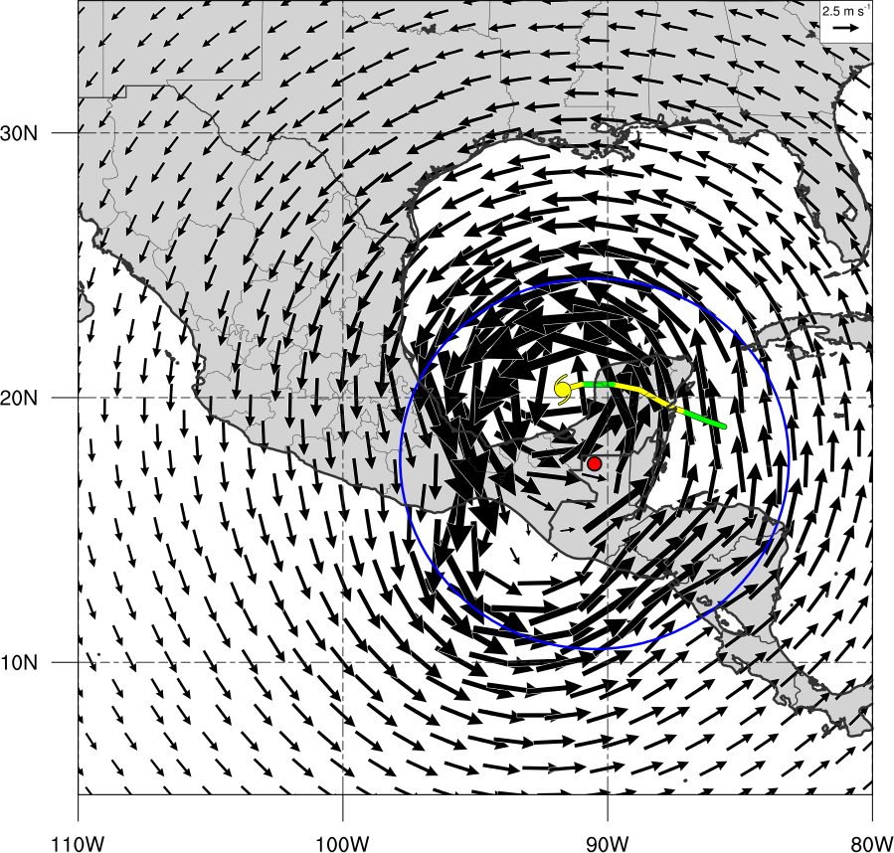
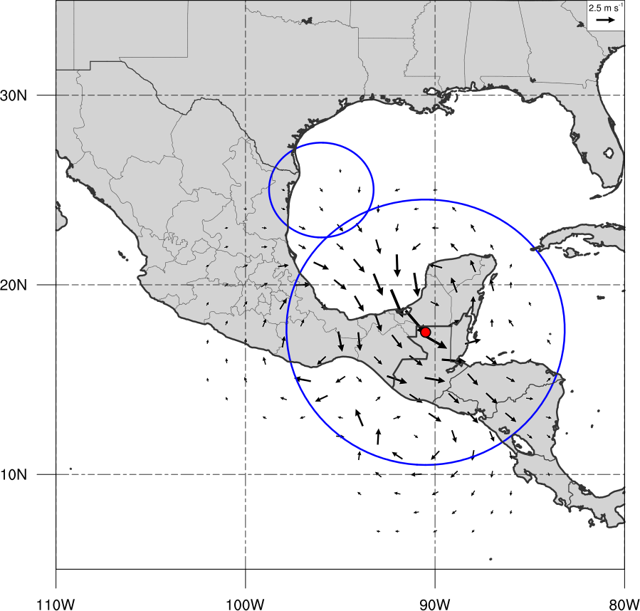
Steering Flow – CAG including TC Stan
925 – 500-hPa layer mean flow
Large circulation of Stan + CAG
GFS Forecast of Stan much further north and west, no CAG forecasted
0.5º CFSR
1.0º GFS
1200 UTC 3 Oct 2005
Inverted Winds of CAG
Actual TC motion: 270º at 9 kt

Slide 39
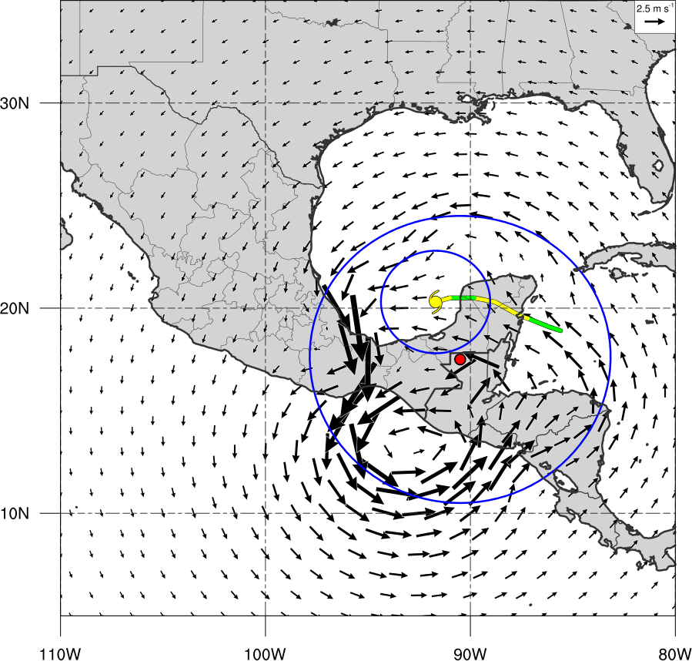
Steering Flow – CAG minus TC Stan
925 – 500-hPa layer mean flow
CAG flow moving TC Stan westward
Little steering flow from same region in GFS Forecast
0.5º CFSR
1.0º GFS
1200 UTC 3 Oct 2005
271º at 3 kt
Actual TC motion: 270º at 9 kt

Slide 40
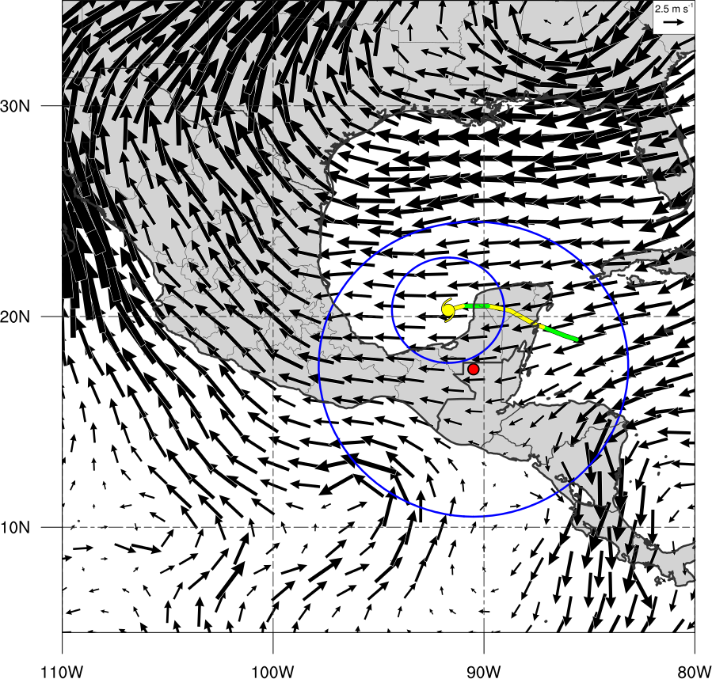
Steering Flow – environment minus CAG
925 – 500-hPa layer mean flow
Environmental flow moving TC Stan westward
Environmental flow moving TC Stan westward
0.5º CFSR
1.0º GFS
1200 UTC 3 Oct 2005
268º at 7 kt
Actual TC motion: 270º at 9 kt

Slide 41
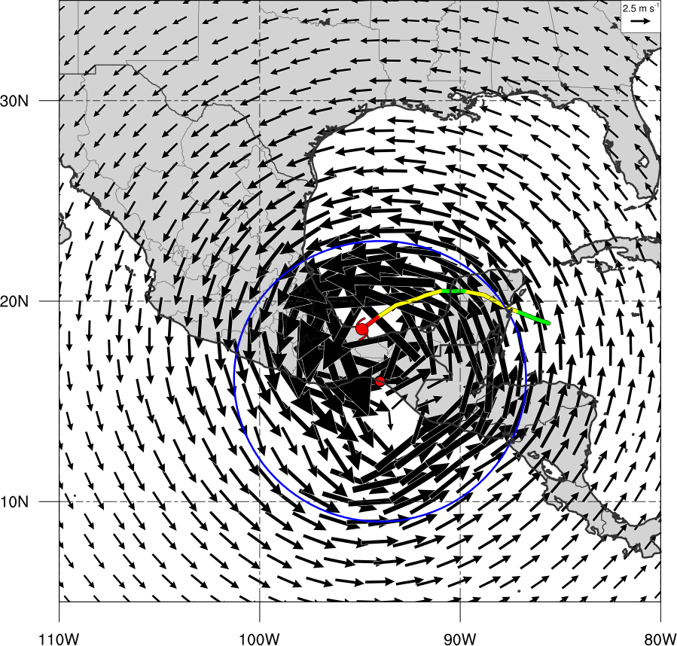
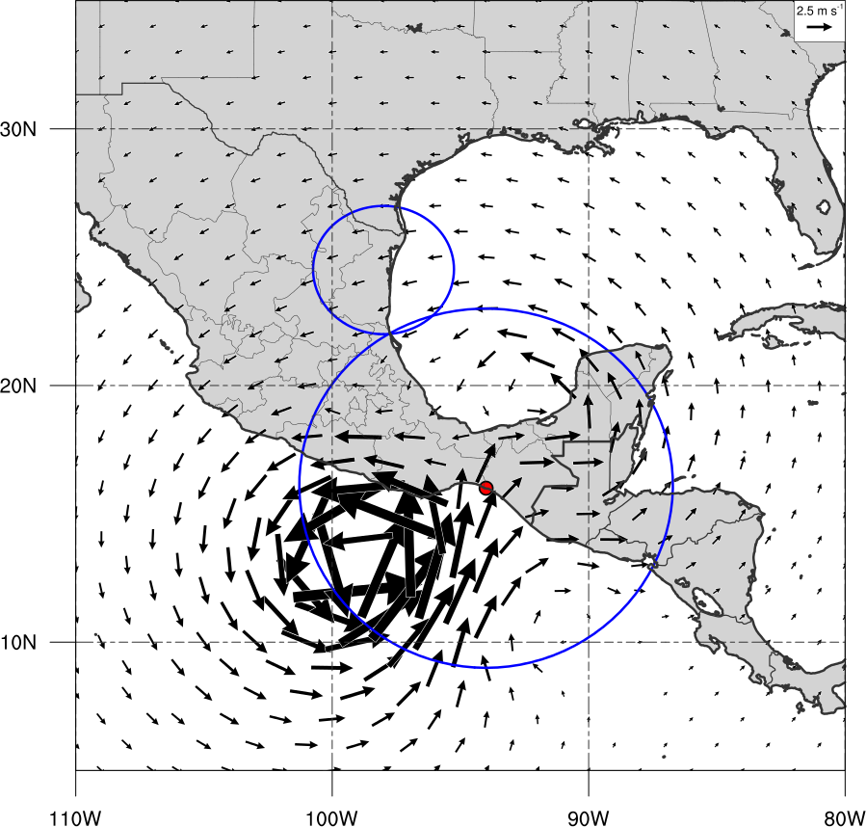
Steering Flow – CAG including TC Stan
925 – 500-hPa layer mean flow
Large circulation of Stan + CAG
Absence of CAG results in only weak cyclonic flow over Central America
0.5º CFSR
1.0º GFS
1200 UTC 4 Oct 2005
Inverted Winds of CAG
Actual TC motion: 235º at 10 kt

Slide 42
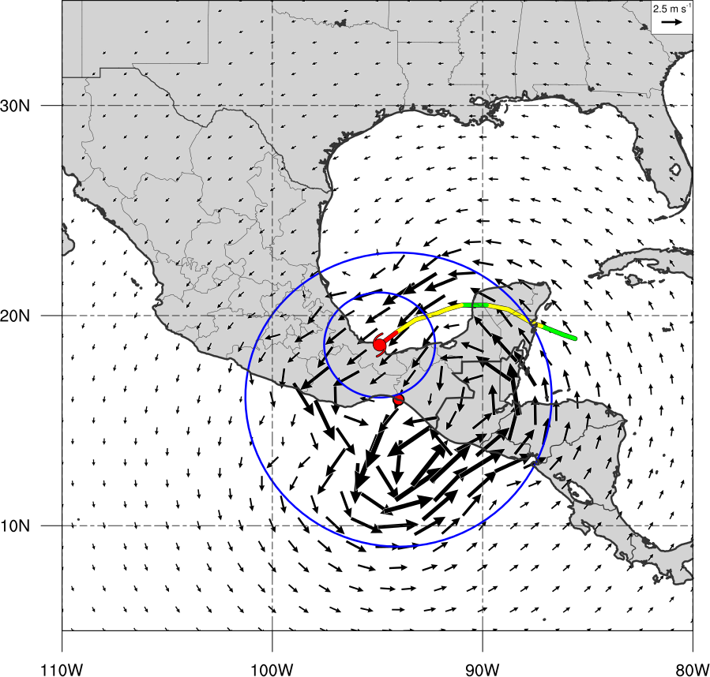
Steering Flow – CAG minus TC Stan
925 – 500-hPa layer mean flow
CAG flow moving TC Stan southwestward
Little steering flow from same region in GFS Forecast
0.5º CFSR
1.0º GFS
1200 UTC 4 Oct 2005
228º at 6 kt
Actual TC motion: 235º at 10 kt

Slide 43
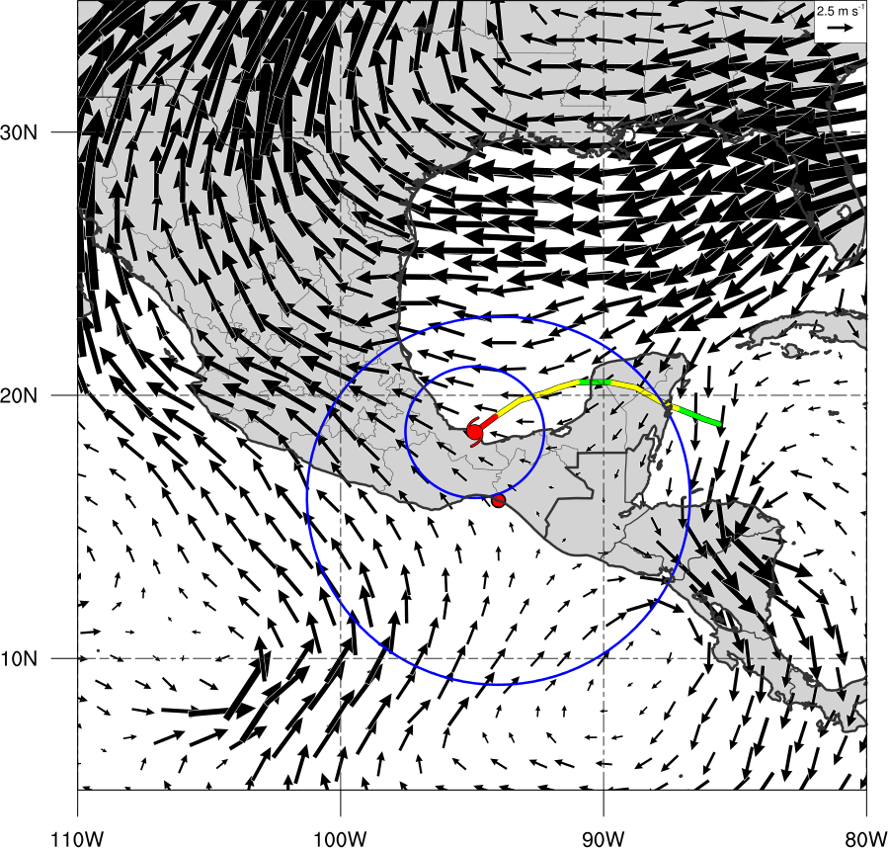
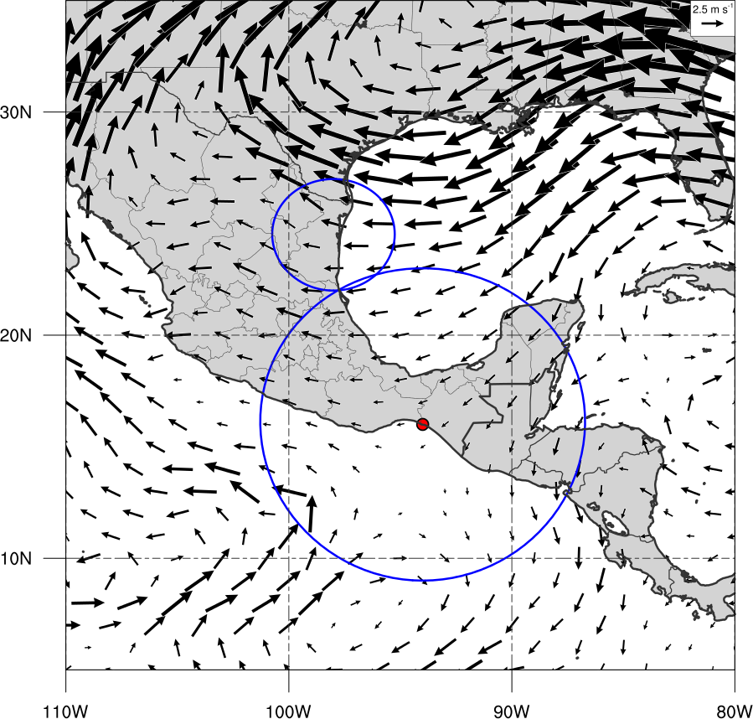
Steering Flow – environment minus CAG
925 – 500-hPa layer mean flow
Environmental flow moving TC Stan to west-northwest (not consistent with actual motion)
Environmental flow moving remnant TC Stan in GFS westward
0.5º CFSR
1.0º GFS
1200 UTC 4 Oct 2005
291º at 4 kt
Actual TC motion: 235º at 10 kt

Slide 44
Conclusions
Investigated a TC that appeared to interact with a CAG
Lead to poor track verification by the NHC
TC Stan likely moved cyclonically around CAG via barotropic binary interaction
Piecewise inversion of vorticity strongly suggests TC motion driven by CAG circulation
Flow attributed to CAG matched track of TC Stan
Environmental flow did not match track of TC Stan
GFS track error likely due to initial position error and failure to develop CAG

Slide 45
QUESTIONS?

